Slide 1
2021 Washington County 4-h Update
Presented by:
Nebraska Extension in Washington County 4-H Staff
Sponsored by:
Washington County 4-H Council

Slide 2
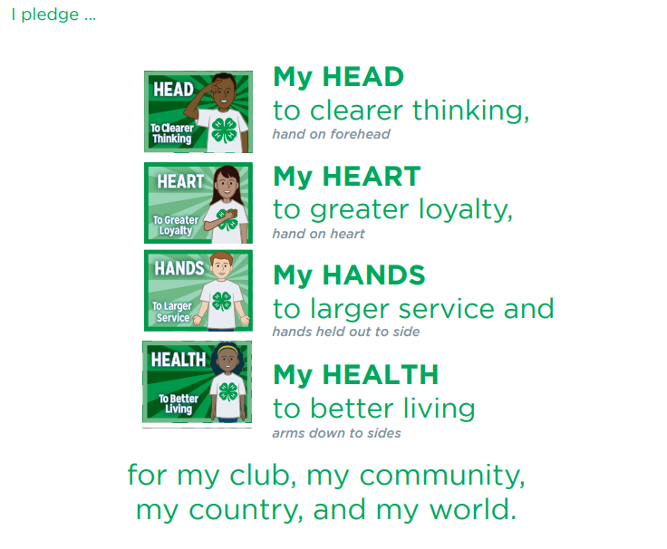
4-H Pledge
2021 WASHINGTON COUNTY 4-H UPDATE | MARCH 18, 2021

Slide 3
WASHINGTON COUNTY
4-H TEAM
Jaki Zahourek, Extension Assistant
Mickayla Blender, Extension Assistant
Mary K. Larsen, 4-H Support Staff
2021 WASHINGTON COUNTY 4-H UPDATE | MARCH 18, 2021

Slide 4
WELCOME
&
INTRODUCTIONS
SHARE:
NAME | 4-H AREA OF REPRESENTATION
2021 WASHINGTON COUNTY 4-H UPDATE | MARCH 18, 2021

Slide 5
2021 4-H COUNCIL
Kevin Flesner, President
Walker Behnken, Vice President
Secretary, Hollie Booth
Treasurer, Karen Murch-Shafer
Carter Behnken
Ella Booth
Norah Cloudt
Connor Flesner
Cindy Laaker
Chelsea Lambert
Keith Mertz
Russell Quinn
Tyler Thompson
2021 WASHINGTON COUNTY 4-H UPDATE | MARCH 18, 2021

Slide 6
UPDATE AGENDA
COMMUNICATIONS
ENROLLMENT – YOUTH & ADULT
CLUB MANAGEMENT
UPCOMING EVENTS
4-H ANIMAL SCIENCE PROCEDURES
WASHINGTON COUNTY FAIR
NEBRASKA STATE FAIR
END OF YEAR RECOGNITION
ACHIEVEMENT CELEBRATION
2021 WASHINGTON COUNTY 4-H UPDATE | MARCH 18, 2021

Slide 7
4-H TRIVIA
Open a web browser on your computer/or mobile device
Go to: https://kahoot.it/
Enter Game Pin: 710502
2021 WASHINGTON COUNTY 4-H UPDATE | MARCH 18, 2021

Slide 8
COMMUNICATIONS
Washington County 4-H Program Communication
All Staff E-mail: washingtoncounty4h@unl.edu
Office Phone Number: 402-426-9455
Facebook: @UNLWASHINGTONCOUNTY TWITTER: @WCNE4H
Weekly S’MORE is e-mailed once enrolled or found at https://washington.unl.edu/smore/
Washington County 4-H Program Website – https://washington.unl.edu/4h/
Nebraska 4-H Program Information – https://4h.unl.edu
2021 WASHINGTON COUNTY 4-H UPDATE | MARCH 18, 2021

Slide 9
ENROLLMENT
4-H ENROLLMENT DEADLINE FOR EXHIBITING ELIGIBILITY
4-H Horse Members entering district/state shows – May 7th
4-H Horse Members NOT entering district/state shows – June 15th
ALL 4-H Livestock and Other Project Members – June 15th
4-H members may change or add project to online enrollment until June 15th
4-H Adult Volunteer Enrollment & Screening – June 15th
2021 WASHINGTON COUNTY 4-H UPDATE | MARCH 18, 2021

Slide 10
ENROLLMENT
4-H ENROLLMENT SYSTEM – MEMBERS & LEADERS
Access the online enrollment – https://ne.4honline.com/
A $10 member fee will be issued, no leader fee.
Once enrolled, Washington County 4-H Staff will need to (approve) the enrollment in the database.
Step-by-step instructions can be found by going to: https://4h.unl.edu/enroll
2021 WASHINGTON COUNTY 4-H UPDATE | MARCH 18, 2021

Slide 11
ENROLLMENT
4-H VOLUNTEER SCREENING
Adults wishing to become 4-H Volunteer/Leaders MUST complete a DHHS Volunteer Screening in addition to their enrollment.
As of October 1, 2019 Volunteers are responsible for the $5.00 fee associated with their screening. A special link will be sent to you to ensure you are associated with Nebraska 4-H.
Every five years a re-screening is REQUIRED of ALL 4-H volunteers. Washington County volunteers will be re-screened in 2022.
2021 WASHINGTON COUNTY 4-H UPDATE | MARCH 18, 2021

Slide 12
CLUB MANAGMENT
4-H CLUB STRUCTURE
Enroll at least 5 youth members from at least 3 families.
Is advised by adult 4-H Volunteers who have been screened and is in accordance with the Nebraska 4-H Policy and Procedure Handbook.
Conduct a minimum of 6 regular club meetings (virtual or face-to-face) per year.
Selects youth officers or youth leader to provide leadership to the club.
Meets in any location—a home, community center, military institution, library and/or others.
Helps youth and parents/guardians adapt in cased of mobility—linking them to 4-H programs in other counties and states. Meets interests and needs of youth in same-age or cross-age groupings and using single project or multiple project formats.
2021 WASHINGTON COUNTY 4-H UPDATE | MARCH 18, 2021

Slide 13
CLUB MANAGMENT
4-H CLUB MANAGEMENT RESOURCES (Nebraska 4-H) https://4h.unl.edu/clubs
Washington County 4-H Program Calendar (Printable) https://washington.unl.edu/calendar/
NEW! Nebraska 4-H Volunteer Resources
https://4h.unl.edu/volunteer
Volunteer Roles
Risk Management
Volunteer Community Club Leader Training
Volunteer Project Leader Training
Special Interest Volunteer Leader Training
2021 WASHINGTON COUNTY 4-H UPDATE | MARCH 18, 2021

Slide 14
CLUB MANAGMENT
Positive Youth Development– 4-H promotes PYD by giving youth opportunities to get involved and develop their full potential.
Essential Elements
Belonging—a safe, inclusive environment
4-H Pledge, Roll Call, Ice Breakers
Independence—opportunity to see oneself as an activity participant
Connect learned skills to the future
Generosity—opportunity to value and practice service to others
Brainstorm and implement community service activities
Mastery—opportunity for mastery or engagement in learning
Experiential Learning opportunities
2021 WASHINGTON COUNTY 4-H UPDATE | MARCH 18, 2021
Notes:
Using essential elements in activities is important to youth development in a number of ways. They reinforce sustained youth-adult relationships and emphasize mastering skills that can be used in the real world.

Slide 15
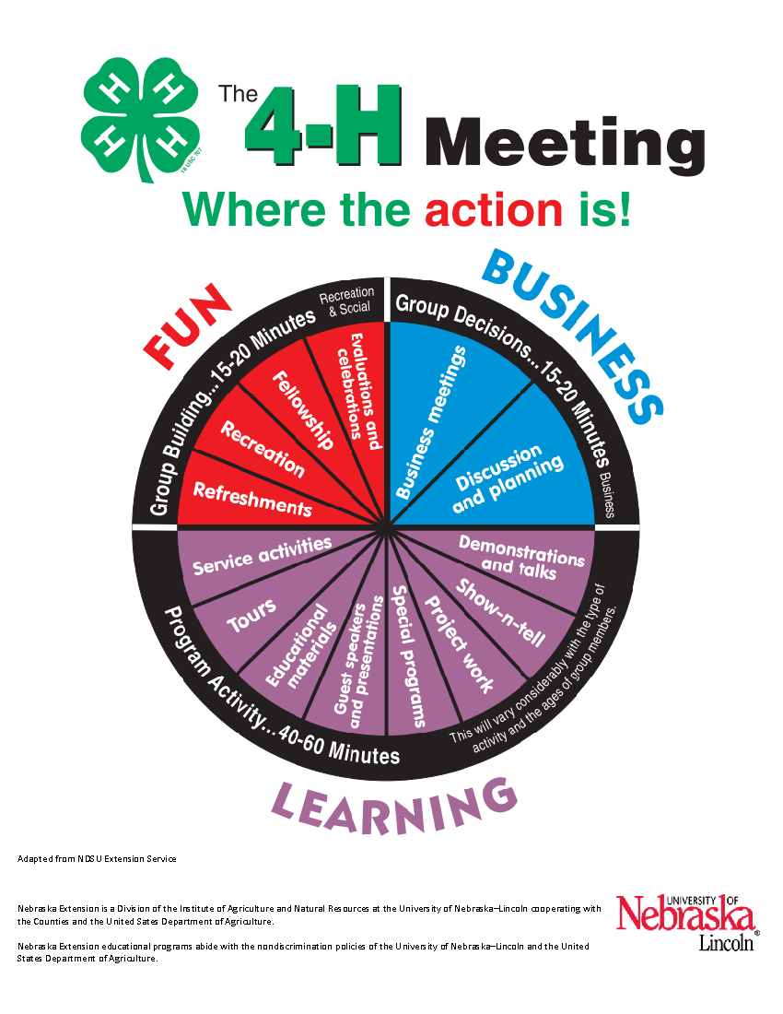
CLUB MANAGMENT
PROGRAM ACTIVITY EXAMPLE
POPABLY POPCORN SUPPLIES
Popcorn Story
Popcorn Handout
Crayon, marker or pencil
½ cup Popcorn Kernels
1 teaspoon Vegetable Oil
½ teaspoon salt
Small Bowl
Small Brown Sack
RESOURCES FOUND HERE:
https://extension.unl.edu/statewide/washington/Popably%20Popcorn.pdf
2021 WASHINGTON COUNTY 4-H UPDATE | MARCH 18, 2021

Slide 16
UPCOMING EVENTS
LEND A HAND SERVICE MONTH
Month of April, via GooseChase App
4-H HOME ENVIRONMENT VIRTUAL WORKSHOP
April 15th, 5:30-7:00PM via Zoom
PUBLIC SPEAKING CONTEST
April 25th, 2:00 PM | Washington County Fairgrounds
FAMILY LIVESTOCK JUDGING CONTEST
June 6th, 5:30 PM | Washington County Fairgrounds
COMING SOON! 4-H SUMMER WORKSHOP REGISTRATION
2021 WASHINGTON COUNTY 4-H UPDATE | MARCH 18, 2021

Slide 17
4-H ANIMAL SCIENCE
All 2021 4-H and FFA Animal Identification procedures can be found at https://washington.unl.edu/livestock
Animal ID Sheets & Affidavits can be found at https://washington.unl.edu/id-sheets. Be sure that all information is complete and accurate before submitting to the Extension office by the June 15th deadline.
2021 WASHINGTON COUNTY 4-H UPDATE | MARCH 18, 2021

Slide 18
4-H ANIMAL SCIENCE
DEADLINES – ALL paperwork must be submitted to the Extension Office in Blair by the set deadline.
All Identification Sheets (June 15th)
Beef, Dairy Cattle, Dairy Goat, Meat Goat, Swine, Rabbit, Sheep
Nebraska State Fair online ID entry by exhibitors by June 15 on Show Stock Manager.
YQCA (Youth for the Quality Care of Animals) – complete at https://yqca.org accessible using 4HOnline login (June 15th)
2021 WASHINGTON COUNTY 4-H UPDATE | MARCH 18, 2021

Slide 19
4-H ANIMAL SCIENCE
4-H Horse Project Dates & Deadlines
FRIDAY, MAY 7 DEADLINE
MEMBERS ENTERING STATE & DISTRICT HORSE SHOWS
4-H Member Online Enrollment
4-H Horse ID Sheets
4-H Horsemanship Level Tests
District and State 4-H Horse Show Entries & Fees
TUESDAY, JUNE 15 DEADLINE
MEMBERS NOT ENTERING STATE & DISTRICT HORSE SHOWS
4-H Member Online Enrollment
4-H Horse ID Sheets
2021 WASHINGTON COUNTY 4-H UPDATE | MARCH 18, 2021

Slide 20
DOOR PRIZE

Slide 21
WASHINGTON COUNTY FAIR
July 30th – August 4th
Arlington, Nebraska
https://www.wcffair.com/
2021 WASHINGTON COUNTY 4-H UPDATE | MARCH 18, 2021

Slide 22
WASHINGTON COUNTY FAIR
WASHINGTON COUNTY FAIR BOOK
One printed fair book will be provided for each enrolled 4-H family. Thanks to the Washington County Fair Board.
ENTRY DEADLINES
Thursday, July 8 by 5:00PM
4-H Club Booth Requests
4-H Club Pizza Stand Sign-up
Livestock Exhibits Online Pre-Entry
Certificate of Vaccination for Cats and Ferrets (SF262)
Certificate of Vaccination for Dogs (SF263)
Clover Kid Animal Entry Forms
Communications Contest Entry Forms
Dog Ownership Affidavit
Dog Show Entry Forms
Fashion Show Entry Forms
Favorite Foods Day Contest Entry Forms
Horse Show Entry Forms
Overall Horseman Entry Forms
Shooting Sports – Archery Contest Entry Forms
Shooting Sports – BB Gun Contest Entry Forms
Tractor Driving Contest Entry Forms
2021 WASHINGTON COUNTY 4-H UPDATE | MARCH 18, 2021

Slide 23
WASHINGTON COUNTY FAIR
STATIC EXHIBIT UPDATES
Agronomy
ADDITIONS
G/750/011 – Special Agronomy Project – Education Exhibit—Educational exhibit based on what was learned from the project. Present information on a poster or in a clear plastic report cover. Each display must have a one-page essay explaining why the exhibitor chose the area of display and what they learned.
G/750/012 – Special Agronomy Project – Video Presentation—4-H exhibitor designs a multimedia presentation related to the crop. This could include a narration of the growing process, presenting facts about the crop or any other innovative multimedia practices.
G/750/013– Special Agronomy Project – Freshly Harvested Crop – Plant Exhibits must be the result of the current year’s project.
2021 WASHINGTON COUNTY 4-H UPDATE | MARCH 18, 2021

Slide 24
WASHINGTON COUNTY FAIR
STATIC EXHIBIT UPDATES
Photography
ELIMINATIONS
B/181/70 – Challenging Photo Exhibit – Pictures with a Purpose
B/182/70 – Challenging Photo Exhibit – Photo Joiner
2021 WASHINGTON COUNTY 4-H UPDATE | MARCH 18, 2021

Slide 25
WASHINGTON COUNTY FAIR
SCHEDULE CHANGES
*BASED ON FAIR BOARD RECOMMENDATION AND 4-H COUNCIL APPROVAL THE SCHEDULE WILL RETURN TO A PRE-COVID FAIR SCHEDULE*
TRACTOR DRIVING CONTEST –
Will now be held during Contest Day on July 24th from 1PM-4PM at the Washington County Fairgrounds, Arlington
BUCKET CALF RECORD BOOKS & INTERVIEWS –
Record Books will be due during Bucket Calf Check-in Monday, August 2nd from 7-8:00AM.
Bucket Calf Interviews will begin following the bucket calf show at approximately 10:30 AM on Monday, August 2nd.
2021 WASHINGTON COUNTY 4-H UPDATE | MARCH 18, 2021

Slide 26
FREMONT 4-H EXPO
July 7-10, 2021
Christensen Field, Fremont, NE
Expo details found here: https://extension.unl.edu/statewide/dodge/frfourhexhguide/
ENTRY DEADLINES:
4-H King & Queen Contest Applications (June 15th)
Send to:
Dodge County Extension Office
1206 West 23rd Street
Fremont, NE 68025
Pre-entries for Culinary Challenge Contest & Shooting Sports (July 1st)
Send to:
Jamie Poppe, Event Coordinator
1206 West 23rd Street
Fremont, NE 68025
2021 WASHINGTON COUNTY 4-H UPDATE | MARCH 18, 2021

Slide 27
NEBRASKA STATE FAIR
August 27 – September 6, 2021
State Fair details found here: https://4h.unl.edu/state-fair
ENTRY DEADLINES:
ANIMAL PRE-ENTRY DEADLINE (August 10 by 8:00PM)
Families will enter on their own via ShoWorks (online)
Beef, Dairy Cattle, Dog, Swine, Meat Goat, Poultry, Rabbit & Sheep
CONTEST PRE-ENTRY DEADLINE (August 10 by 8:00PM)
Families will enter on their own via ShoWorks (online)
Presentations, Fashion Show, Dog Skillathon, Dairy Judging, Premier Exhibitor (Livestock), Insect Identification, Tree Identification, Weed & Grass Identification, Horticulture Identification, Culinary Challenge, Presentation Contest
STATIC EXHIBITS “Selected for State Fair”
4-H Static Exhibits will be entered by Extension Staff
Exhibits must be brought to the Extension Office in Blair
Monday, August 23 from 8:30 a.m. – 6:00 p.m. OR
Tuesday, August 24 from 8:30 a.m. – 12 noon
2021 WASHINGTON COUNTY 4-H UPDATE | MARCH 18, 2021

Slide 28
NEBRASKA STATE FAIR
4-H & FFA separate weekends again in 2021!
Livestock Changes–
Beef
Feeder Calf show, Junior Breeding Heifer classes
MAX 5 Beef Animals (2 market, 3 breeding heifers, 2 feeder calves)
Swine
Breeding Gilt show, 9 purebred classes to breeding gilt and market show, “Farrowed and Owned Breeding and Market Swine” dvisions
MAX 5 Swine projects (3 market, 2 breeding gilts)
Sheep
MAX 5 sheep, if at least two are breeding ewes. Cannot exhibit more than 3 market lambs.
Goat
MAX 5 goats, if at least two are breeding does. Cannot exhibit more than 3 market goats.
2021 WASHINGTON COUNTY 4-H UPDATE | MARCH 18, 2021

Slide 29
DOOR PRIZE

Slide 30
END OF YEAR RECOGNTION
ANNUAL ACHIEVEMENT APPLICATION
Deadline: November 1, Nebraska Extension Office, Blair
DIAMOND CLOVER
Deadline: November 1, Nebraska Extension Office, Blair
CLOVER KID RECORD BOOK
Deadline: November 1, Nebraska Extension Office, Blair
SCHOLARSHIPS & 4-H CAMP SCHOLARSHIPS
Specific Deadlines & Qualifications vary
ALL recognition information and forms can be found at: https://extension.unl.edu/statewide/washington/recognition/
2021 WASHINGTON COUNTY 4-H UPDATE | MARCH 18, 2021

Slide 31
END OF YEAR RECOGNTION
4-H ACHIEVEMENT CELEBRATION
Sunday, December 5, 2021 @ 6PM
Rybin Building, Washington County Fairgrounds
2021 WASHINGTON COUNTY 4-H UPDATE | MARCH 18, 2021

Slide 32
THANK YOU!
Thank you for dedicating some of your time to the Washington County 4-H Program in various ways. We truly could not continue without you.
Please plan to pick up your “4-H Update Training Gift” at the Extension Office in Blair.
2021 WASHINGTON COUNTY 4-H UPDATE | MARCH 18, 2021

Slide 33
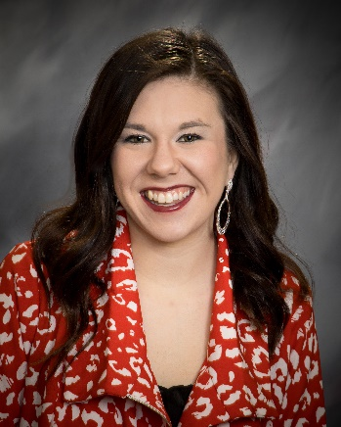
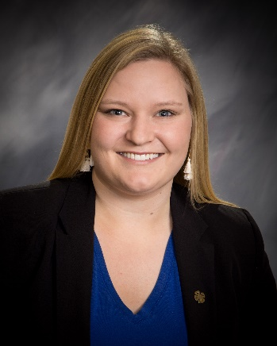
NEED FURTHER INFORMATION?
Connect with us:
Jaki Zahourek Mickayla Blender Mary Larsen
4-H Extension Assistant 4-H Extension Assistant 4-H Support Staff
jaki.zahourek@unl.edu mblender2@unl.edu mlarsen9@unl.edu
2021 WASHINGTON COUNTY 4-H UPDATE | MARCH 18, 2021

Slide 34
Extension is a Division of the Institute of Agriculture and Natural Resources at the University of Nebraska–Lincoln cooperating with the Counties and the United States Department of Agriculture.
University of Nebraska–Lincoln Extension educational programs abide with the nondiscrimination policies of the University of Nebraska–Lincoln and the United States Department of Agriculture.

