Slide 1
2021 Washington County Achievement Celebration

Slide 2
2021 WASHINGTON COUNTY 4-H PROGRAM
All Aboard the 4-H Express
Pledge of Allegiance

Slide 3
2021 WASHINGTON COUNTY 4-H PROGRAM
All Aboard the 4-H Express
4-H Pledge
I Pledge…
my HEAD to clearer thinking,
my HEART to greater loyalty,
my HANDS to larger service,
and my HEALTH to better living,
for my club, my community,
my country and my world.

Slide 4
2021 WASHINGTON COUNTY 4-H PROGRAM
All Aboard the 4-H Express
4-H Volunteer
Recognition

Slide 5
2021 WASHINGTON COUNTY 4-H PROGRAM
All Aboard the 4-H Express
2021 4-H Council
Kevin Flesner, President
Walker Behnken, Vice President
Hollie Booth, Secretary
Karen Murch-Shafer, Treasurer
Carter Behnken
Ella Booth
Norah Cloudt
Conner Flesner
Cindy Laaker
Chelsea Lambert
Keith Mertz
Russell Quinn
Tyler Thompson

Slide 6
2021 WASHINGTON COUNTY 4-H PROGRAM
All Aboard the 4-H Express
2022 4-H Council
Kevin Flesner
Hollie Booth
Carter Behnken
Ella Booth
Norah Cloudt
Erin Denker
Sarah Fuchs
Emma Huntley
Chelsea Lambert
Keith Mertz
Jenna Murch-Shafer
Tate Pruess
Russell Quinn

Slide 7
2021 WASHINGTON COUNTY 4-H PROGRAM
All Aboard the 4-H Express
2021 Washington County 4-H Senior Ambassadors
Sponsored By: Washington County 4-H Council
Norah Cloudt – 4-H Ambassador Queen
Amber Goertz – 4-H Ambassador
Kendra Loseke – 4-H Ambassador
Jenna Murch-Shafer – 4-H Ambassador

Slide 8
2021 WASHINGTON COUNTY 4-H PROGRAM
All Aboard the 4-H Express
2022 Washington County 4-H Senior Ambassadors
Sponsored By: Washington County 4-H Council
Norah Cloudt
Adriana Hernandez
McKenzie Lucas
Jenna Murch-Shafer
Courtney Smith

Slide 9
2021 WASHINGTON COUNTY 4-H PROGRAM
All Aboard the 4-H Express
2021 Washington County 4-H Junior Ambassadors
Sponsored By: Washington County 4-H Council
Ella Booth
Triston Clausen
Adriana Hernandez
McKenzie Lucas
Courtney Smith
Mason Stoddard

Slide 10
2021 WASHINGTON COUNTY 4-H PROGRAM
All Aboard the 4-H Express
2022 Washington County 4-H Junior Ambassadors
Sponsored By: Washington County 4-H Council
Ethan Hilgenkamp
Aaron Fuchs

Slide 11
2021 WASHINGTON COUNTY 4-H PROGRAM
All Aboard the 4-H Express
4-H Leader
Years of Service

Slide 12
2021 WASHINGTON COUNTY 4-H PROGRAM
All Aboard the 4-H Express
4-H Leader & Volunteers
5 Years of Service
Michelle Bentley
Aaron Jensen
Kori Jensen
Keith Mertz
Christy Ott
Michelle Strom
Kent Tjardes
Michelle Tjardes

Slide 13
2021 WASHINGTON COUNTY 4-H PROGRAM
All Aboard the 4-H Express
4-H Leader & Volunteers
10 Years of Service
Jen Hilgenkamp
Alicia Rhea
20 Years of Service
Jennifer Opfer

Slide 14
2021 WASHINGTON COUNTY 4-H PROGRAM
All Aboard the 4-H Express
THANKS TO OUR:
4-H Organizational Leaders
4-H Project Leaders
4-H Event Volunteers
4-H Parents/Guardians

Slide 15
2021 WASHINGTON COUNTY 4-H PROGRAM
All Aboard the 4-H Express
4-H MEMBER
YEARS OF PARTICIPATION

Slide 16
2021 WASHINGTON COUNTY 4-H PROGRAM
All Aboard the 4-H Express
4-H CLOVER KIDS MEMBERS (1/3)
Teyadora Alzuri
Collin Andersen
Eli Andersen
Justin Anthony
Jace Biodrowski
Bryleigh Brown
Camille Buckman
Eden Classen
Eric Denker
Karson Depperman
Dani Dodd
Hallie Dryden
Peyton Dryden
Emme Dunklau
Maddax Earley
Taryn French
Tenley French
Landon Fuchs
Hadley Grabbe
Sophie Hansen
Jase Hemminger
Jenica Henton
Katelyn Hilgenkamp
Payton Hunter

Slide 17
2021 WASHINGTON COUNTY 4-H PROGRAM
All Aboard the 4-H Express
4-H CLOVER KIDS MEMBERS (2/3)
Jacob Huntley
Lori Jacobson
Wyatt Jenson
Lilly Lage
Max Lage
Zayla Lambert
Wyatt Langel
Emersen Larsen
Timmerlyn Larsen
Brant Lauritsen
Richard Lucas
Lucas Marcucci
AydanLee Matz
Haley Mertz
McCoy Mueller
Isla Muse
Ryker Nelson
Aasher Nobles
Ezekiel Oelfke
Stetson Pane
Weston Rasmussen
Aubrey Reese
Emry Reese
Riley Reese

Slide 18
2021 WASHINGTON COUNTY 4-H PROGRAM
All Aboard the 4-H Express
4-H CLOVER KIDS MEMBERS (3/3)
Grant Robinson
Kaleb Royuk
Dawson Saltzman
James Satorie
Leo Schaefer
Holden Scheer
Elizabeth Shope
Stetson Smith
Liam Tabor
Ethan Taylor
Frazier Tegtmeier
Lillian Tetrick
Carter Thayer
Jacob Thiemann
Nova-Lynn Walford
Anna White
Addison Wilkins
Blake Wilkins
Tennessee Wimpey
Berkely Wolf
Leah Wurtz

Slide 19
2021 WASHINGTON COUNTY 4-H PROGRAM
All Aboard the 4-H Express
1st Year of Participation (1/3)
(Starting at 4-H age of 8 years and does not include 4-H Clover Kid years.)
Kaylie Adams
Corryn Albers
Iliana Alzuri
Haley Andersen
Preston Baker
Emily Beam
Bennett Biodrowski
McKenna Brown
Andrew Byrne
Avrie Camenzind
Gracyn Camenzind
Hunter Camenzind
Mia Christ
Lucas Church
Liam Cunard
Lily Cunard
Arya Denker
Ellie Ferry
Gemma Fullner
Jessie Goebel
Lucy Goertz
Makenna Green
Emily Guthmann
Peyton Hathaway-Rice

Slide 20
2021 WASHINGTON COUNTY 4-H PROGRAM
All Aboard the 4-H Express
1st Year of Participation (2/3)
(Starting at 4-H age of 8 years and does not include 4-H Clover Kid years.)
Hannah Heuton
Henry Heuton
Trinity Howard
Blake Jackson
Kellen Jensen
Mahony Jenson
Piper Krumel
Tyler Kuhr
William Langel
Allisen Larsen
Trace Larsen
Jesse Lode
Toni Martinez
Grayson McIlnay
Eowyn Melhus
Gabrielle Muse
Piper Nelson
Anika Nemechek
Zoey Nemechek

Slide 21
2021 WASHINGTON COUNTY 4-H PROGRAM
All Aboard the 4-H Express
1st Year of Participation (3/3)
(Starting at 4-H age of 8 years and does not include 4-H Clover Kid years.)
Aubree Nobles
Kennadee Nobles
Rosemary Ott
Avery Reese
Mason Rezac-Meads
Jayclyn Schmitz
Landon Shada
Graham Shearer
Oakley Sheets
Annika Shope
Lillian Short
Wesley Short
Andrew Sorrows
Isaac Sorrows
Rylee Strom
Hanna Sukraw
Finley Timm
Jaiden Wageman
Thomas Warfield
Noelle Warm
Norah Westerhuis

Slide 22
2021 WASHINGTON COUNTY 4-H PROGRAM
All Aboard the 4-H Express
5th Year of Participation (1/2)
(Starting at 4-H age of 8 years and does not include 4-H Clover Kid years.)
Ethan Hilgenkamp
Gwen Howard
Andrew Korth
Zadyn Lambert
Anna Langel
Emily Barta
Morgan Bentley
Ruby Booth
Judson Cloudt
Ryder Crouse
Erika Cruikshank
Braylee Duckworth
Leigha Hanusek
Haydn Hegemann
Johnny Henton

Slide 23
2021 WASHINGTON COUNTY 4-H PROGRAM
All Aboard the 4-H Express
5th Year of Participation (2/2)
(Starting at 4-H age of 8 years and does not include 4-H Clover Kid years.)
Callee Shearer
Matthew Smith
Kiana Thayer
Harper Tjardes
Lawson Tjardes
Gradi Wilkins
Madisen Larsen
Emma Lucas
Annika Melhus
Aaron Melville
Anna Melville
Jesse Mentzer
Madyson Mildward
Lawson Oerman
Ellie Ortmeier
Luke Ott
Savannah Rahn
Sophia Schaefer

Slide 24
2021 WASHINGTON COUNTY 4-H PROGRAM
All Aboard the 4-H Express
10th Year of Participation
(Starting at 4-H age of 8 years and does not include 4-H Clover Kid years.)
James Rhea
Alaina Schwedhelm
Bradley Tonn
Maria Tonn
Margaret Valasek
Cassidy Arp
Walker Behnken
Bradie Crouse
Tyler Larsen
Kendra Loseke

Slide 25
2021 WASHINGTON COUNTY 4-H PROGRAM
All Aboard the 4-H Express
4-H Graduates in 2021
Final Year of Participation
Amber Goertz
Allison Nielsen
Mallory Ruwe
Maggie Sheets
Zaena Stork
Tommy Thompson
Wyatt Wiemer

Slide 26
2021 WASHINGTON COUNTY 4-H PROGRAM
All Aboard the 4-H Express
Washington County Fair
Top Exhibitor Award Winners In Each Curriculum Area
ANIMAL SCIENCE
CHAMPION: Adriana Hernandez
RESERVE: Brooke Hilgenkamp
COMMUNICATIONS & EXPRESSIVE ARTS
CHAMPION: Trent Koger
RESERVE: Addilyn Hilgenkamp

Slide 27
2021 WASHINGTON COUNTY 4-H PROGRAM
All Aboard the 4-H Express
Washington County Fair
Top Exhibitor Award Winners In Each Curriculum Area
CONSUMER & FAMILY SCIENCES
CHAMPION: Zayling Ott
RESERVE: Emma Huntley
ENVIRONMENTAL EDUCATION & EARTH SCIENCE
CHAMPION: Trent Koger
RESERVE: Jack Bendell

Slide 28
2021 WASHINGTON COUNTY 4-H PROGRAM
All Aboard the 4-H Express
Washington County Fair
Top Exhibitor Award Winners In Each Curriculum Area
HEALTHY LIFESTYLES
CHAMPION: Addilyn Hilgenkamp
RESERVE: Trent Koger
PLANT SCIENCE
CHAMPION: Ethan Hilgenkamp
RESERVE: Adriana Hernandez
SCIENCE, ENGINEERING & TECHNOLOGY
CHAMPION: Trent Koger

Slide 29
2021 WASHINGTON COUNTY 4-H PROGRAM
All Aboard the 4-H Express
RECOGNITION & ACHIEVEMENTS 2021

Slide 30
2021 WASHINGTON COUNTY 4-H PROGRAM
All Aboard the 4-H Express
Youth For Quality Care of Animals (YQCA) Online Certification
68 Juniors
57 Intermediates
35 Seniors
Horsemanship Advancement Level Testing
7 – Level 1 Horseman Certifications

Slide 31
2021 WASHINGTON COUNTY 4-H PROGRAM
All Aboard the 4-H Express
2021
Diamond Clover Recognition

Slide 32
2021 WASHINGTON COUNTY 4-H PROGRAM
All Aboard the 4-H Express
2021Diamond Clover Recognition
Level 1: Amethyst – Completed 3 Goals
Jack Bendell
Liam Cunard
Arya Denker
Piper Krumel
Kristina Lucas
Aubree Nobles
Kenadee Nobles
Annika Shope
Gabriella Siecke

Slide 33
2021 WASHINGTON COUNTY 4-H PROGRAM
All Aboard the 4-H Express
2021Diamond Clover Recognition
Level 2: Aquamarine – Completed 4 Goals
Logan Hilgenkamp
Dustin Smith

Slide 34
2021 WASHINGTON COUNTY 4-H PROGRAM
All Aboard the 4-H Express
2021Diamond Clover Recognition
Level 3: ruby – Completed 5 Goals
Jewel Denker
Lillian Huntley

Slide 35
2021 WASHINGTON COUNTY 4-H PROGRAM
All Aboard the 4-H Express
2021Diamond Clover Recognition
Level 4: sapphire – Completed 6 Goals
Ethan Hilgenkamp
Emma Huntley
McKenzie Lucas

Slide 36
2021 WASHINGTON COUNTY 4-H PROGRAM
All Aboard the 4-H Express
2021Diamond Clover Recognition
Level 6: diamond – Completed 8 Goals
Adriana Hernandez

Slide 37
2021 WASHINGTON COUNTY 4-H PROGRAM
All Aboard the 4-H Express
Clover Kid Record Books
Ages 5-7 years old as of January 1, 2021
Submitted by:
Eric Denker
Katelyn Hilgenkamp
Jacob Huntley
Lori Jacobson
Richard Lucas
Haley Mertz
Aasher Nobles
Elizabeth Shope

Slide 38
2021 WASHINGTON COUNTY 4-H PROGRAM
All Aboard the 4-H Express
Annual Achievement Applications
Applicants may choose one “program area” to focus their report on. Program Areas are:
Agriculture
Healthy Living
STEM
Leadership & Entrepreneurship
College & Career Preparation for My Future

Slide 39
2021 WASHINGTON COUNTY 4-H PROGRAM
All Aboard the 4-H Express
2021 Achievement Applications were submitted by:
Jack Bendell
Arya Denker
Jewel Denker
Aaron Fuchs
Erica Fuchs
Isaiah Fuchs
Adriana Hernandez
Ethan Hilgenkamp
Logan Hilgenkamp
Emma Huntley
Lillian Huntley
Casey Mertz
Annika Shope

Slide 40
2021 WASHINGTON COUNTY 4-H PROGRAM
All Aboard the 4-H Express
Achievement Application Award Winners
Program Area: Agriculture
JUNIOR – GOLD: Logan Hilgenkamp
JUNIOR – SILVER: Casey Mertz
INTERMEDIATE - GOLD: Aaron Fuchs
INTERMEDIATE – SILVER: Ethan Hilgenkamp
SENIOR – GOLD: Adriana Hernandez
(Senior winner is eligible for state level application & awards!)

Slide 41
2021 WASHINGTON COUNTY 4-H PROGRAM
All Aboard the 4-H Express
Achievement Application Award Winners
Program Area: Healthy Living
JUNIOR – GOLD: Erica Fuchs
Program Area: STEM
JUNIOR – GOLD: Jack Bendell
JUNIOR – SILVER: Arya Denker

Slide 42
2021 WASHINGTON COUNTY 4-H PROGRAM
All Aboard the 4-H Express
Achievement Application Award Winners
Program Area: Leadership & Entrepreneurship
JUNIOR – GOLD: Isaiah Fuchs
INTERMEDIATE – GOLD: Emma Huntley
INTERMEDIATE - SILVER: Jewel Denker
INTERMEDIATE – BRONZE: Lillian Huntley
INTERMEDIATE – Honorable Mention: Annika Shope

Slide 43
2021 WASHINGTON COUNTY 4-H PROGRAM
All Aboard the 4-H Express
NEW CHARTER 4-H CLUB IN 2021
Badger Buddies 4-H Club
Organizational Leader: Erin Denker

Slide 44
2021 WASHINGTON COUNTY 4-H PROGRAM
All Aboard the 4-H Express
"Nebraska Club of Excellence"
Requirements
1. Have at least five members from at least two different families.
2. Recite the 4-H Pledge at meetings.
3. Meet at least six times per year.
4. Choose/elect youth officers
5. Give youth leadership roles.
6. Have one club project which is done together.
7. Have adult role models & parental involvement.
8. Meetings are facilitated by a volunteer/organizational leader who has successfully completed the Volunteer Profile.
9. Have members who perform a demonstration or public speaking at the club level or above.
10. Complete one community service project.
11. Have members who participate in a county, district or state event(s).
12. Celebrate member and club achievement.

Slide 45
2021 WASHINGTON COUNTY 4-H PROGRAM
All Aboard the 4-H Express
2021 Nebraska Club of Excellence Recipients
Badger Buddies 4-H Club
Organizational Leader: Erin Denker
Future Producers 4-H Club
Organizational Leader: Craig Hegemann
Pioneer Pals 4-H Club
Organizational Leaders: Vicki Smith & Micki Hernandez
Trail Blazers 4-H Club
Organizational Leaders: Mary Larsen & David Anderson
(1st time recipients receive a certificate & seal, others receive the seal to add to their previously earned certificate)

Slide 46
2021 WASHINGTON COUNTY 4-H PROGRAM
All Aboard the 4-H Express
4-H Club Community Service Recognition
Badger Buddies 4-H Club
Future Producers 4-H Club
Pioneer Pals 4-H Club
Trail Blazers 4-H Club
Washco Blazers 4-H Club

Slide 47
2021 WASHINGTON COUNTY 4-H PROGRAM
All Aboard the 4-H Express
The Governor's Ag Excellence Award
Congratulations to the Badger Buddies 4-H Club – 2021 Winner
The club received their award from Governor Ricketts in June, 2021. Sponsored by the Nebraska Investment Finance Authority, the purpose of this award is to recognize 4-H Clubs for the work of individuals in the club and the community service work of the entire club.

Slide 48
2021 WASHINGTON COUNTY 4-H PROGRAM
All Aboard the 4-H Express
4-H Pizza Stand Drawing
!! THANK YOU !!
To all the 4-Hers who worked in the 4-H Pizza Stand during the Washington County Fair.
We'll now draw names to determine winners of two $25 Pizza Hut gift certificates from those clubs who worked.

Slide 49
2021 WASHINGTON COUNTY 4-H PROGRAM
All Aboard the 4-H Express
4-H Pizza Stand Manager
Hartvigsen Scholarship Recipients
Sponsored by:
Washington County 4-H Council
Triston Clausen
Jenna Murch-Shafer

Slide 50
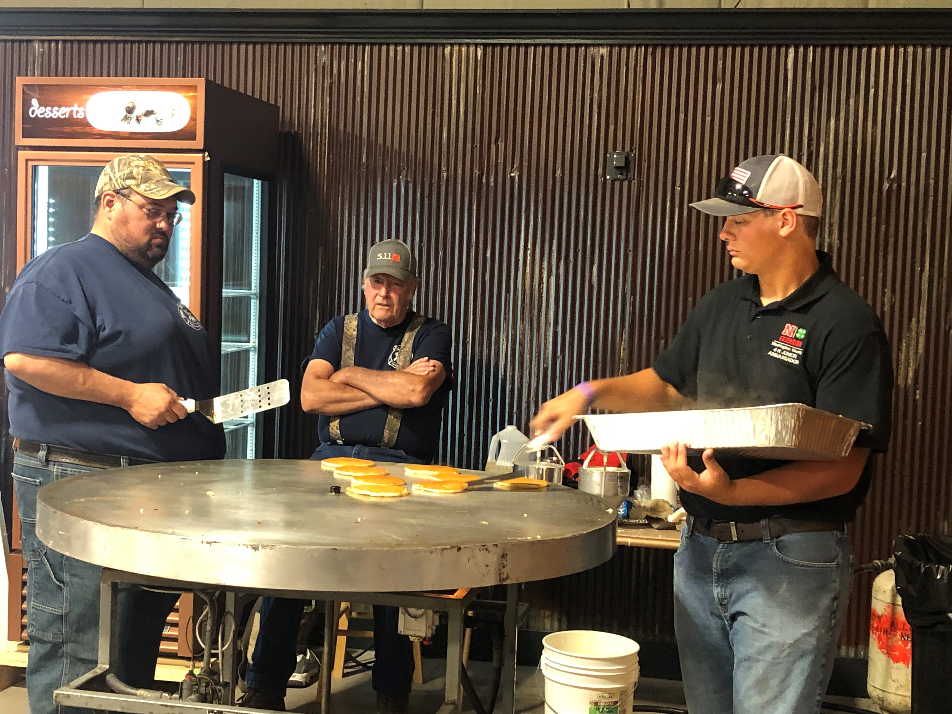
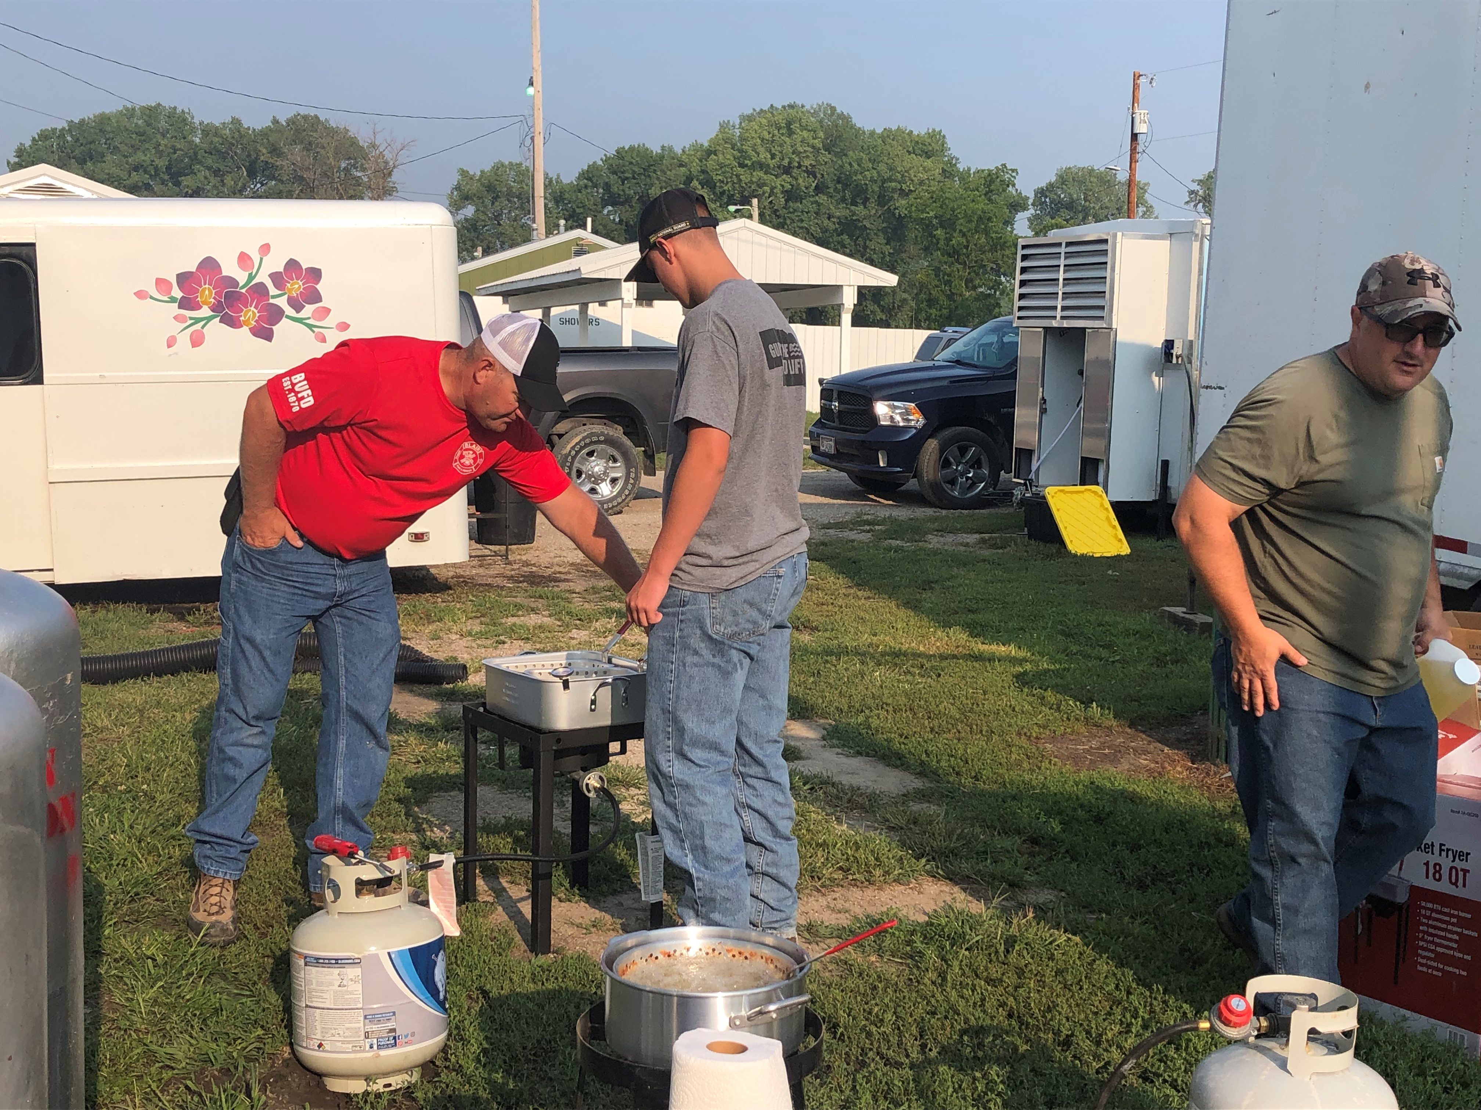
2021 WASHINGTON COUNTY 4-H PROGRAM
All Aboard the 4-H Express
Washington County 4-H Council
Friends of 4-H Award
Blair Volunteer Fire Department

Slide 51
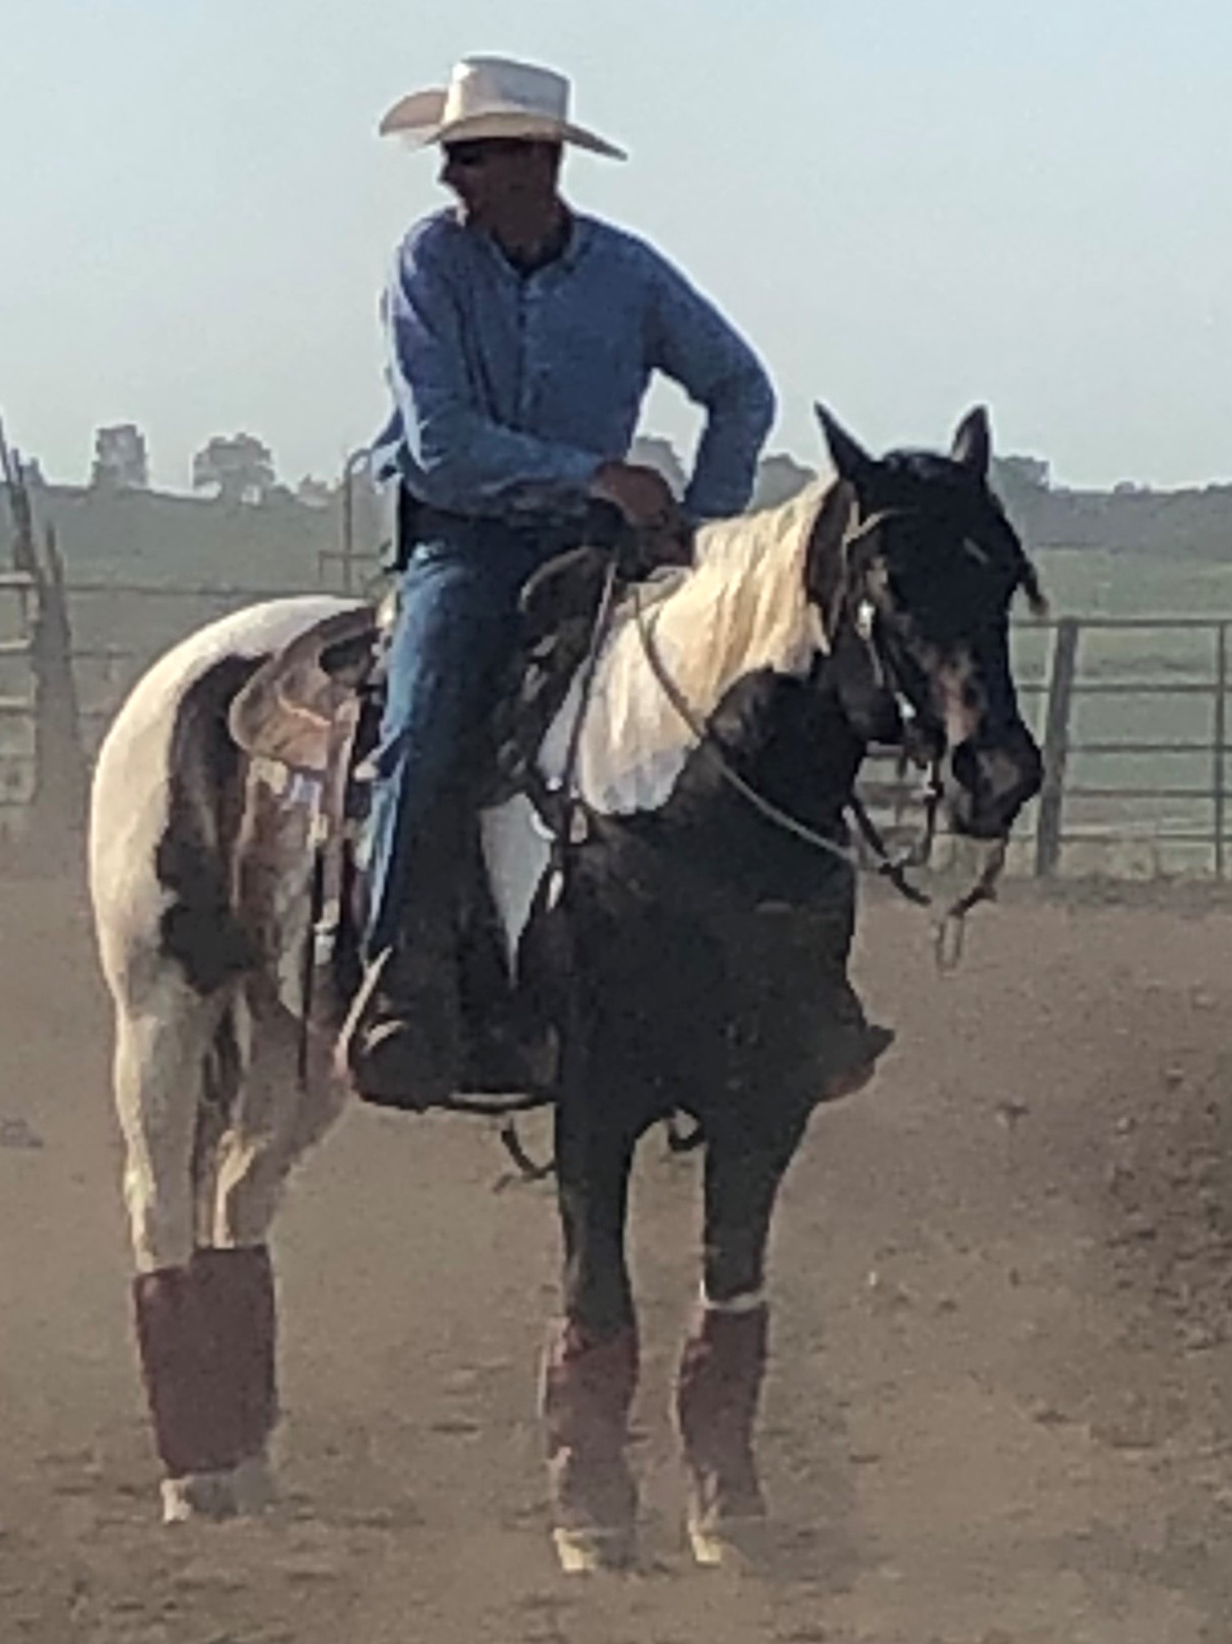
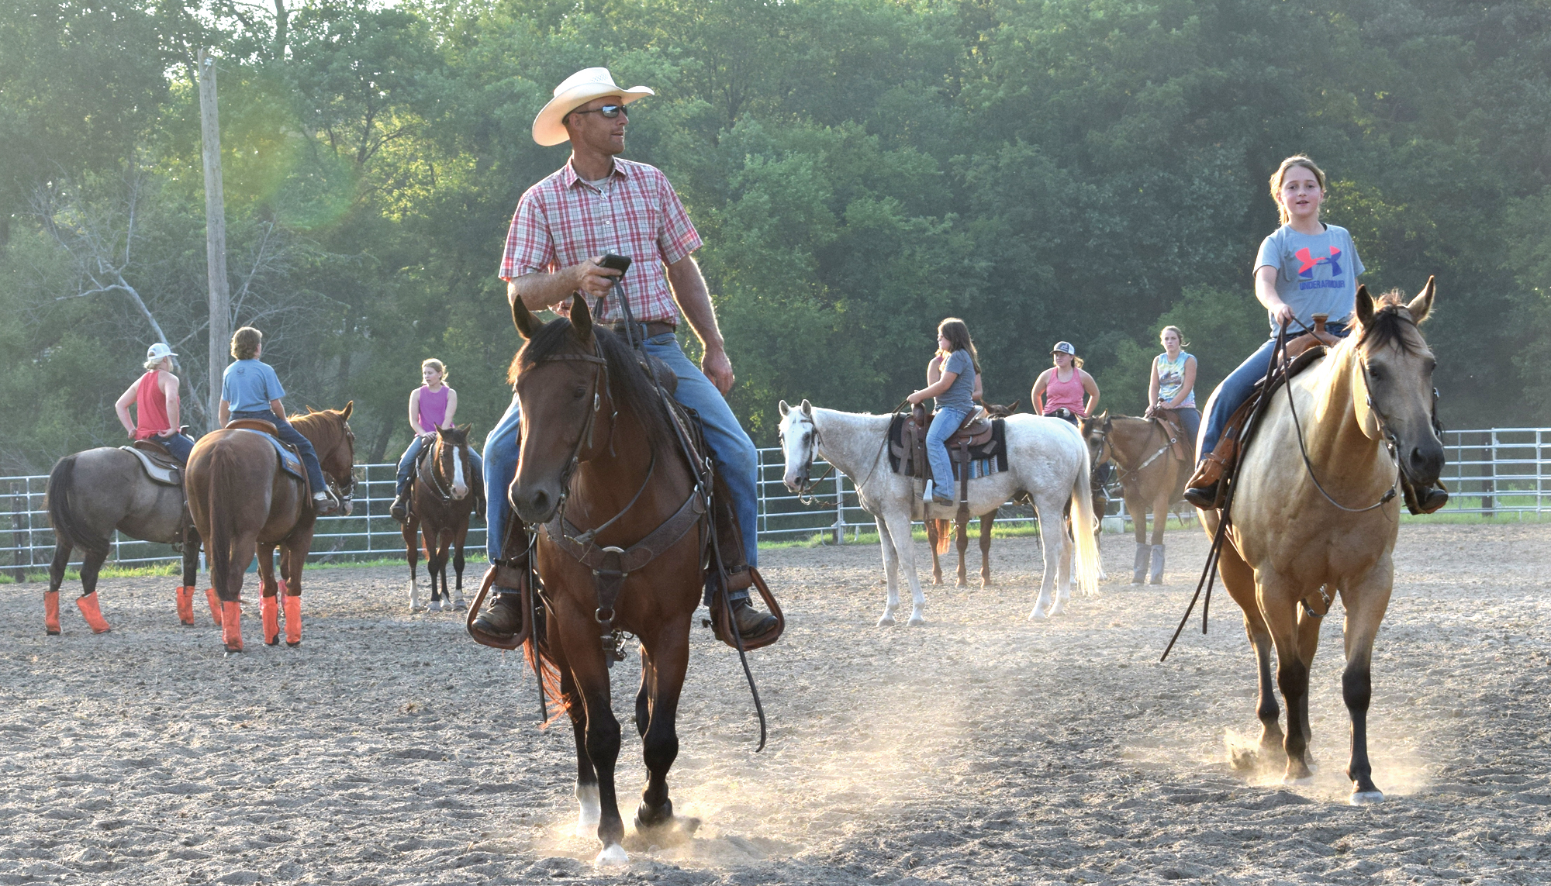
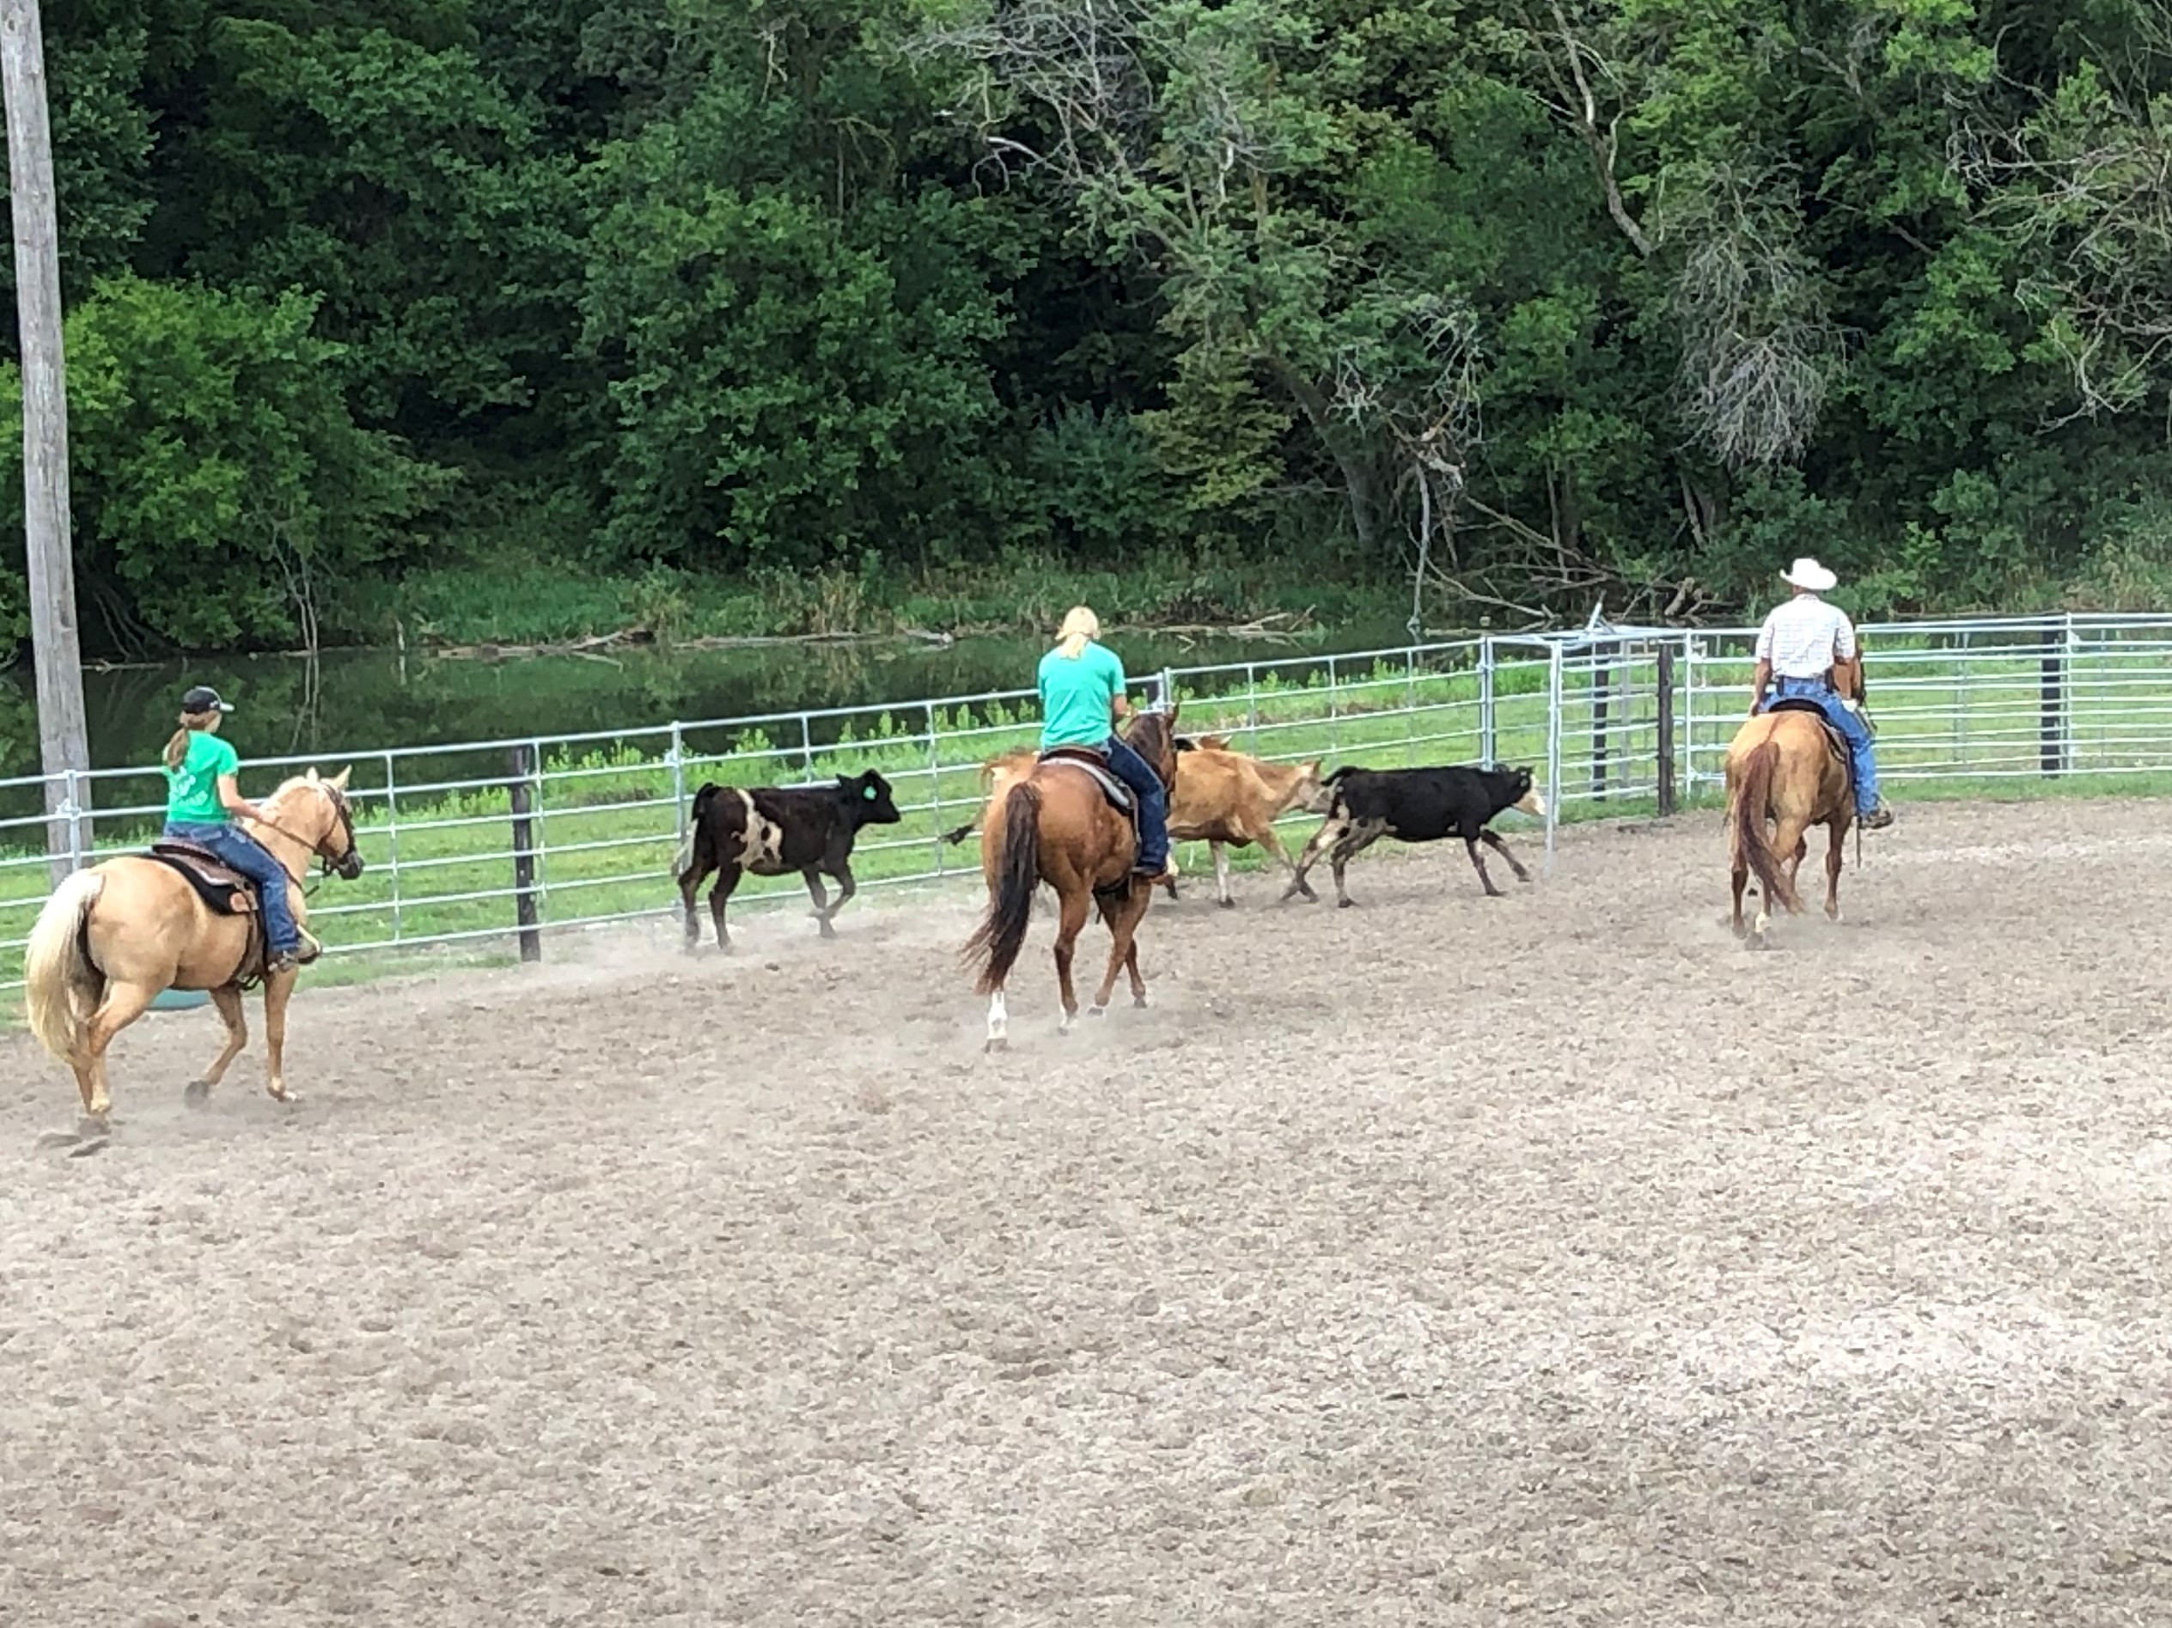
2021 WASHINGTON COUNTY 4-H PROGRAM
All Aboard the 4-H Express
Washington County 4-H Council
4-H Alumnus Award
David Anderson

Slide 52
2021 WASHINGTON COUNTY 4-H PROGRAM
All Aboard the 4-H Express
THANK YOU
for supporting the Washington County 4-H Program
Grand Champion Supporter ($1,000 or more)
Washington County Bank
Channel Seed – Tim Sass

Slide 53
2021 WASHINGTON COUNTY 4-H PROGRAM
All Aboard the 4-H Express
THANK YOU
for supporting the Washington County 4-H Program
Gold Medal Supporter ($500-$749)
Douglas County Farm Bureau
Lauritsen Ag
Sagehorn Seed
Jeff & Kelli Shaner
The Tjardes Family

Slide 54
2021 WASHINGTON COUNTY 4-H PROGRAM
All Aboard the 4-H Express
THANK YOU
for supporting the Washington County 4-H Program
ACHIEVEMENT CELEBRATION SUPPORTERS
Washington County 4-H Council
(Prizes, Scholarships and Awards)
Washington County Fairboard
(Facilities)

