Slide 1
ANIMALS INSIDE & OUT
Interactive Animals Science Education Activities

Slide 2
WHY ANIMALS INSIDE & OUT?
A Needs Assessment was conducted in Nebraska to determine the Nebraska 4-H Strategic Plan for 2012-2017 which found the following as program priorities:
Develop science interests, skills and abilities in the areas of
Agriculture
Energy
Environmental Stewardship
Technology
Helping youth think and problem solve within a scientific framework and encouraging an excitement for science.”
Animal Science is a focus area important to 4-H.

Slide 3
OBJECTIVES
RESEARCH
The “Animals Inside & Out program is a 10 Hour Signature Program. It was designed so each activity includes hands on/active learning of participants.
Youth will gain knowledge and understanding of the livestock industry.
Youth will develop science skills and abilities to help solve everyday situations.
Youth will become aware of careers related to animal science.
PRIMARY AUDIENCE
3 – 5th Grades
Presented to youth with animal projects as well as youth with no animal experience in a wide variety of delivery modes

Slide 4
CURRICULUM TOPICS
Animal Management
By-Products
Digestive System
Feeds & Nutrition
Muscular System
Skeletal System
Respiratory & Circulatory Systems
Reproductive System
Animal Science Careers

Slide 5
MODES OF DELIVERY
Field Days
Day Camps
Summer Camps
Fairs
School Enrichment Programs
After School/Out of School Programs

Slide 6
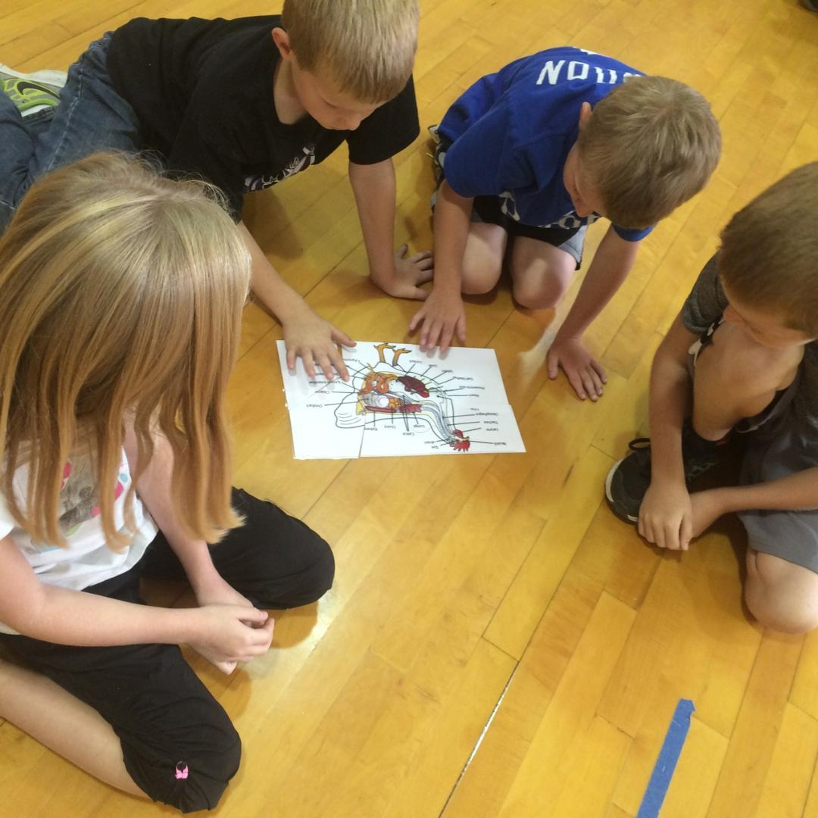
INTRODUCTORY SESSION
Notes:
Puzzles on tables at beginning. - Rhonda

Slide 7
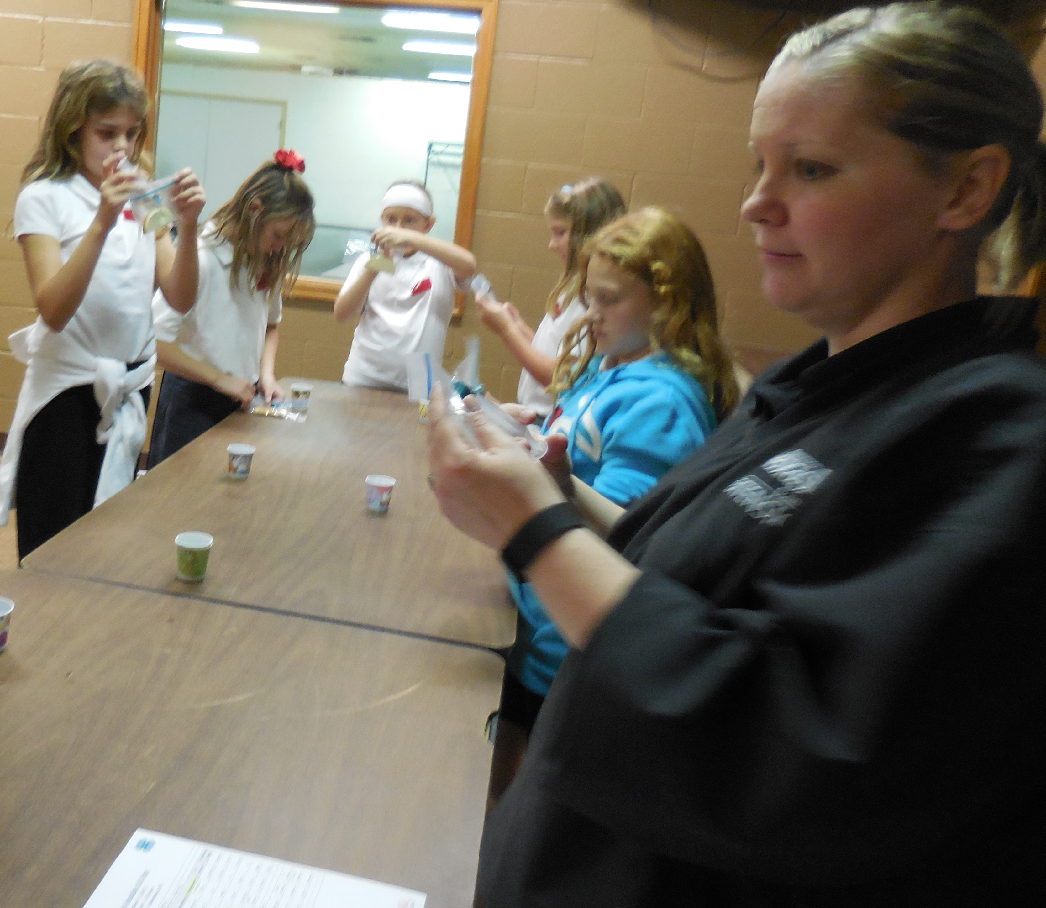
ANIMAL MANAGEMENT
Notes:
bun injection activity Darci

Slide 8
MUSCULAR SYSTEM
Notes:
Pineapple Activity - Rhonda

Slide 9
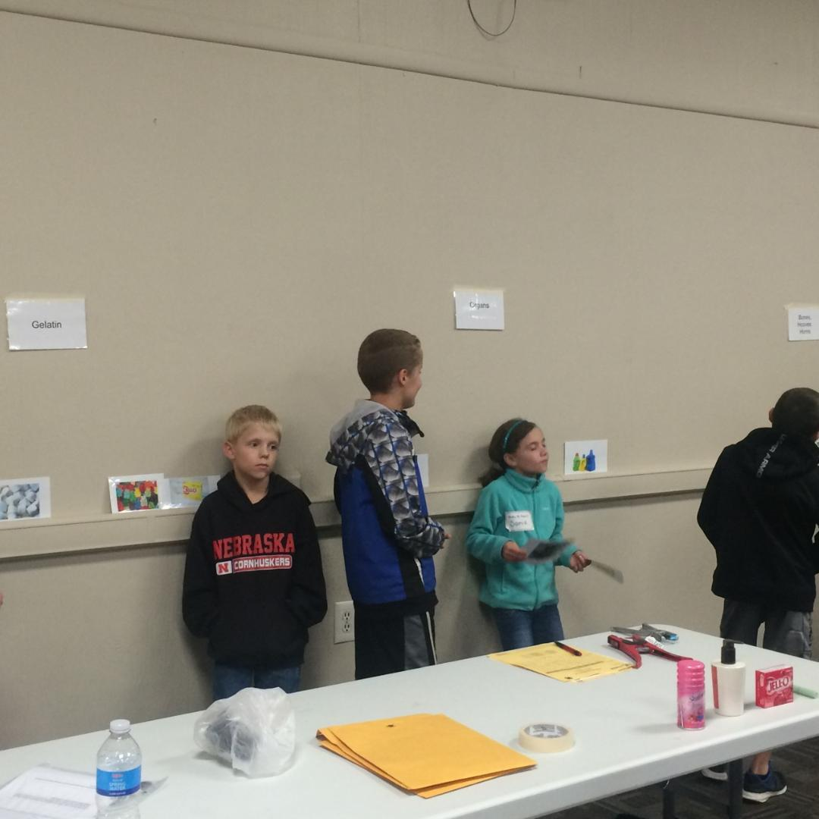
BY-PRODUCTS
Notes:
brief description - Darci

Slide 10
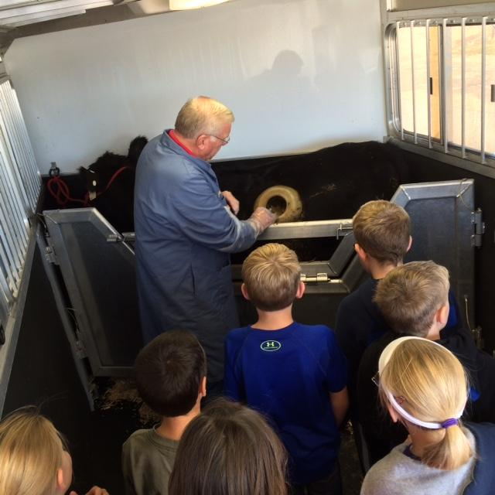
DIGESTIVE SYSTEM
Notes:
Ashley

Slide 11
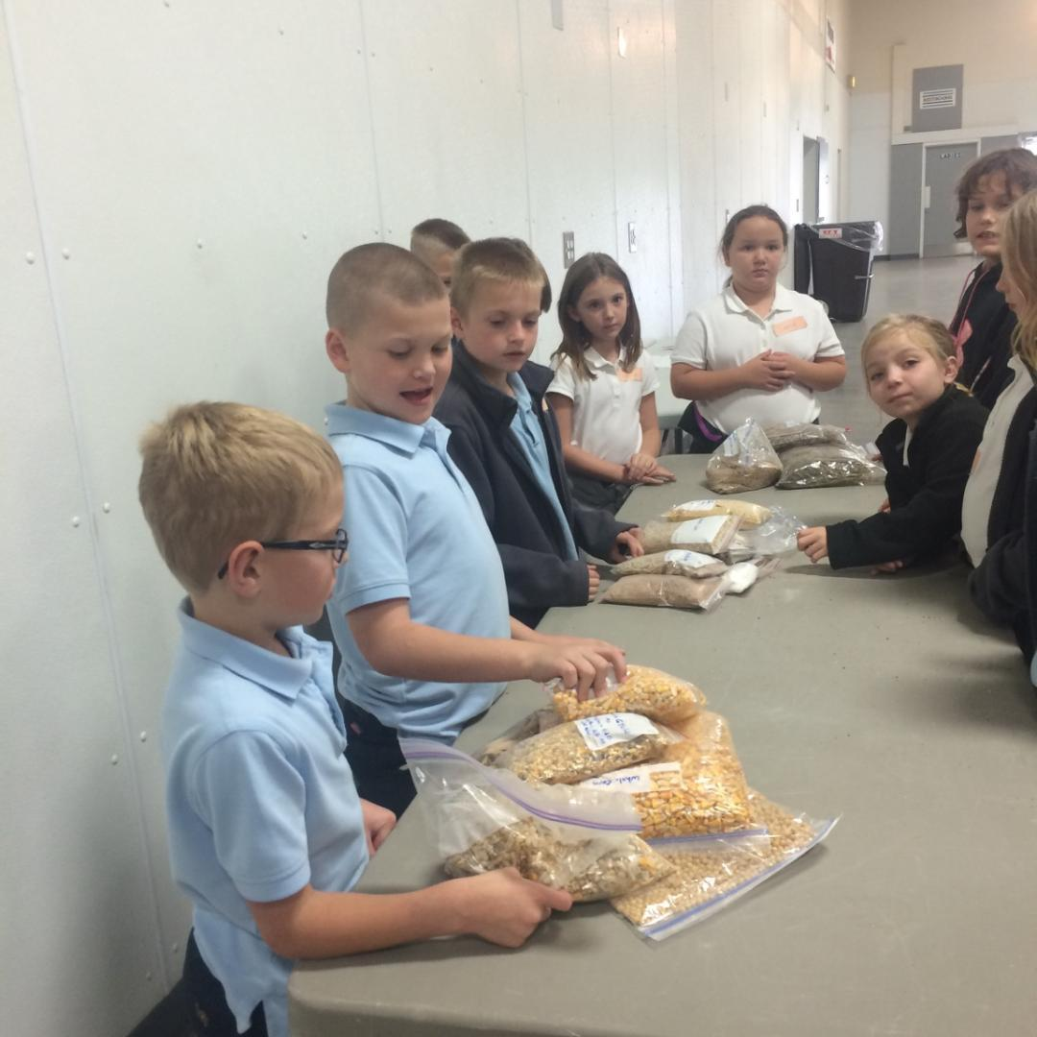
FEEDS & NUTRITION
Notes:
Crystal

Slide 12
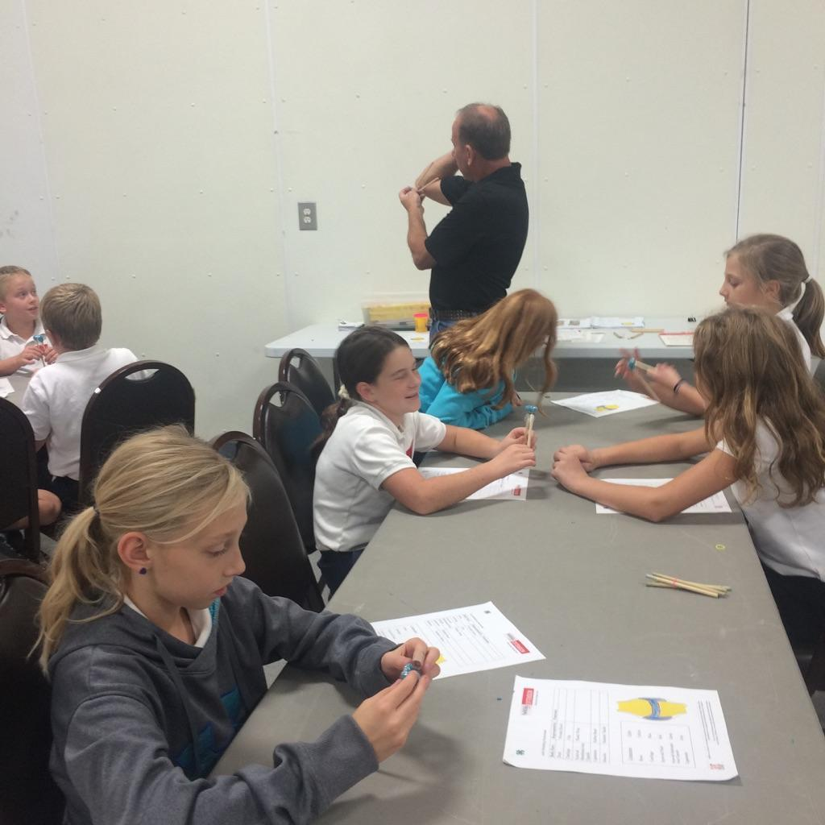
SKELETAL SYSTEM
Notes:
Build Joint - Eric

Slide 13
CIRCULATORY & RESPIRATORY SYSTEM
Notes:
Heart Mat -Kathy

Slide 14
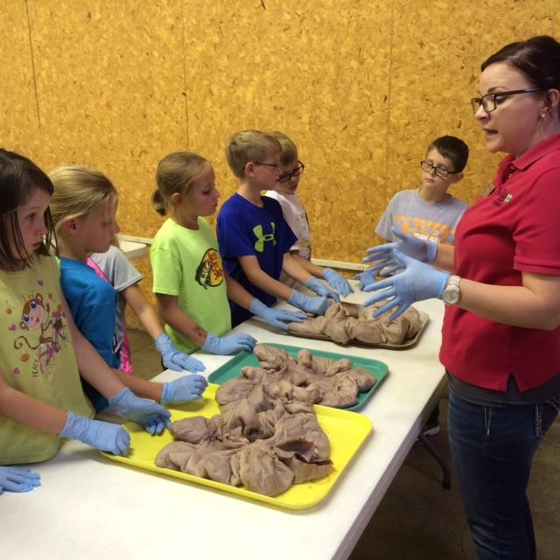
REPRODUCTIVE SYSTEM
Notes:
describe - Ashley

Slide 15
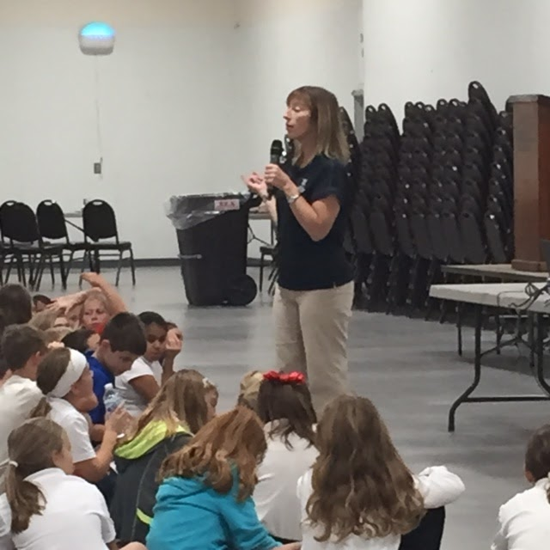
ANIMAL SCIENCE CAREERS

Slide 16
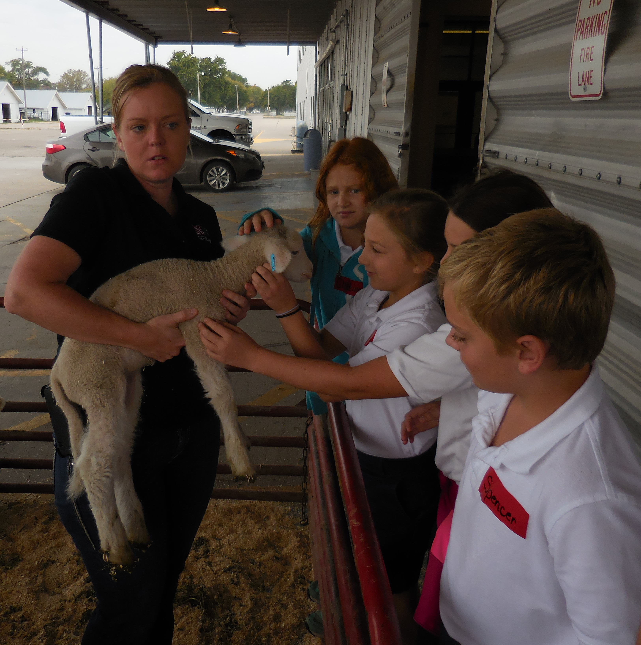
ANIMALS CLOSE - UP

Slide 17
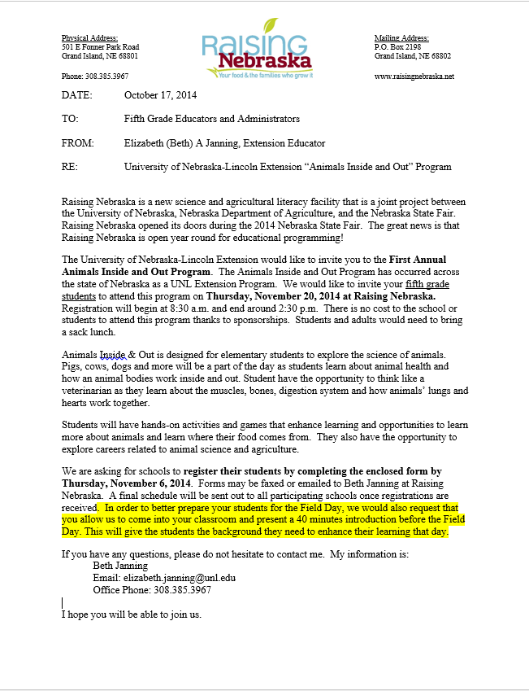
PREP WORK

Slide 18
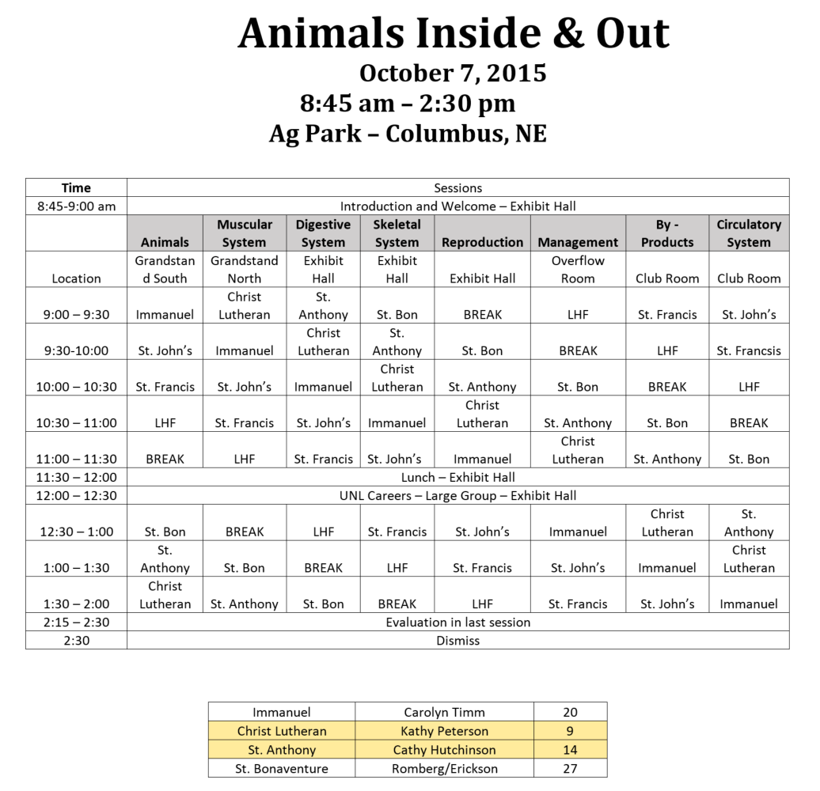
SET-UP OF FIELD DAY
Notes:
Fix this picture

Slide 19
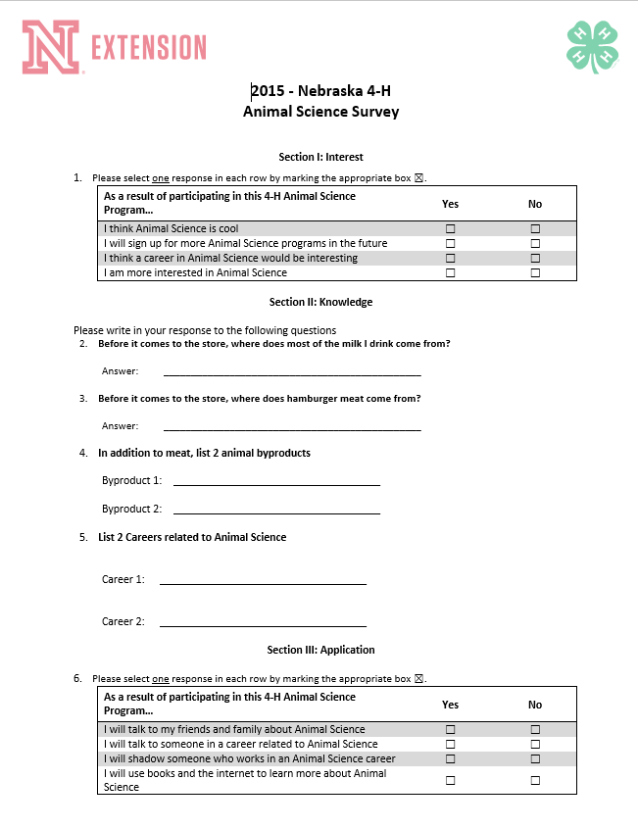
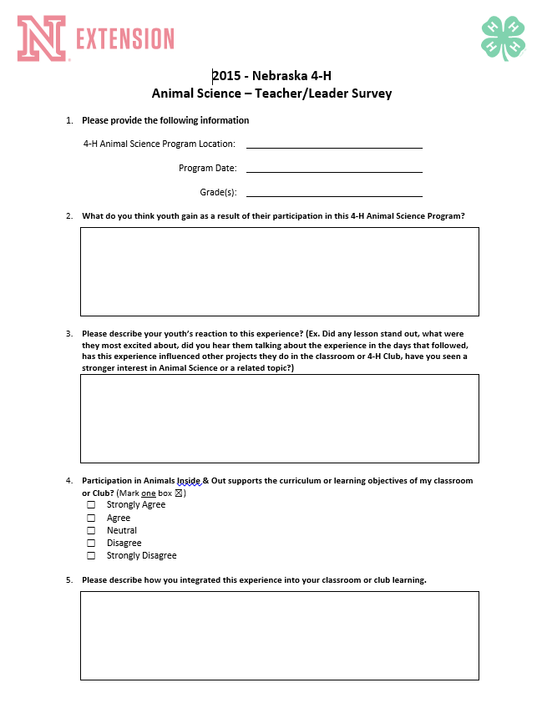
EVALUATIONS

Slide 20
IMPACT – YOUTH POST EVALUATIONS
98% strongly agreed or agreed it’s important to keep good records and that good records can help keep animals healthy.
89% can group animals into meat and dairy groups.
75% were more interested in Animal Science after completing the program.
75% could list 3 careers related to Animal Science.
70% could name 2 animal by-products.

Slide 21
IMPACT – TEACHER POST EVALUATIONS
“My students have made reference to the activities and knowledge gained many times. We have been able to expand on specific topics as we have integrated information into our existing curriculum. Topics such as the heart and how it works goes with our health unit. Animal products and byproducts also work with our health, occupations, and communities units. It was absolutely amazing to see the fetus of a pig and cow (AND get to actually touch them). We live in a rural community, yet many students don’t understand what that means. They came away from ‘Animals Inside & Out’ with new curiosities about science as a whole. I learned a great deal also. THANK YOU!!!”
“Lots of great learning opportunities we wouldn’t have in the classroom!”
“It hit home about how animals produce the products we have.”
“Great opportunity to get students hands-on experiences with the science of animals.”

Slide 22
QUESTIONS
PRESENTERS:
Rhonda Herrick rhonda.herrick@unl.edu
Kathy Potthoff kathy.potthoff@unl.edu
Ashley Benes ashley.benes@unl.edu
Darci Pesek darci.pesek@unl.edu
Eric Stehlik eric.stehlik@unl.edu
Crystal Fangmeier crystal.fangmeier@unl.edu

Slide 23
RESEARCH BASE
The “Animals Inside & Out program, which is a 10 Hour Signature Program, was designed so each activity includes hands on/active learning of participants based on research material from the following:
4-H Set Abilities – Science, Engineering, and Technology (SET), Programming in the context of 4-H Youth Development – National 4-H Council, The Ohio State University, 2007.
Animal Project Content Grid – House, Horton, Ohio State University Extension, 2008.
Positive youth development is operationalized by the Five Cs of competence confidence, character, connection, and caring, leading to youth contributions, the “sixth C” of PYD. (Bowers et al., 2010; Jelicic et al., 2007; Lerner et al., 2005; Phelps et al., 2009).
Central and Western Region Committees for Agricultural Literacy July 1999 Summaries of Research and Development in Agricultural Literacy Page 34 Frick, M. J., Birkenholz, R. J., & Machtmes, K. (1995).
From the 8 Essential Elements Research Base - The program incorporates the following “Best Practices”
Provide a Safe Emotional & Physical Environment
Engagement in Learning
Opportunity for Mastery
Opportunity to See Oneself as an Active Participant in the Future
Kolbs Learning Model (1984) - 5 steps of the Experiential Learning Model of Experience,
Share, Process, Generalize and Apply.

Slide 24
Extension is a Division of the Institute of Agriculture and Natural Resources at the University of Nebraska–Lincoln cooperating with the Counties and the United States Department of Agriculture.
University of Nebraska–Lincoln Extension educational programs abide with the nondiscrimination policies of the University of Nebraska–Lincoln and the United States Department of Agriculture.

