Slide 1
Symptoms of a Sick or Injured Animal

Slide 2
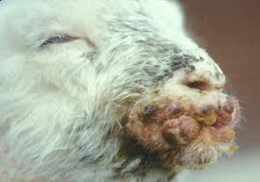
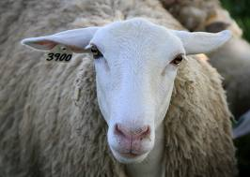
A
B

Slide 3
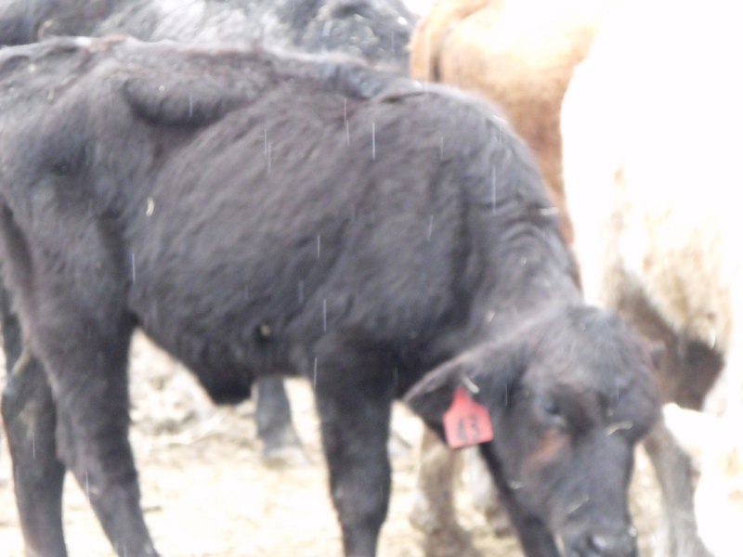
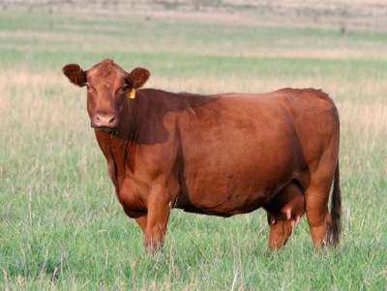
A
B

Slide 4
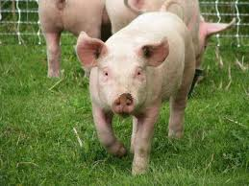
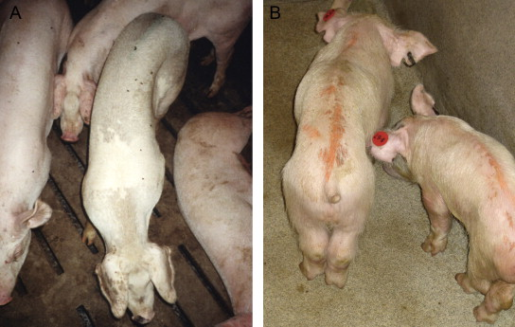
A
B

Slide 5
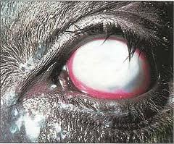
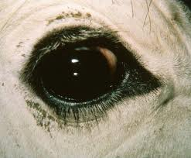
A
B

Slide 6
We like to say that prevention is the best medicine? How can we prevent animals from getting sick? Proper nutition, proper space/facilities, clean environment, fresh water, keeping them away from other sick animals, or giving preventative vaccinations.
Unfortunately we cannot always prevent an animal getting sick just like we can’t always prevent ourselves from getting sick. We can determine if they’re sick by all the things we’ve already discussed.
What do we need to do when an animal is sick? Give them medication. This can be done orally in some cases or through the mouth through either their feed/water or drenching/tubing them. In a lot of cases they need an injection of medication.
**discuss animal handling and why we put them in the chute- our safety and their safety. Also talk about filling a syringe and giving the shot in the neck. Why do we inject in the neck? How do we give the injection?
**Leads into the vaccinations/injections activity

Slide 7
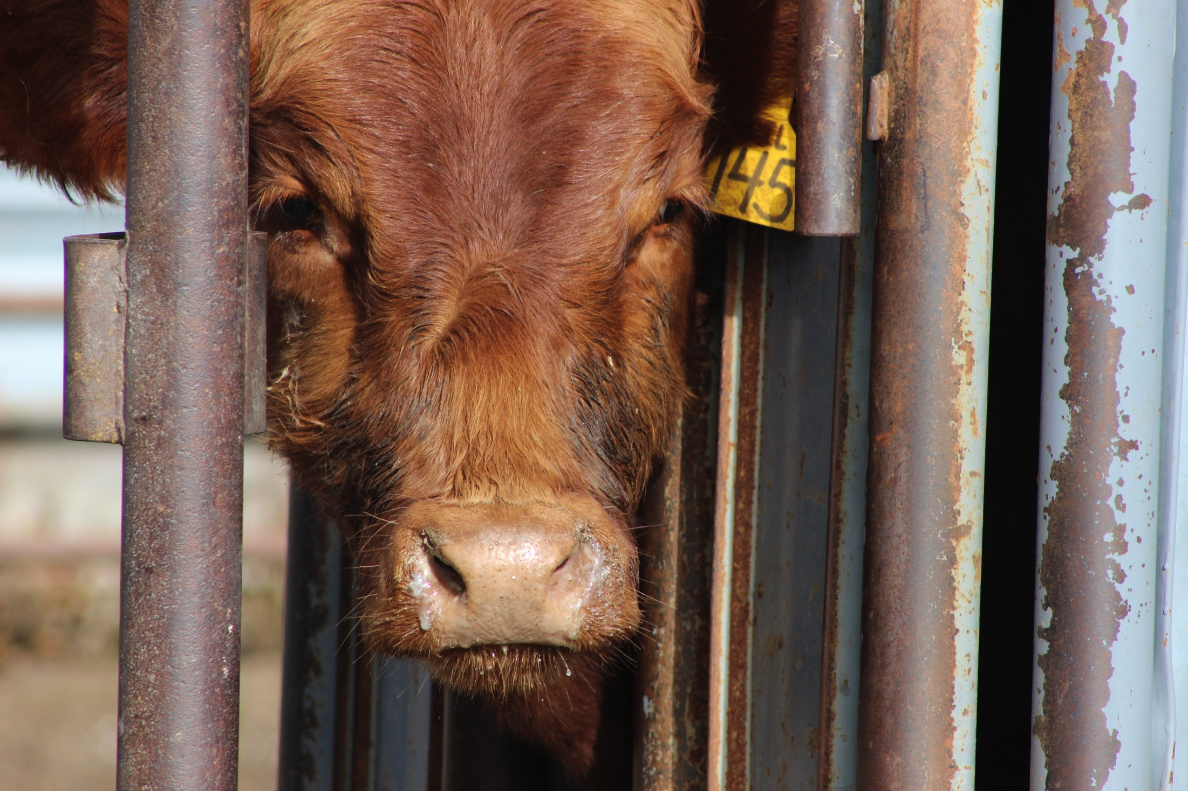

Slide 8
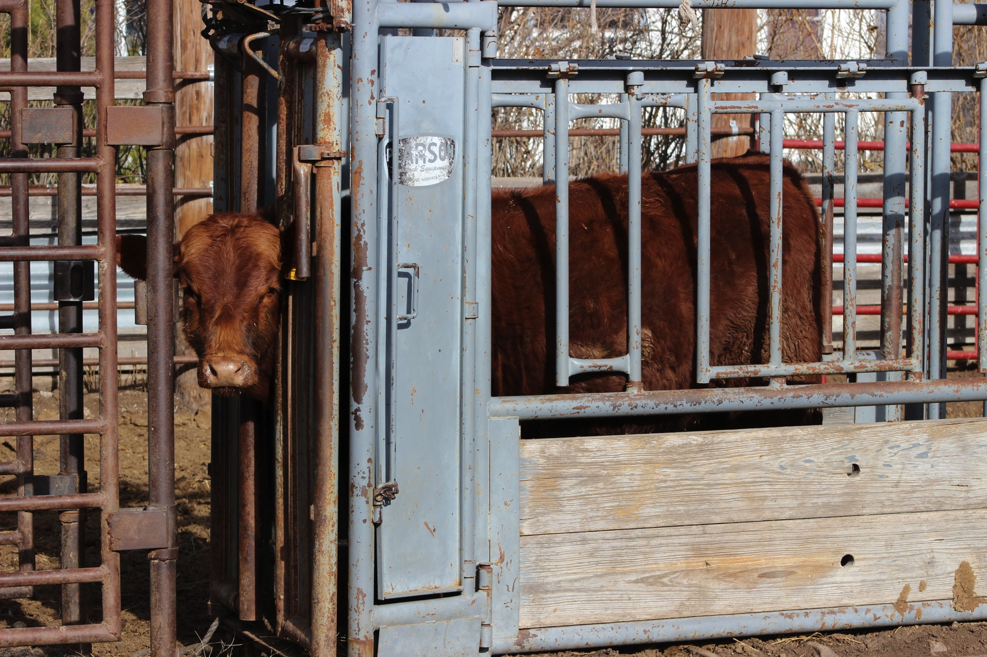

Slide 9
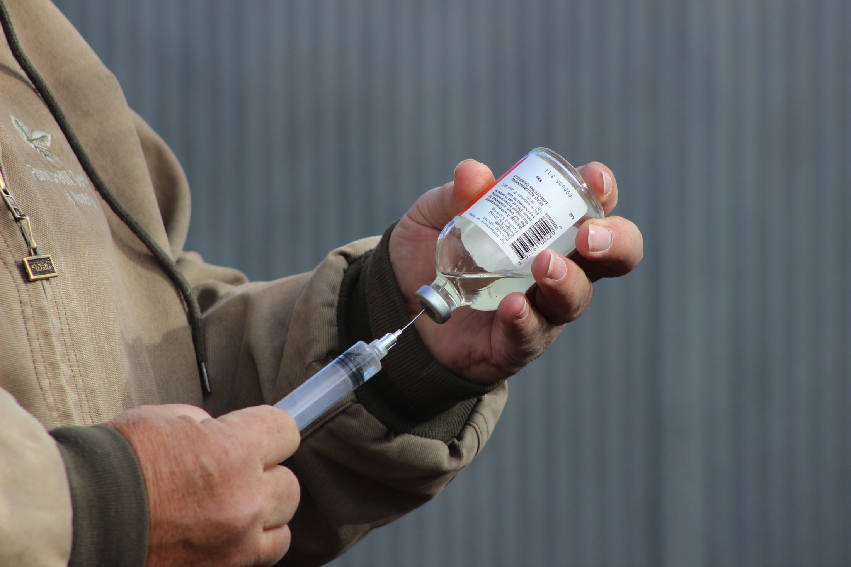

Slide 10
