Slide 1


Where does your food come from?

Slide 2

GrowIt-KnowIt App
http://ianr.unl.edu/growit-knowit-app
Notes:
FYI – About the APP USED - Where do hot dogs come from? How about milk? Hamburgers? Eggs? Most youngsters likely will say the grocery store. Of course, the real answer is much more fascinating, and “We Grow It, Do You Know It” is a lively free app that gives kids their first lessons in how agriculture produces the things they love to eat – and even their crayons. From the University of Nebraska’s Institute of Agriculture and Natural Resources.

Slide 3

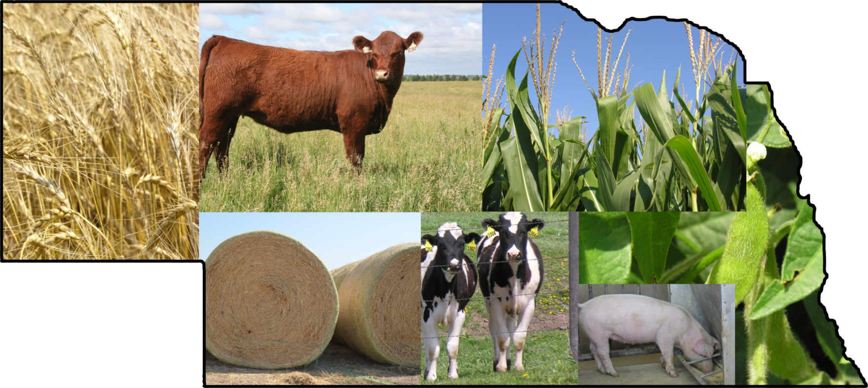

AGRICULTURE
of Nebraska’s Land
is used for
Farming and Ranching
The average farm size is
One farmer produces
enough food to feed
155
PEOPLE

Slide 4
What was for lunch?

Slide 5
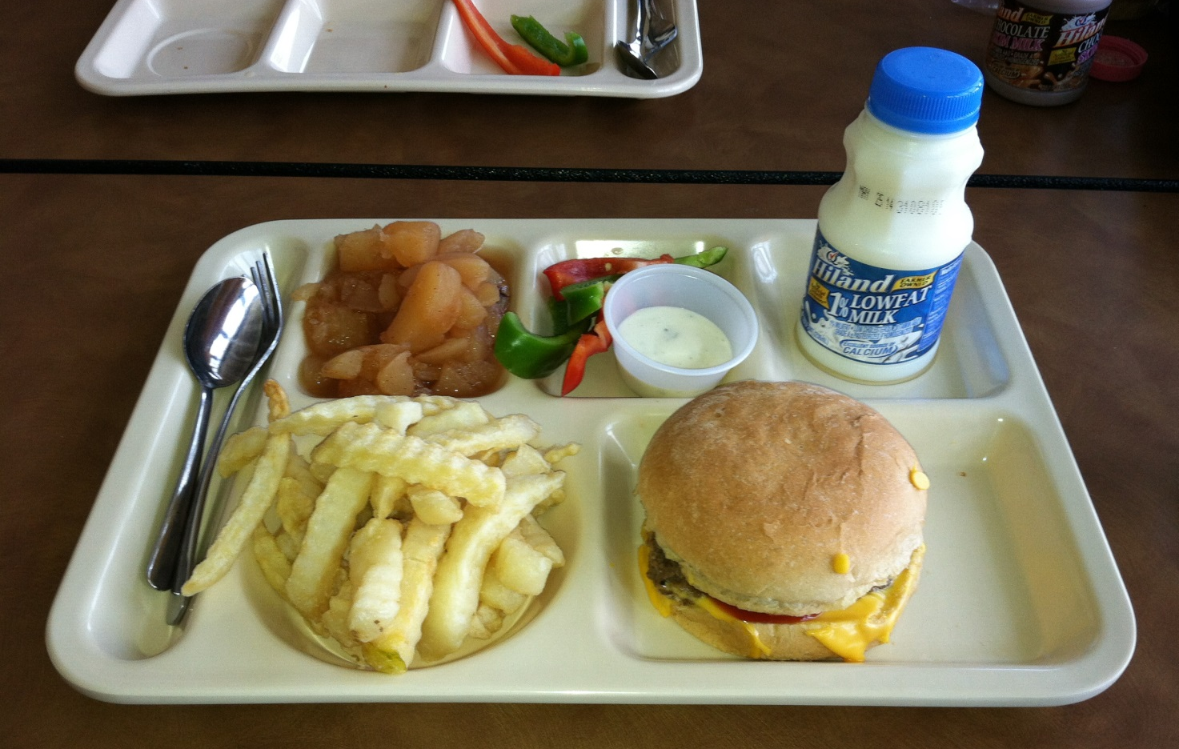

Slide 6


Slide 7
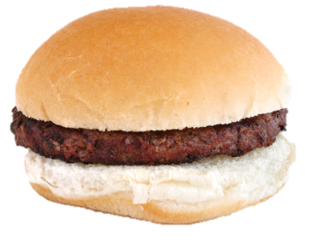
Hamburger
Where did it come from?

Slide 8
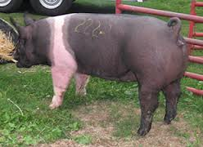
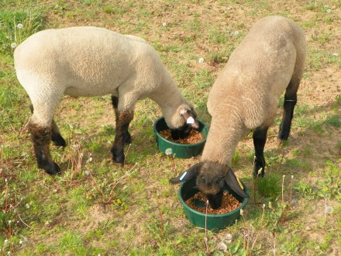
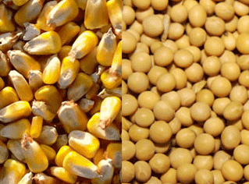
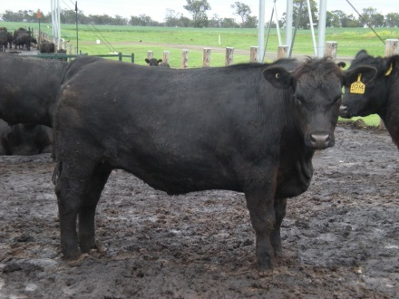
Hamburger
Pigs (Pork)?
Sheep (Lamb)?
Corn & Soybeans?
Beef (Beef)?

Slide 9
Hamburger
NO
Pigs (Pork)?
Sheep (Lamb)?
Corn & Soybeans?
Beef (Beef)?

Slide 10
Hamburger
NO
NO
Pigs (Pork)?
Sheep (Lamb)?
Corn & Soybeans?
Beef (Beef)?

Slide 11
Hamburger
NO
NO
NO
Pigs (Pork)?
Sheep (Lamb)?
Corn & Soybeans?
Beef (Beef)?

Slide 12
Hamburger
YES
NO
NO
NO
Pigs (Pork)?
Sheep (Lamb)?
Corn & Soybeans?
Beef (Beef)

Slide 13
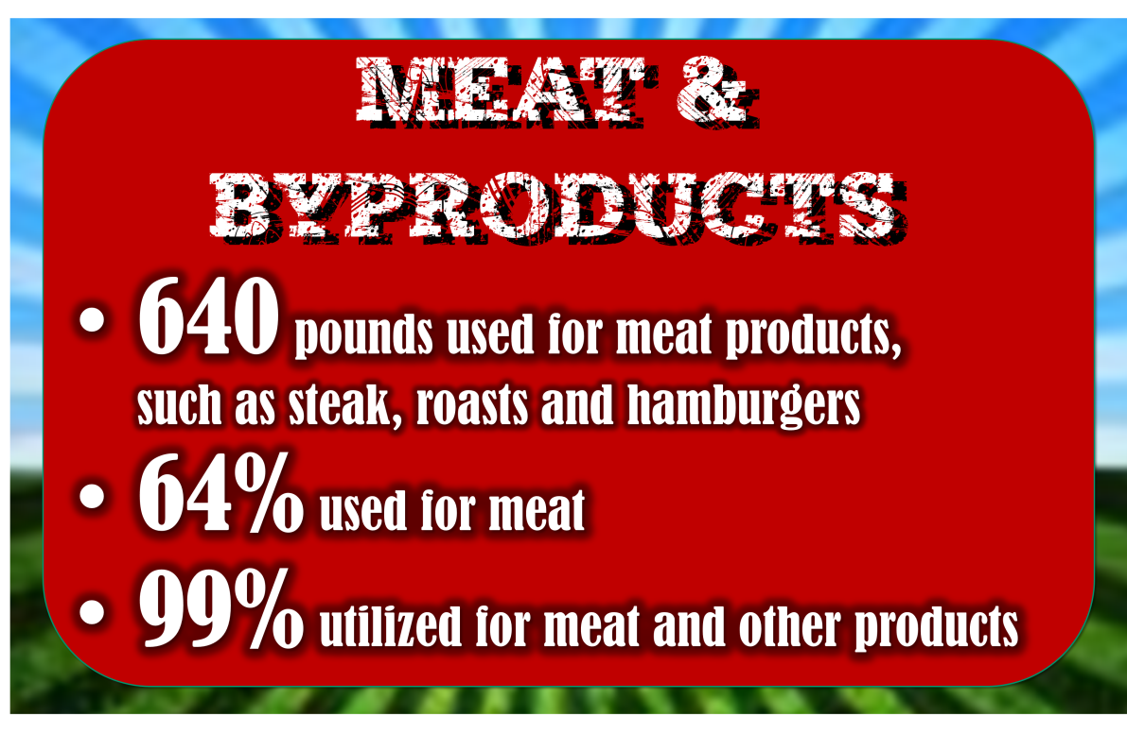

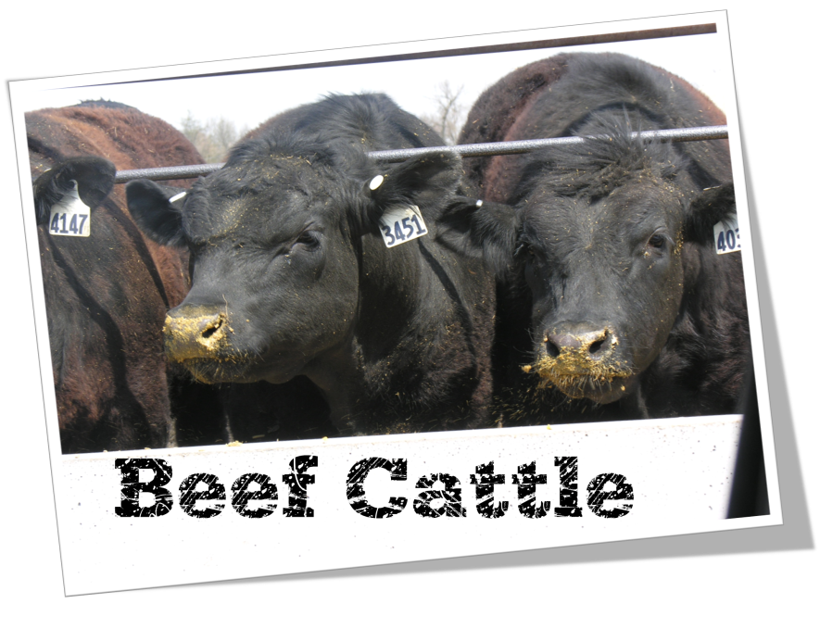








Notes:
Correct! We raise beef cattle for the primary purpose of producing MEAT. We raise dairy cattle for the primary purpose of producing MILK. We are able to get milk and meat from both dairy and beef animals, but what I want you to understand is that every animal has a purpose and for these two animals, they each have a very special purpose.

Slide 14
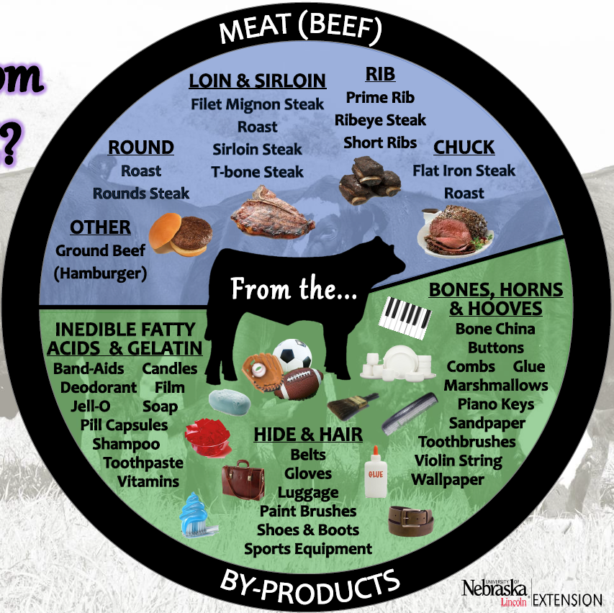

What
Comes
from

Slide 15


FROM PASTURE TO PLATE
A safe food product

Slide 16
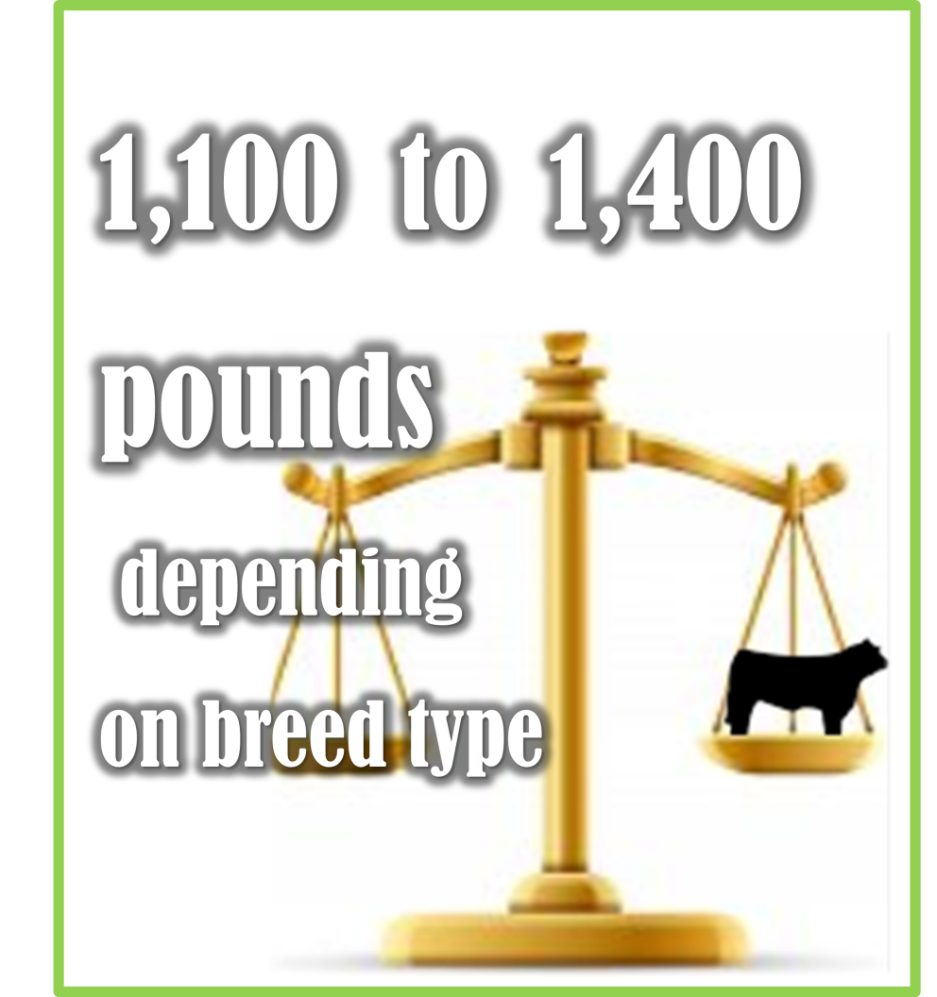

FROM PASTURE TO PLATE
A safe food product

Slide 17
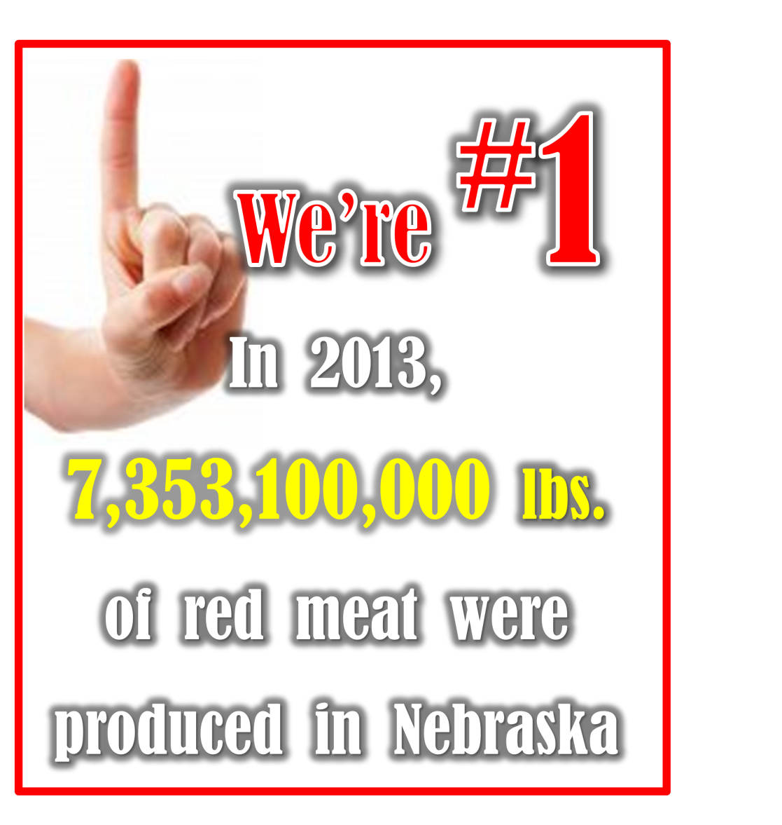
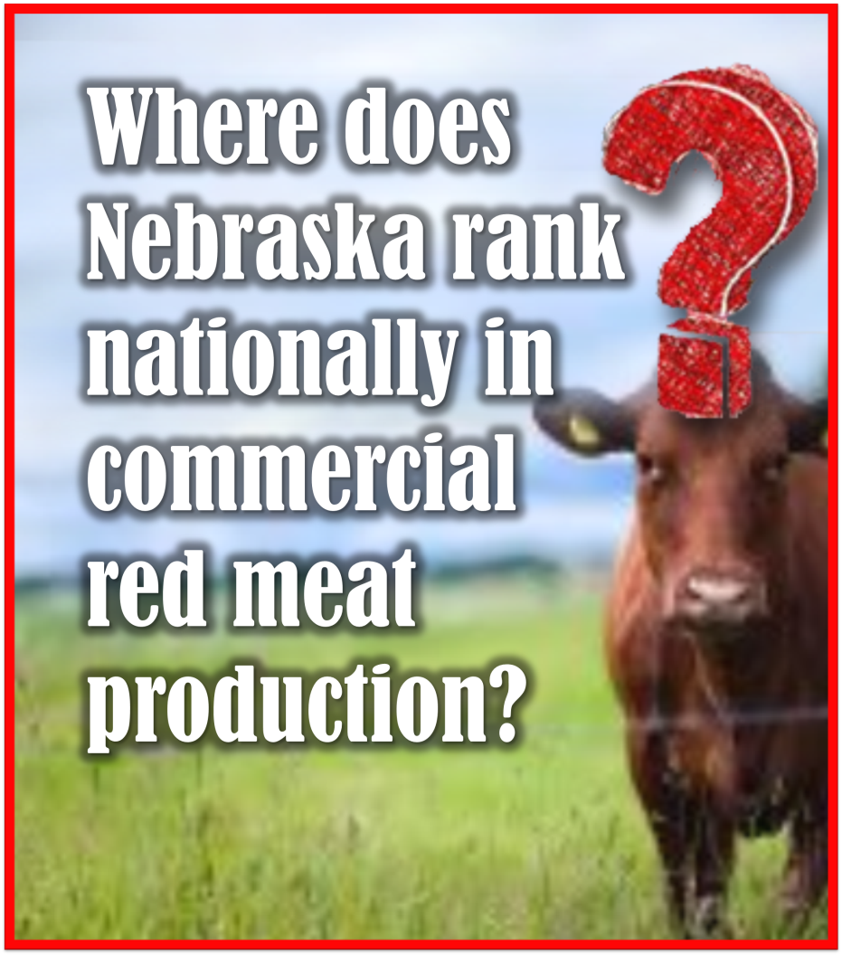
FROM PASTURE TO PLATE
A safe food product

Slide 18
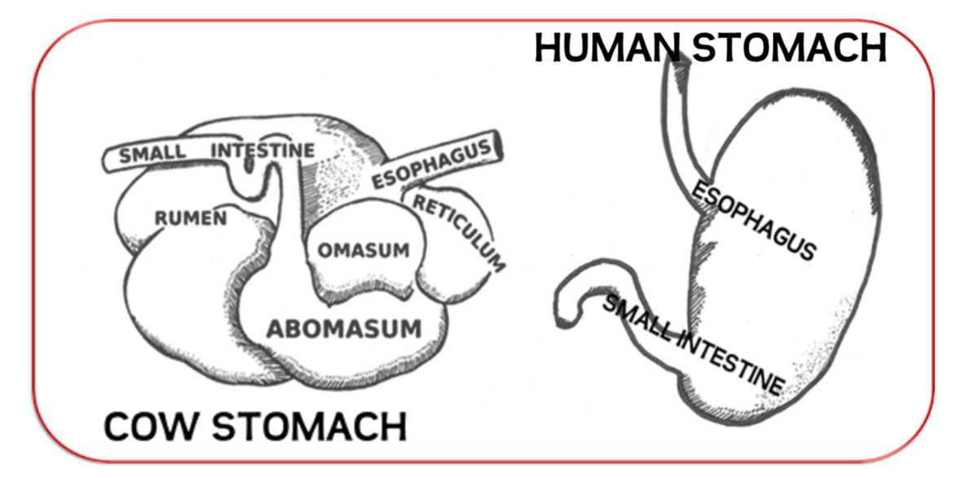
Ruminant
vs
Single Stomach
There is almost 23 million acres of rangeland and pastureland in Nebraska.
NOTE: An acre is about the
size of a football field.

Slide 19

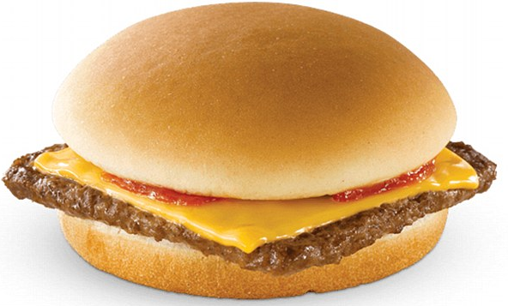
Milk
Cheese
Where do these come from?

Slide 20


Slide 21

From FARM
to You
The Story of Milk Video
C:\MY DOCUMENTS - Tracy\Ag Literary - STATE Festivals & Resources\Dairy\MIDWEST_DAIRY_YOUTH_VIDEO\VIDEO_TS

Slide 22
Bun
Where did it come from?

Slide 23
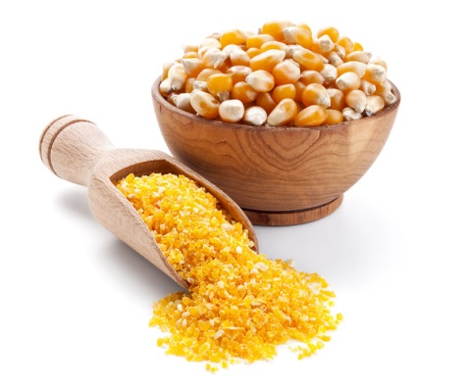
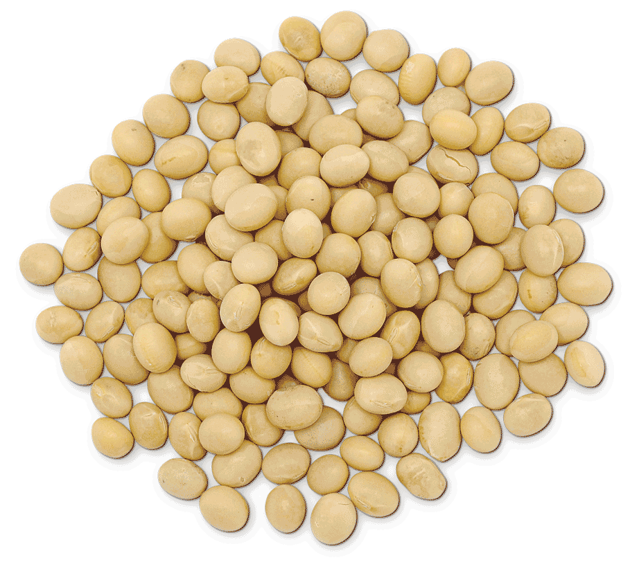
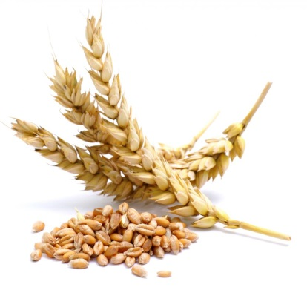
Bun
Corn
Soybeans
Wheat

Slide 24
Bun
NO
Corn
Soybeans
Wheat

Slide 25
Bun
NO
NO
Corn
Soybeans
Wheat

Slide 26
Bun
YES
NO
NO
Corn
Soybeans
Wheat

Slide 27

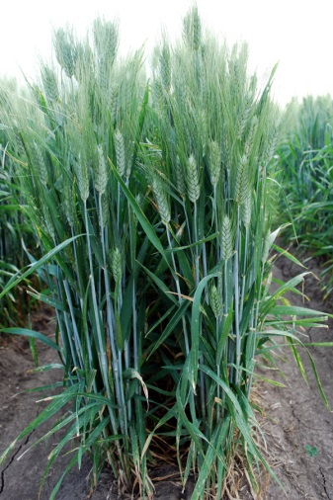
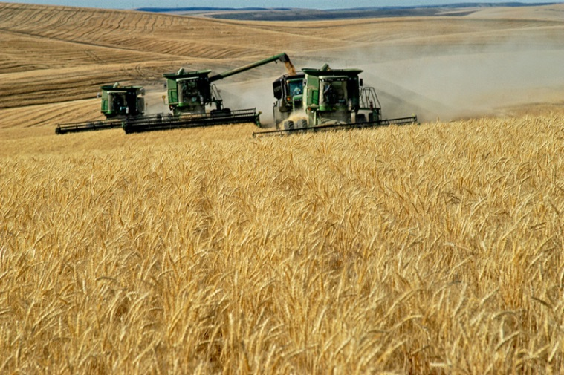
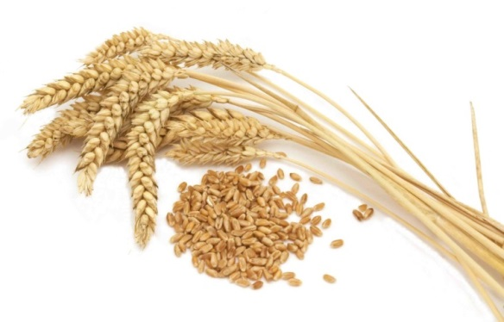
What About Wheat
Wheat comes from a PLANT.
Wheat is a GRAIN.
Other things that are made from WHEAT:
Bread
Baked Goods
Pizza Crust
Pasta
Cereals

Slide 28
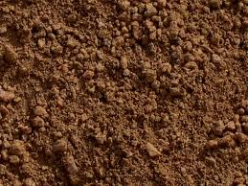
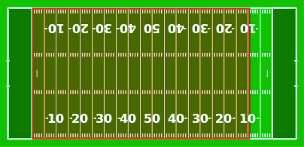
HOW BIG IS AN ACRE?
43,560 square feet
Almost the size of a football field. Outlined in RED.

Slide 29

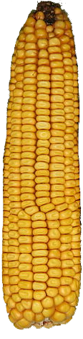
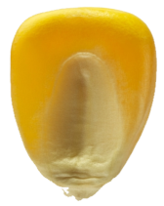


Corn
Soybeans
95 million acres planted in USA
76 million acres planted in USA
9.1 million acres planted in Nebr.
5 million acres planted in Nebr.
Planted
Late April to Mid-May
30,000 seeds
per acre
Planted
Mid-May to Mid-June
150,000 seeds
per acre
Harvested in
September-October
Harvested in
September-October

Slide 30
Control weeds & fertilize
Get the soil ready to plant
Plant
Control weeds and insects
Irrigate
Harvest
Sell, store, or make the crop into food and byproducts
Crops release oxygen into the atmosphere that is used by people and animals.
Soil is the
“grocery store”.
It is where the roots absorb nutrients & water.
Crops need
sunlight, water, nutrients, and carbon dioxide
to grow.
$ - Land, Taxes, Equipment, Fuel, Labor, Insurance, Chemicals, Irrigation, Fertilizer, Seed

Slide 31
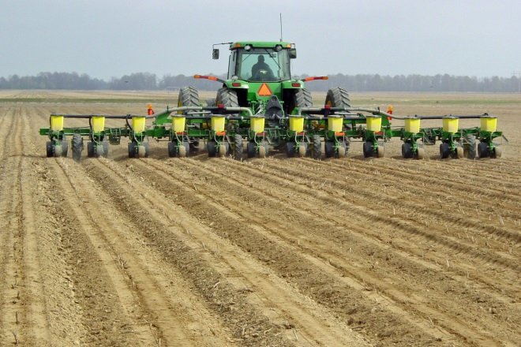
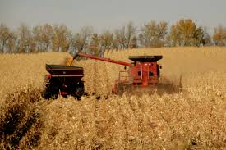
PLANTING CORN
https://www.youtube.com/watch?v=LVVktzvCF50
HARVESTING CORN
https://www.youtube.com/watch?v=CxxEaOw6gZU

Slide 32
Nebraska Ag Facts
CORN
3rd largest corn producing state in the United States.
Farmers are producing 6X more corn than in the 1920s.
9.1 million acres in corn production.
SOYBEANS
5th largest soybean producer in the United States
Soybean production generates $2 billion annually, making soybeans the second leading crop in Nebraska, next to corn.
WHEAT
12th largest wheat producer in the United States
1.5 million acres in wheat production

Slide 33

French Fries
Where do they come from?

Slide 34
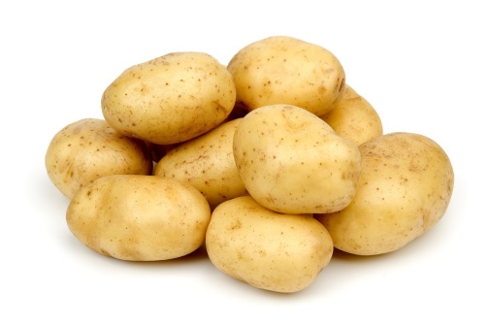
Potatoes

Slide 35
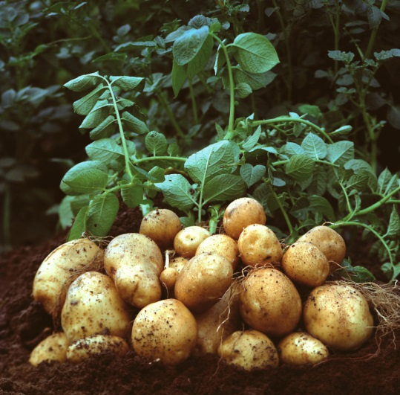
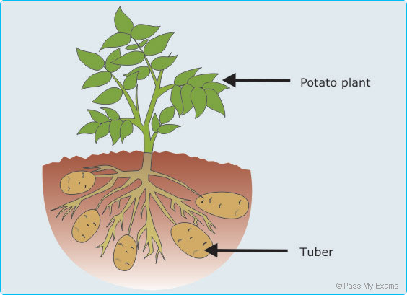
What About Potatoes
Potatoes come from a PLANT.
Potatoes are VEGETABLES.
Mashed, Baked & Roasted
Potato Chips
Hash Browns
Potato Wedges
Tater Tots
Soup
Other ways to eat POTATOES:

Slide 36
Harvesting Potatoes
https://www.youtube.com/watch?v=1-SPuIpsaSs

Slide 37

Peppers for Lunch

Slide 38
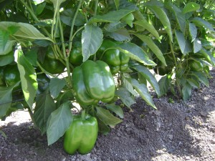
What About Peppers
Peppers come from a PLANT.
Peppers are VEGETABLES.

Slide 40
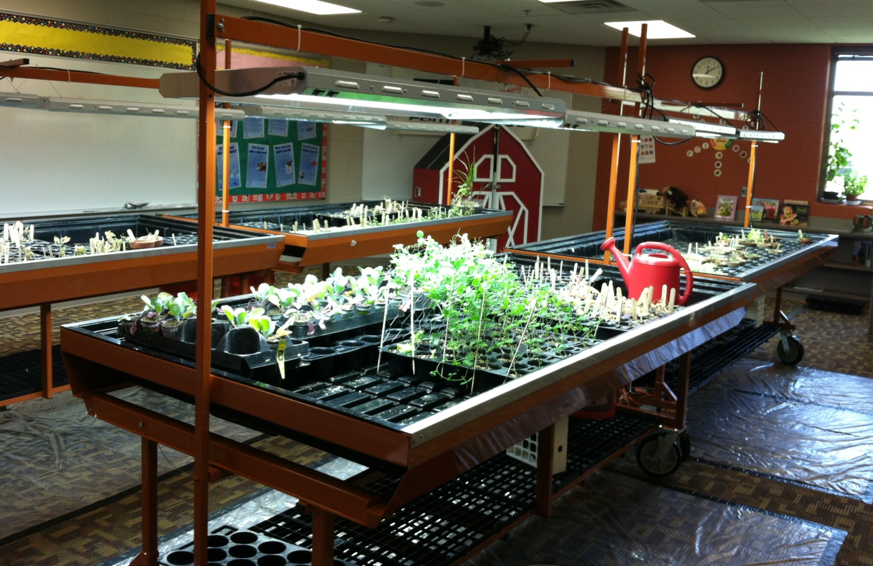

Slide 41
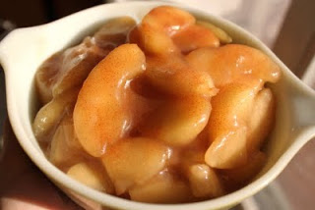
Baked APPLES for Lunch

Slide 42
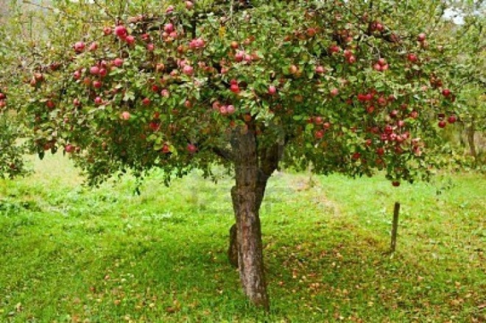
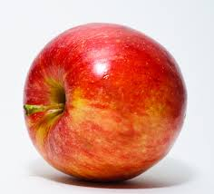
What About Apples
Apples come from a tree (plant).
Apples are FRUIT.

Slide 43
Nebraska Ag Facts
POTATOES
10th-20th in potato production In United States.
Planted about 20,000 acres with a value of $80.5 million.
Native to the Americas, leading the list of popular vegetables.
Average American eats 130 pounds of potatoes a year including 30 pounds of French Fries and 6 pounds of potato chips.
FRUITS & VEGETABLES
Requires special equipment, a lot of people, and a lot of information to make a profit (money).
Sell at farmers’ markets, roadside stands, U-pick operations and/or through wholesale and/or retail outlets.
Growers have increased from 78 in 2000 to 552 in 2011.
In Nebraska - over 80 farmers’ markets, nearly 290 roadside stands, and approximately 55 U-pick operations.

Slide 44
What is for snacks?

Slide 45
MILK
from Prairieland Dairy
&
POPCORN
from Just Pop’d Popcorn

Slide 46
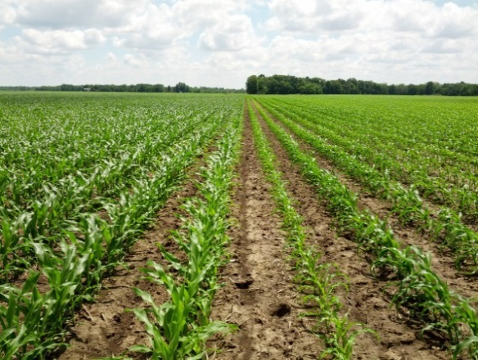
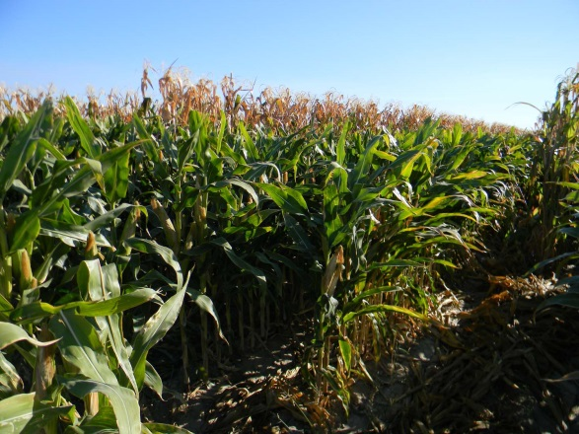
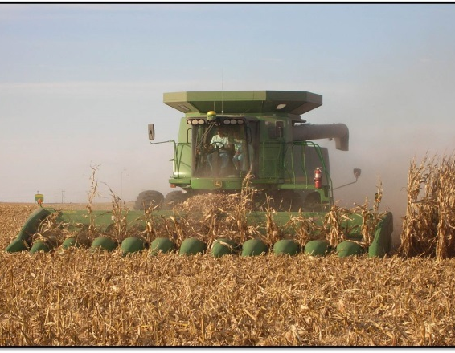
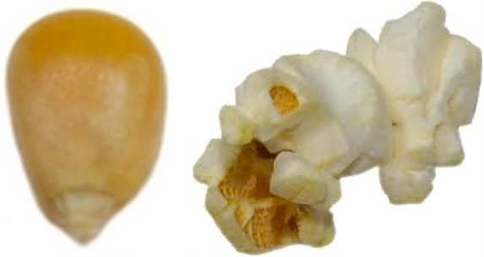
What About Popcorn
Popcorn comes from a PLANT.
Popcorn is a GRAIN.
Nebraska is 1st in popcorn production in the United States!

Slide 47
WORLD POPULATION
Today = 7 Billion People
2050 = 9 Billion People
Where does your food come from?
AGRICULTURE!
AGRICULTURE is the largest industry in Nebraska.
Nebraska AGRICULTURE helps feed the world.
Farmers raise crops and/or livestock to make a profit so that they can feed the world.

Slide 48
Now you know!

