Slide 1
Dawson County 4-H Annual Achievement Application Workshop
July 21, 2021

Slide 2
Agenda
Welcome!
Background for change to the Achievement Application
Moving Forward
Introduction to the Application
Dawson County Achievement Application Components
Livestock Premiums
Outstanding Junior Leader
Judging
Documents
https://extension.unl.edu/statewide/dawson/dawson-county-4-h-annual-achievement-application/
Notes:
The 4-H Incentives and Awards Program begins with you as a 4-H youth doing your best and recording your accomplishments.
In order to be considered by the 4-H Council, you must submit the Nebraska 4-H Annual Achievement Application to the Dawson County Extension Office by October 4, 2021. No matter how fantastic your 4-H year may be, you are not considered unless you submit your 4-H Annual Achievement Application.

Slide 3
Background
2018 State Recognition Committee
Create an experience that is accessible to all delivery modes
(5 delivery modes: camping, after school, school enrichment, community club, special interest)
Create an experience that is applicable for future experiences
Looked at what other states were doing in North Central Region
Iowa, North Dakota, Minnesota
College Readiness
UNL Admission Personal Statement
Buffet Scholarship

Slide 4
Shift in Assessing Project Achievement
Micro-Reporting
List making
Narrative about experience
Notes:
The shift in assessing project achievement is going from micro reporting, exhaustive list making regarding participation, to a higher order narrative about the experience and learning that took place as a result of participation.
In our work we often say, “so, what” when we are reporting. We are encouraged to answer the so what and saw that these tools were also asking a similar question.

Slide 5
How will we move forward?
Achievement Applications will be used to compete for county and state awards
1.
2.
Two divisions of Dawson County competition: Junior (1/1/2008 to 12/31/2012) and Senior (1/1/2003 to 12/31/2007)
3.
Due date for county submission: October 4, 2021 before 5:00 p.m.
4.
All Incentives and Awards will use the Dawson County 4-H Annual Achievement Application
Notes:
The state awards are National 4-H Congress, National 4-H Conference, and State Scholarships.
The Nebraska 4-H Achievement Applications serve as an expansion of the 4-H Story from Career Portfolios.
They are intended for use by all 4-H members to document their annual achievements and continue to build their collective 4-H story.

Slide 6
Nebraska 4-H Achievement Application
Experience synthesizing information
Congruent with the expectations of college admissions, scholarship applications, and future employers
Can be an evolving narrative as it demonstrates change and growth
Notes:
Employers expect concise, accurate information that is reflective of your qualifications and achievements.

Slide 7
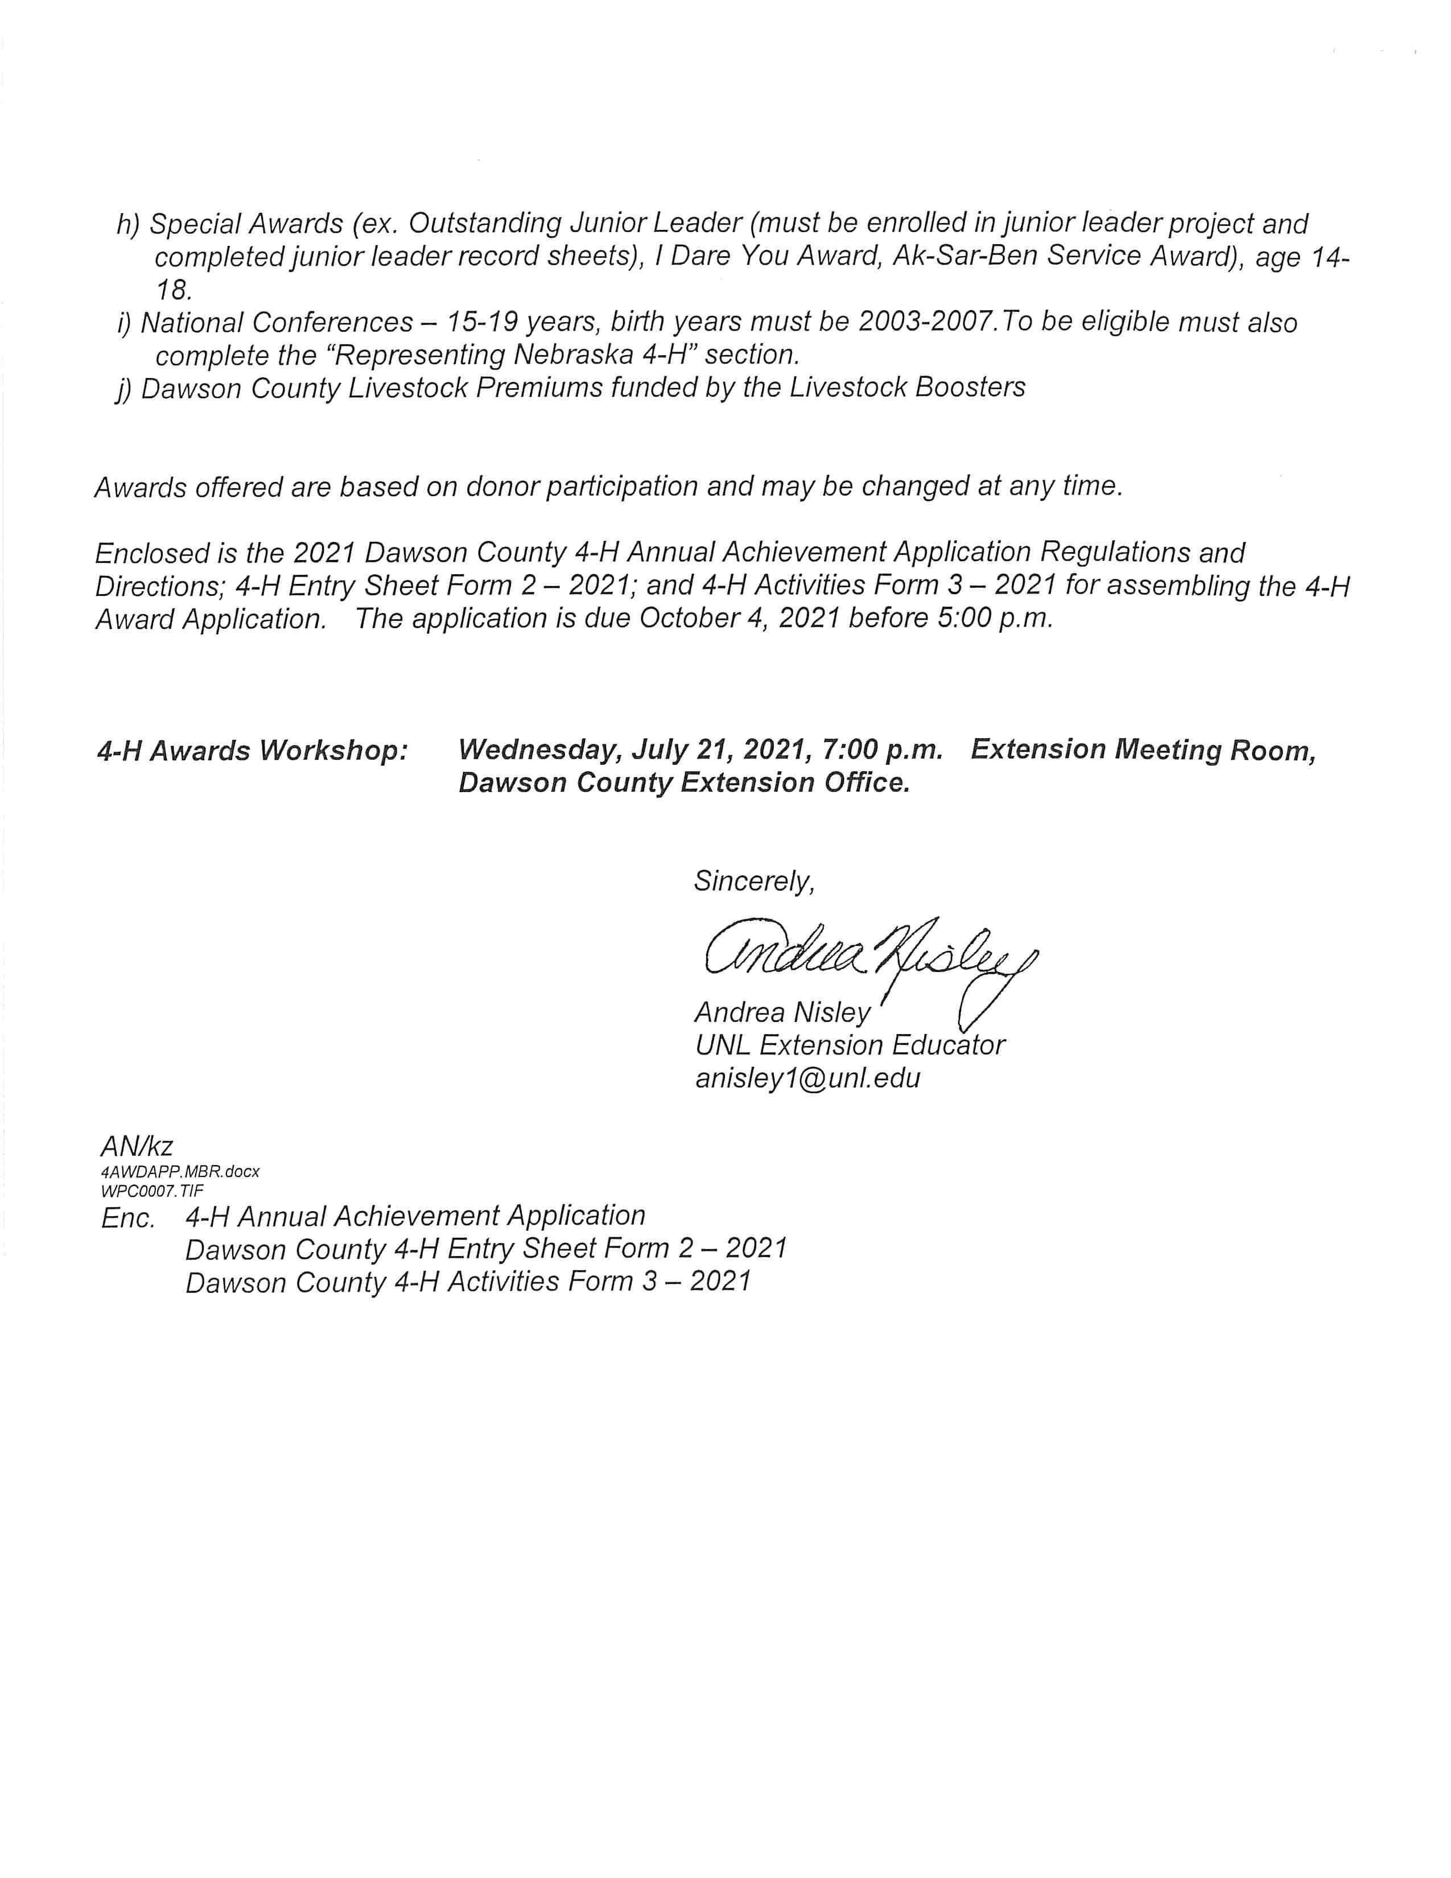
Dawson County 4-H Awards – Cover Letter
Notes:
The 4-H Incentives and Awards Program begins with you as a 4-H youth doing your best and recording your accomplishments.
The Dawson County 4-H Council selects 4-H'ers for awards. In order to be considered by the 4-H Council, you must submit the Nebraska 4-H Annual Achievement Application to the Dawson County Extension Office by October 4, 2021. No matter how fantastic your 4-H year may be you are not considered unless you submit your 4-H Annual Achievement Application.
The cover letter lists the awards that are available. The results will be announced at the 4-H Achievement Barbecue on Sunday, October 24th.

Slide 8
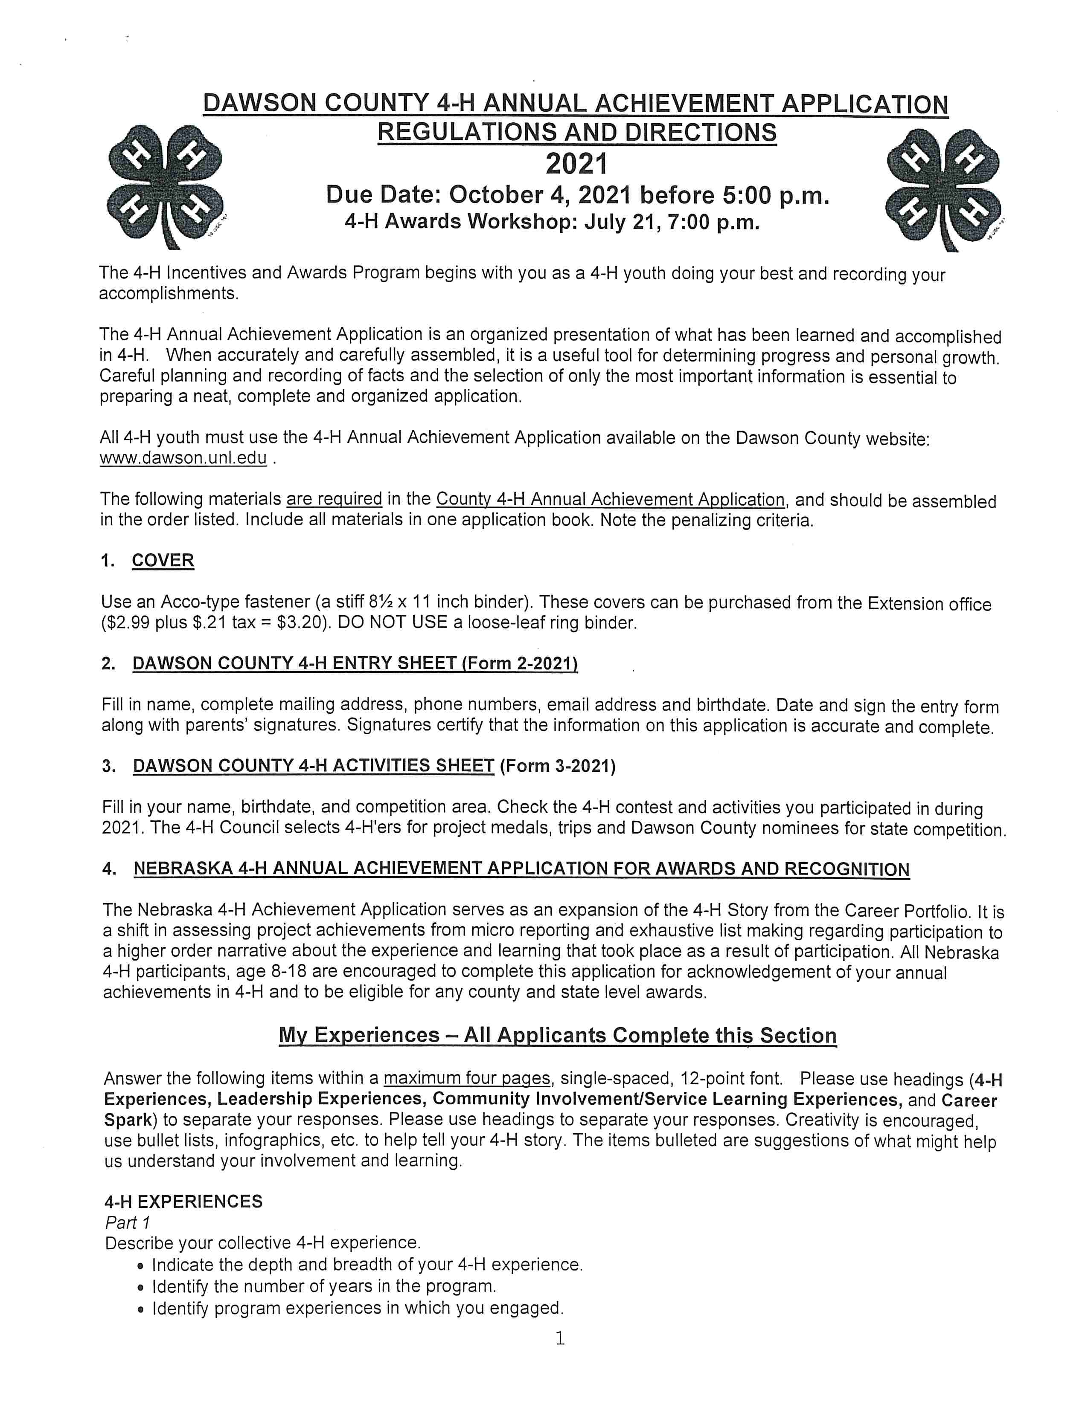
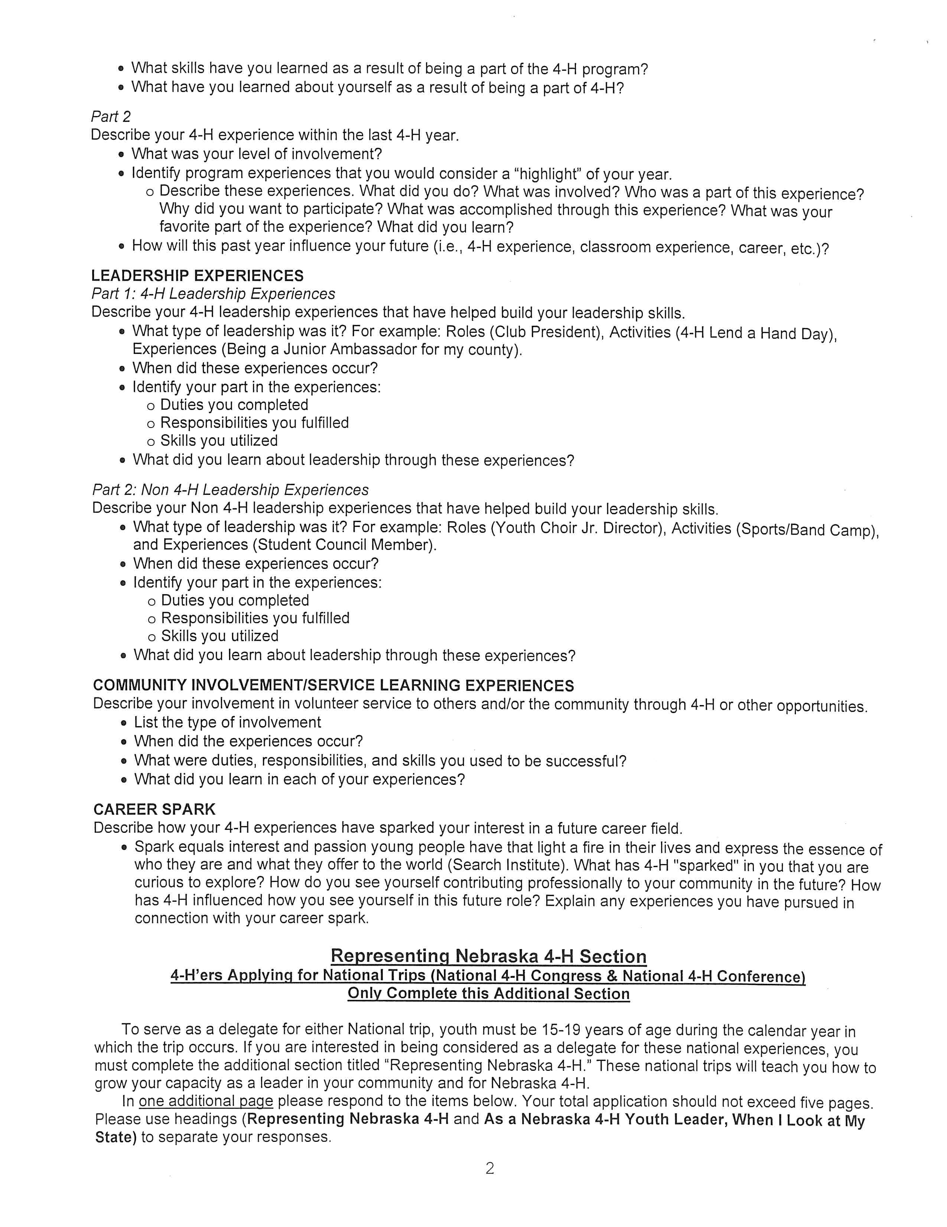
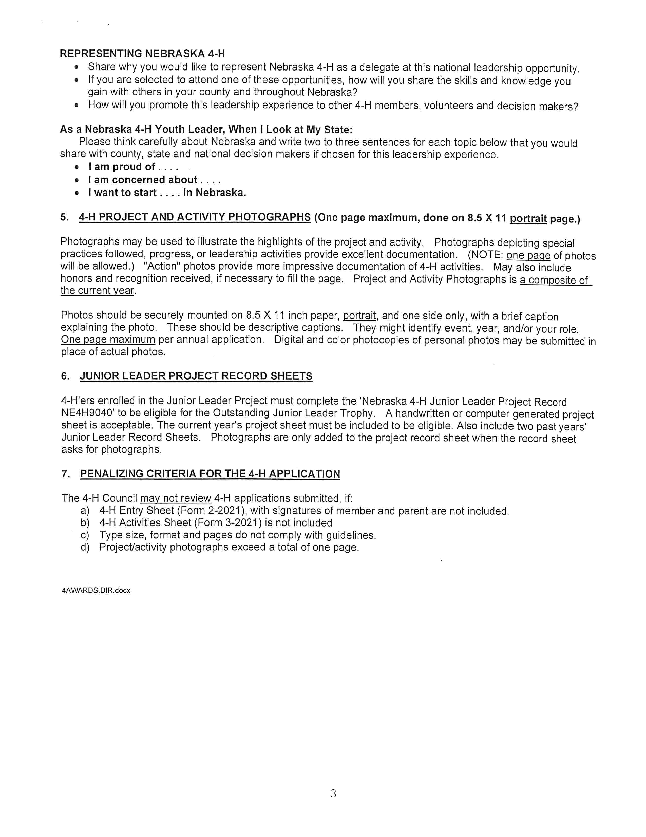
Dawson County 4-H Achievement Application Directions

Slide 9
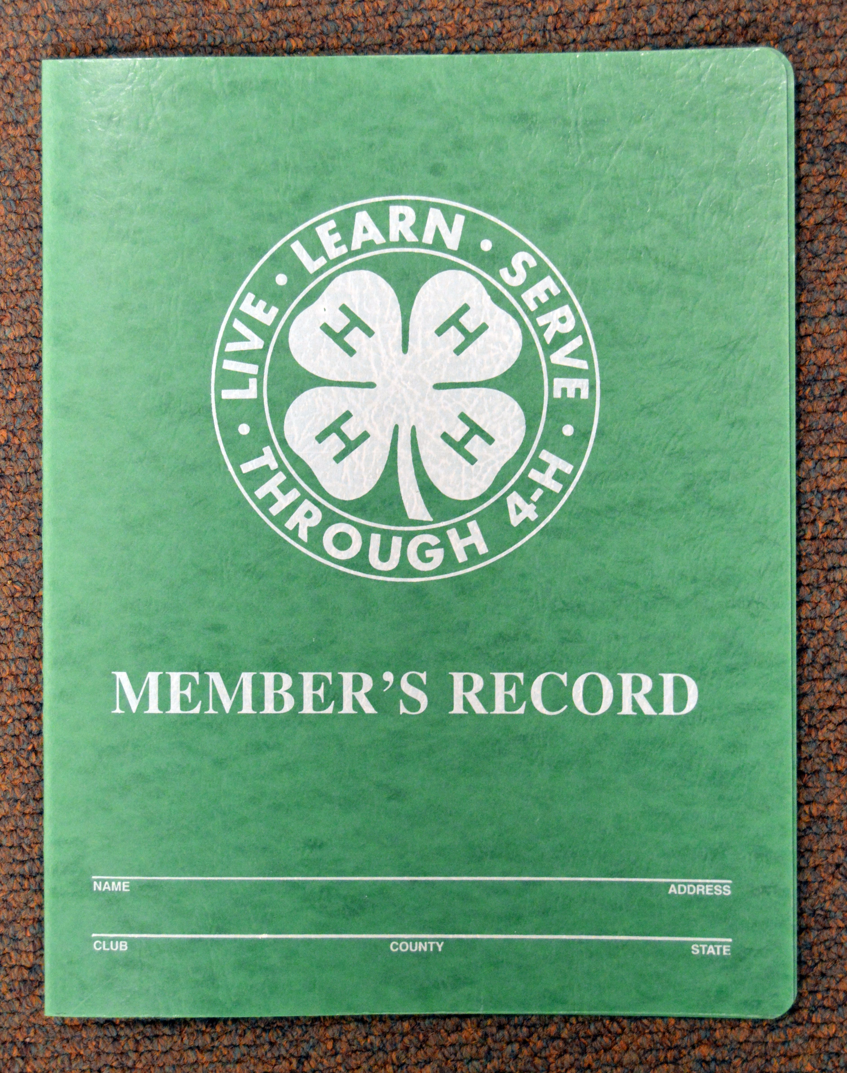
Cover
Use an Acco-type fastener
Purchased from the Extension Office
$2.99 plus tax = $3.20

Slide 10
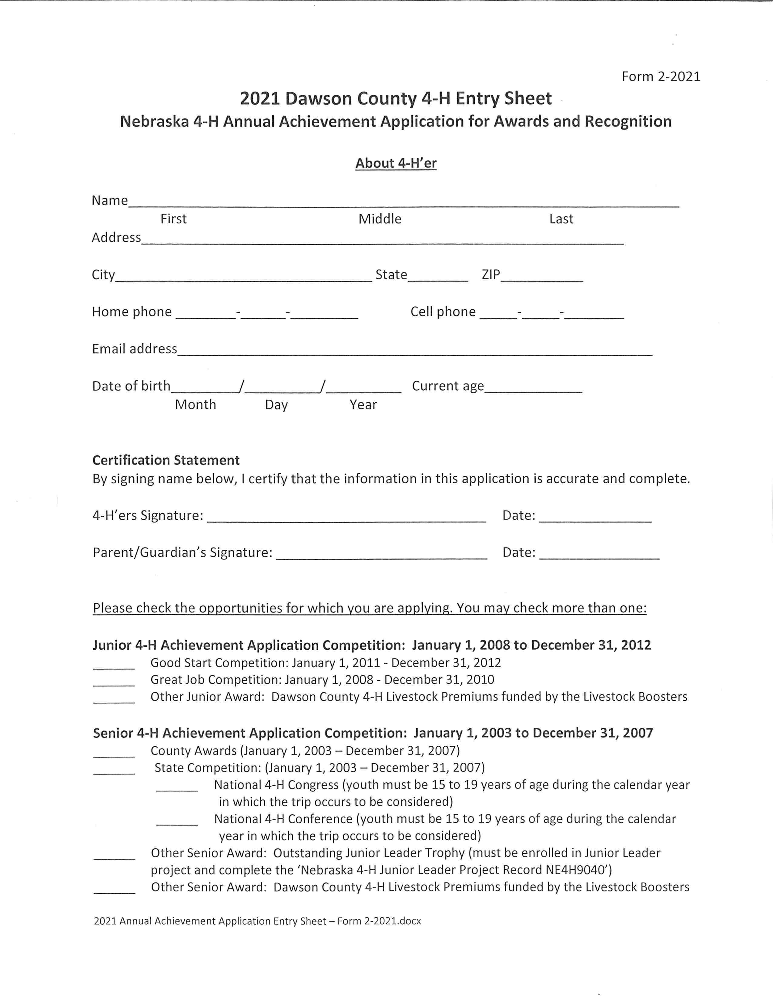
Dawson County 4-H Entry Sheet – Form 2-2021

Slide 11
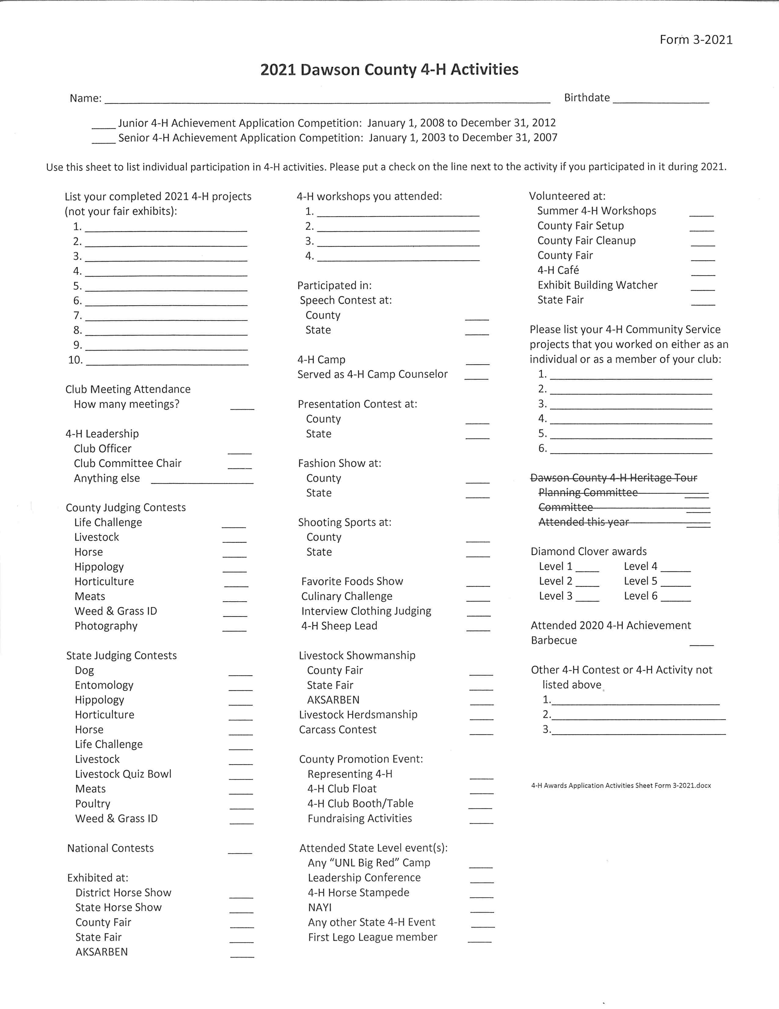
Dawson County 4-H Activities Sheet – Form 3-2021

Slide 12
Achievement Application Items for Response
My Experiences – All Applicants Complete this Section
4-H Experiences
Leadership Experiences
Community Involvement/Service-Learning Experiences
Career Spark
Within the application, items are bulleted as suggestions of prompts that may help demonstrate achievement. These are not all required or mandated. They are suggestions to help organize thoughts and help youth on responding to experience as opposed to reporting to checklists.
Notes:
All 4-H’ers will respond to the same items in the My Experiences section. They are:
4-H Experiences
Leadership Experiences
Community Involvement/Service-Learning Experiences
Career Spark
Within the application, items are bulleted as suggestions of prompts that may help demonstrate achievement. These are not all required or mandated. They are suggestions to help organize thoughts and help you respond to experience as opposed to reporting to checklists.

Slide 13
4-H Experiences
Part 1
Part 2
Describe your collective 4-H experience.
Indicate the depth and breadth of your 4-H experience.
Identify the number of years in the program.
Identify program experiences in which you engaged.
What skills have you learned as a result of being a part of the 4-H program?
What have you learned about yourself as a result of being a part of 4-H?
Describe your 4-H experience within the last 4-H year.
What was your level of involvement?
Identify program experiences that you would consider a “highlight” of your year.
Describe these experiences. What did you do? What was involved? Who was a part of this experience? Why did you want to participate? What was accomplished through this experience? What was your favorite part of the experience? What did you learn?
How will this past year influence your future (i.e., 4-H experience, classroom experience, career, etc.)?
Notes:
Part 1 focuses on the 4-H members total 4-H experience.
Should reflect the extent to which you participated in 4-H or a project area, how thoroughly you explored 4-H. Also includes your span of experiences or the extent of topics covered. Here is where they can communicate their longevity in the program and their change over time as they have interacted with 4-H.
Part 2 focuses on your 4-H Experiences that took place within the last year.
Explain why these are highlights and where you will go from here.

Slide 14
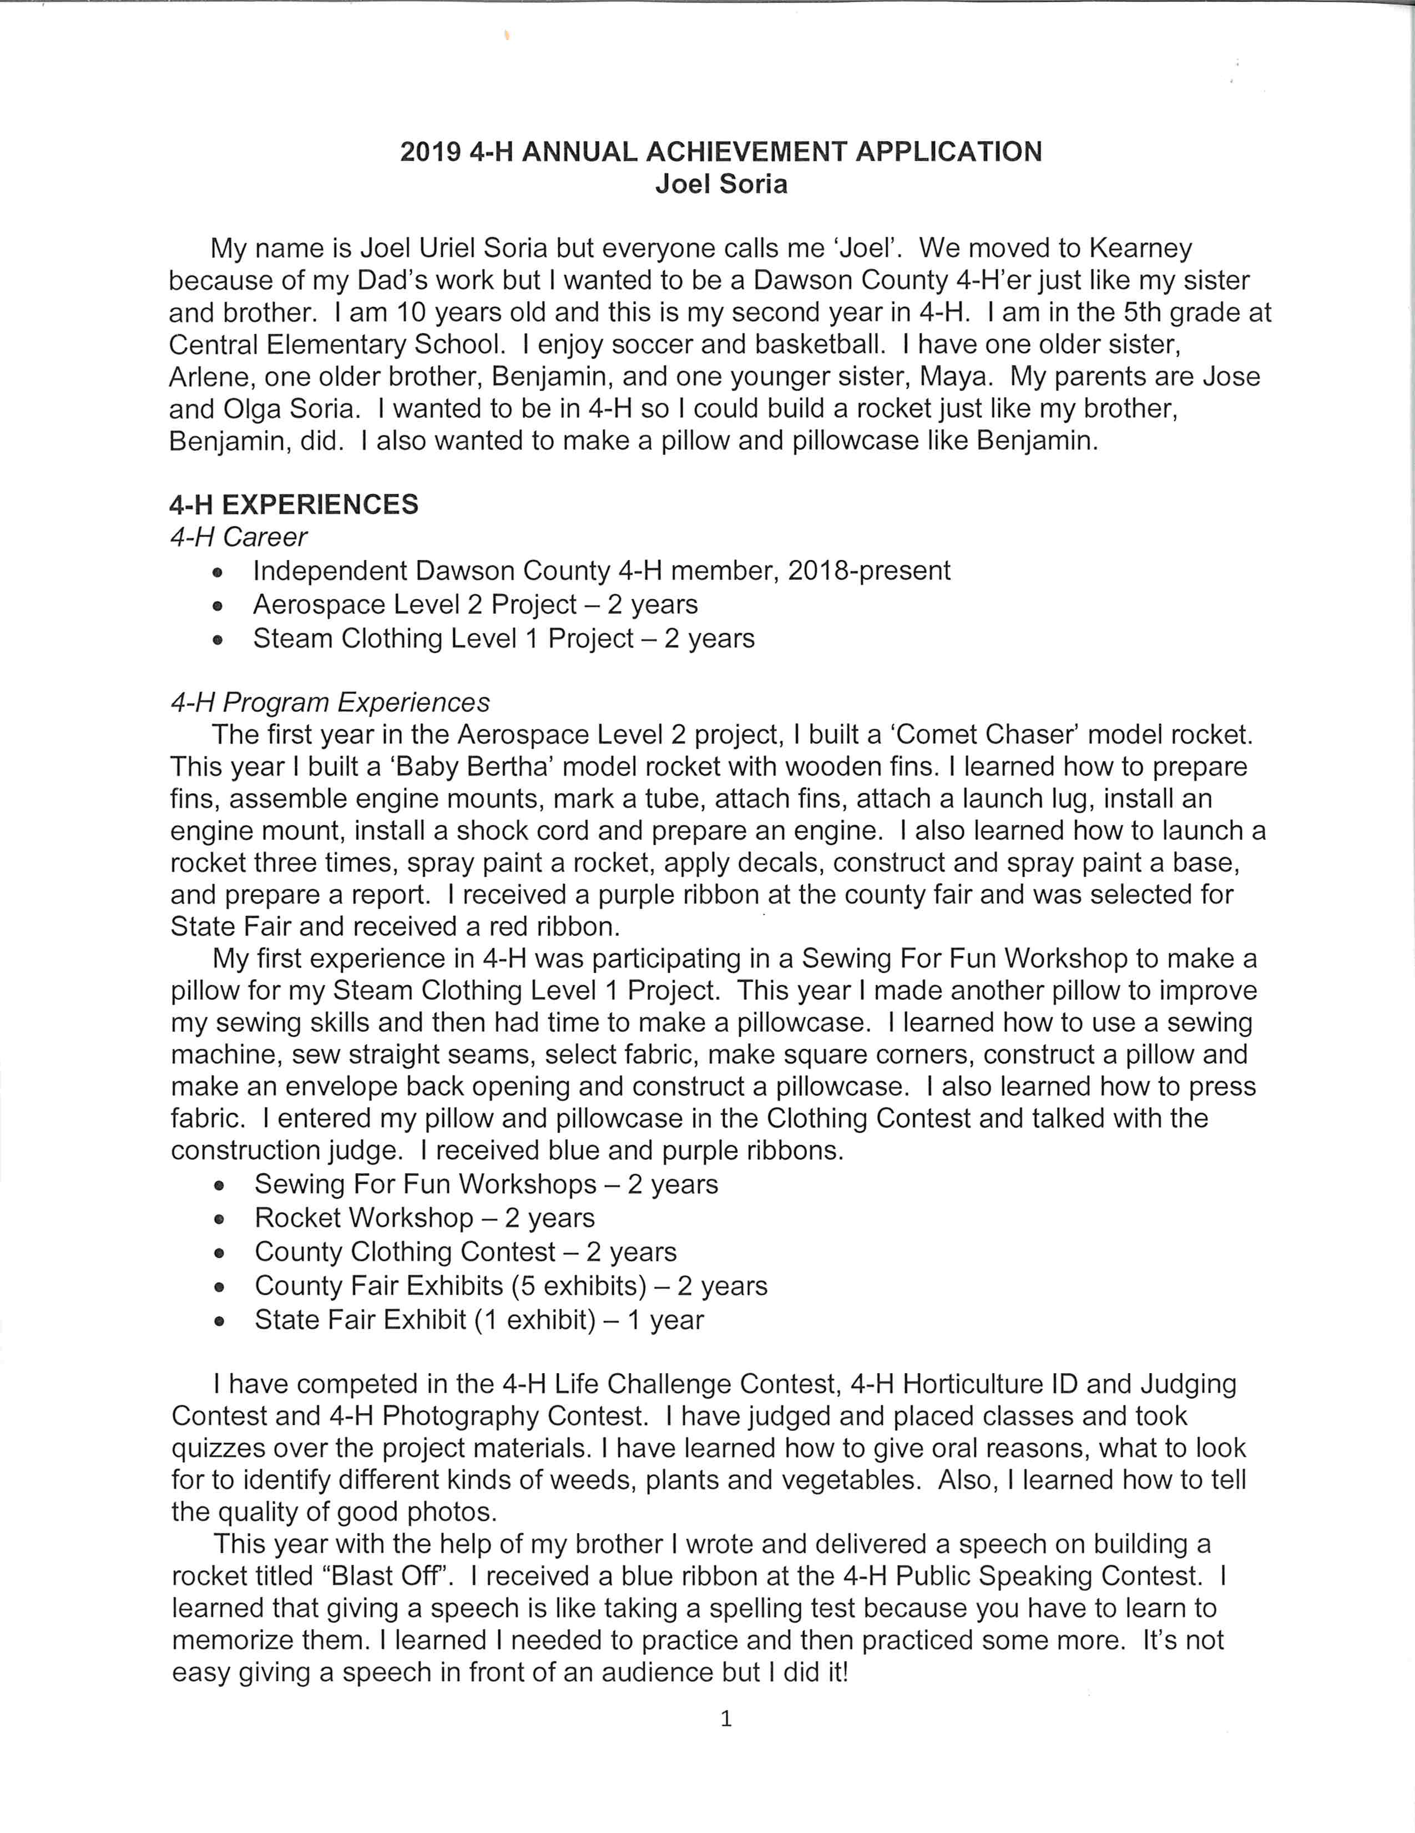
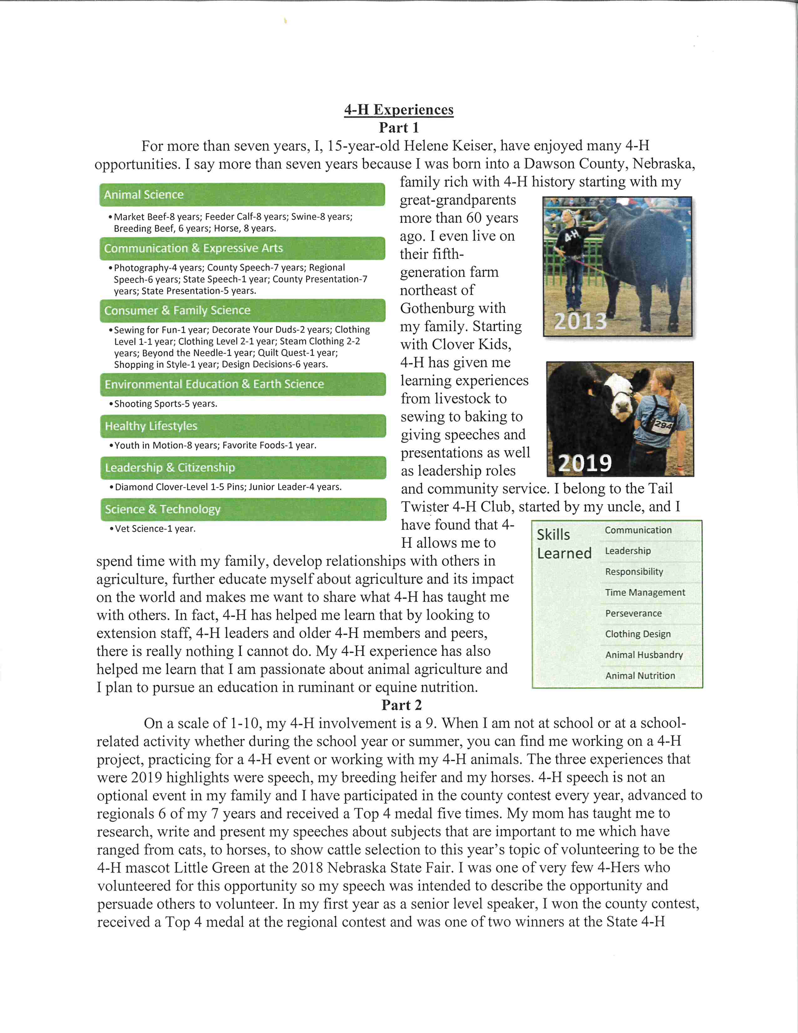
Example: 4-H Experiences, Part 1 & 2
Junior Division Example
Senior Division Example

Slide 15
Leadership Experiences
Part 1
Part 2
Describe your 4-H leadership experiences that have helped build your leadership skills.
What type of leadership was it?
For example: Roles (Club President), Activities (4-H Lend a Hand Day), Experiences (Being a Junior Ambassador for my county).
When did these experiences occur?
Identify your part in the experiences:
Duties you completed
Responsibilities you fulfilled
Skills you utilized
What did you learn about leadership through these experiences?
Describe your Non 4-H leadership experiences that have helped build your leadership skills.
What type of leadership was it?
For example: Roles (Youth Choir Jr. Director), Activities (Sports/Band Camp), and Experiences (Student Council Member).
When did these experiences occur?
Identify your part in the experiences:
Duties you completed
Responsibilities you fulfilled
Skills you utilized
What did you learn about leadership through these experiences?

Slide 16
Example: Non 4-H Leadership Experiences
One the most influential experiences that has helped me build my leadership skills has been being a part of the Worship Committee at my church.
As the only youth on the committee, I am responsible for sharing what music or scripture would be meaningful for youth to hear as they participate in worship. In order to be successful, I have really worked on developing my assertiveness and my listening skills. I meet monthly with the Worship Committee.
I have learned the following things about leadership:
Not being afraid to say your opinion, even if you are the youngest in the room
Asking my friends for their opinions before I attend meetings so I can represent them
Public speaking skills as I read scripture and welcome people to church
Leading worship services at my church
Notes:
This is an example of Non 4-H Leadership Experience

Slide 17
Community Involvement/ Service-Learning Experiences
Describe your involvement in volunteer service to others and/or the community through 4-H or other opportunities.
List the type of involvement
When did the experiences occur?
What were the duties, responsibilities, and skills you used to be successful?
What did you learn in each of your experiences?

Slide 18
Example: Community Involvement
Picking up trash may not seem like a fun way to spend Saturdays, but the members of my 4-H club love getting together every other month for trash clean up day in the Old Market. We have been doing this for the last year.
We compete to see who can fill up the most bags and what is the most unusual piece of trash we can find. I have learned to enjoy serving my community and that when we work together, jobs that may be boring become a lot more exciting. I have also learned that littering is the worst. If I ever did litter when I was younger, I never litter now!
I am ready to clean!
My 4-H club cleaning up the Old Market

Slide 19
Career Spark
Describe how your 4-H experiences have sparked your interest in a future career field.
Spark equals interests and passions young people have that light a fire in their lives and express the essence of who they are and what they offer to the world (Search Institute)
What has 4-H “sparked” in you that you are curious to explore?
How do you see yourself contributing professionally to your community in the future?
How has 4-H influenced how you see yourself in this future role professionally?
Explain any experiences you have pursued in connection with your career spark.

Slide 20
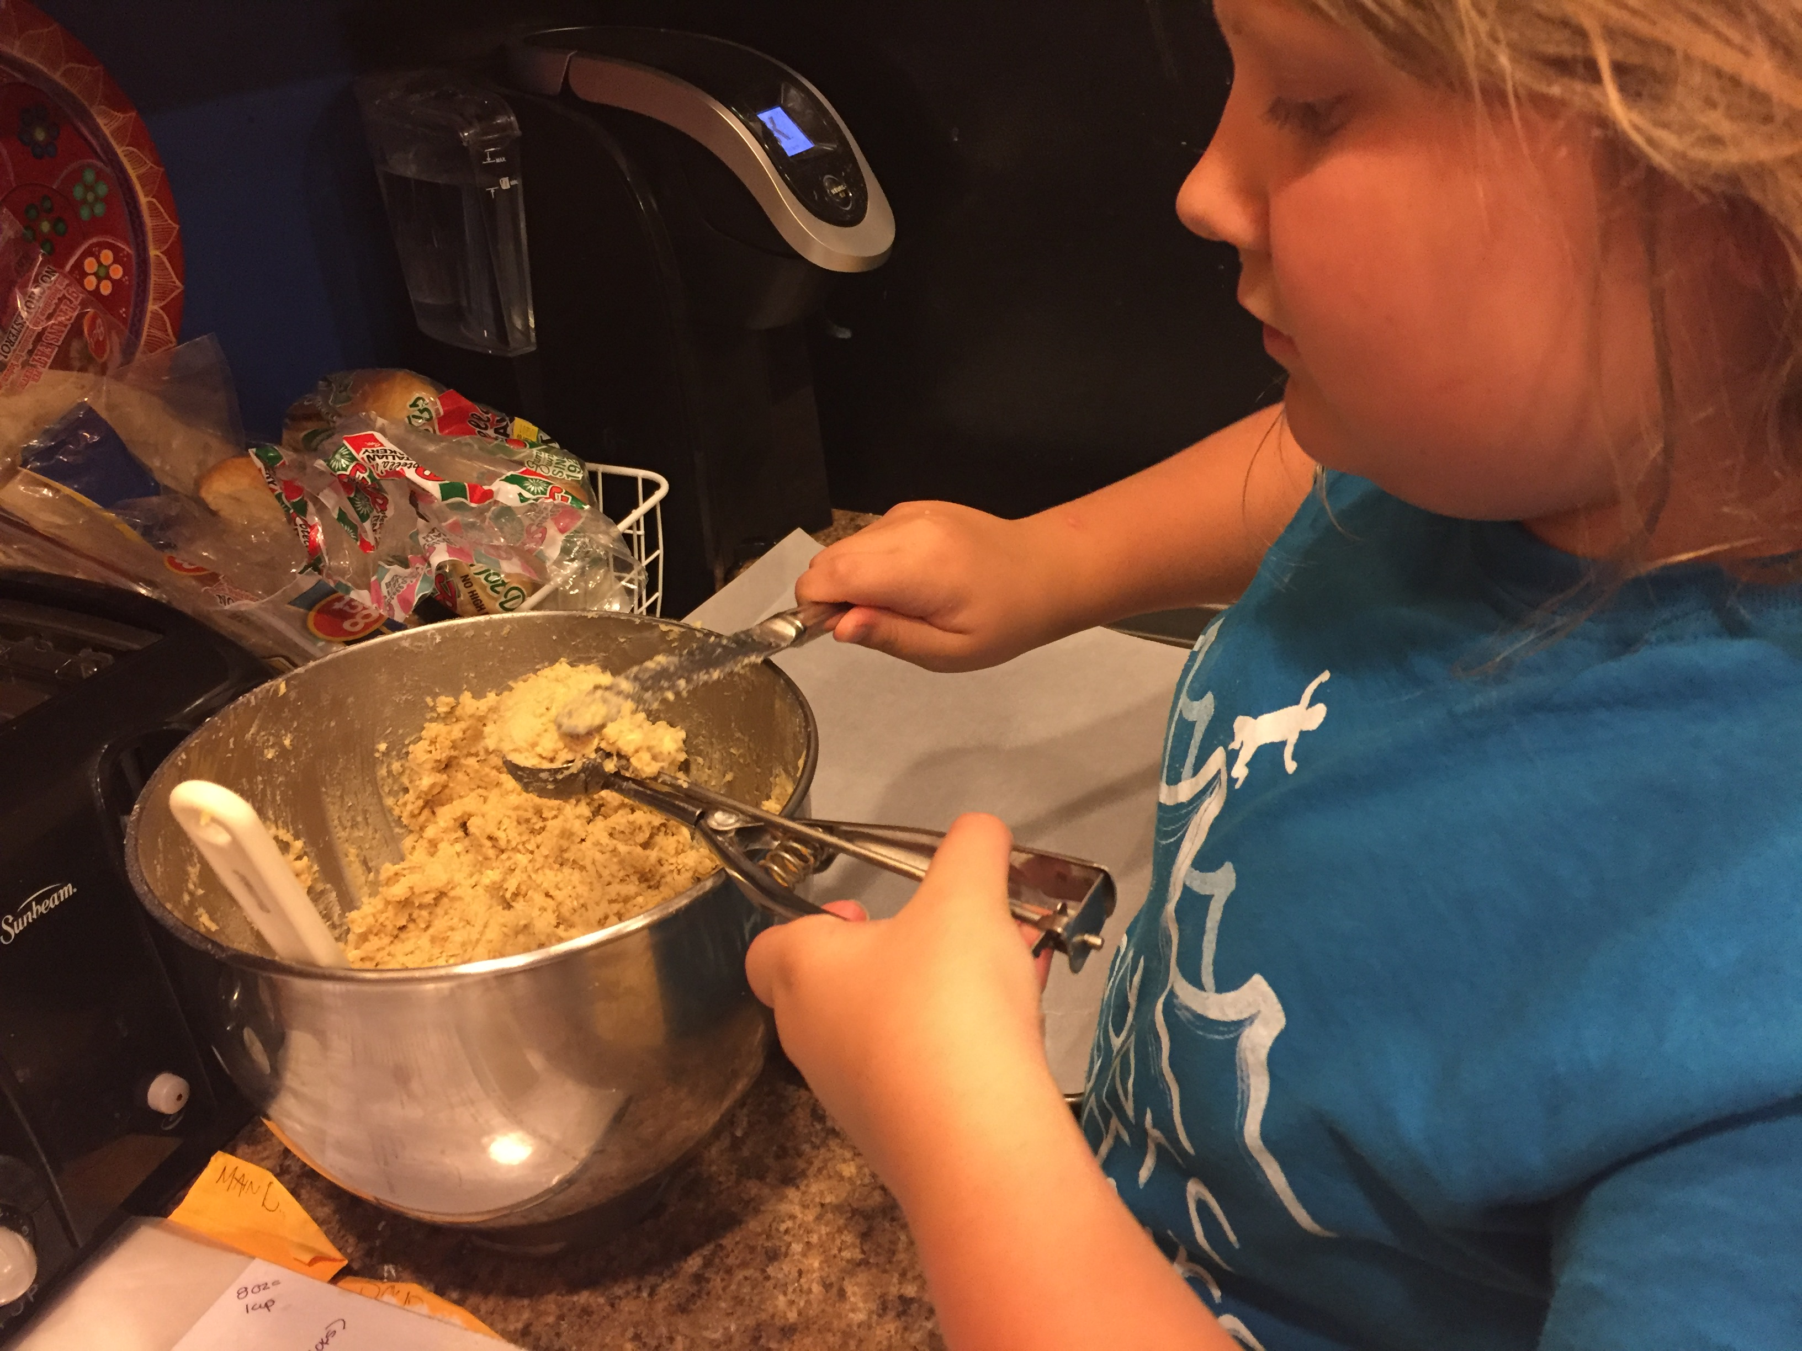
Example: Career Spark
My love for baking began in the 5th grade as I was working on mastering different cookie making techniques with 4-H. I have continued to learn new skills in baking, and have taken 10 projects to the state fair, earning all purple ribbons. As a result, I want to become a professional baker. Here is a list of things I am doing to follow my spark:
Enrolled in French at my school. I am learning the language because I want to study at Le Cordon Bleu in Paris, France after I earn a degree at UNL. Go Big Red!
Volunteer as a teen leader for food science camp at Metro Community College.
Plan on majoring in business at UNL because I want to be confident in my skills as an entrepreneur when I open my bakery.
My first summer mixing it up with baking!

Slide 21
Representing Nebraska 4-H Section
Only complete this additional section if applying for National 4-H Congress and National 4-H Conference
Must be 15-19 years of age during the calendar year in which the trip occurs
1 additional page
2 Headings
Representing Nebraska 4-H
Share why you would like to represent Nebraska 4-H as a delegate at this national leadership opportunity.
If you are selected to attend one of these opportunities, how will you share the skills and knowledge you gain with others in your county and throughout Nebraska?
How will you promote this leadership experience to other 4-H members, volunteers and decision makers?
As a Nebraska 4-H Youth Leader, When I Look at My State
I am proud of . . . I am concerned about . . . I want to start . . . in Nebraska
Applicants should
Write about their motivation for participating in a national opportunity
Write about how they will share their experiences
This is about understanding the why of guiding the youth to apply for this opportunity
Reflect the youth’s experiences and voice

Slide 22
Example: As a Nebraska 4-H youth leader, when I look at my state:
I am proud of the way people in my state come together to help each other in hard times. I was so inspired to see how adults and youth were willing to step up and give all they had to help victims of the flood.
I am concerned about the increased use of illegal drugs in my school. I am noticing more and more friends talking about illegal drugs as though they are no big deal and won’t impact their future. I am concerned more and more friends will start using drugs recreationally.
I want to start talking about how we can come together to decrease youth illegal drug use in Nebraska.

Slide 23
4-H Project and Activity Photographs
Photographs may be used to illustrate the highlights of the project and activity.
Photographs depicting special practices followed, progress, or leadership activities provide excellent documentation. "Action" photos provide more impressive documentation of 4-H activities. May also include honors and recognition received, if necessary to fill the page.
Project and activity photographs are a composite of the current year.
Photos should be securely mounted on 8.5 X 11 inch paper, portrait, and one side only, with a brief caption explaining the picture.
These should be descriptive captions. They might identify the event, year, and/or your role.
One page maximum per annual application. (NOTE: one page of photos will be allowed.)

Slide 24
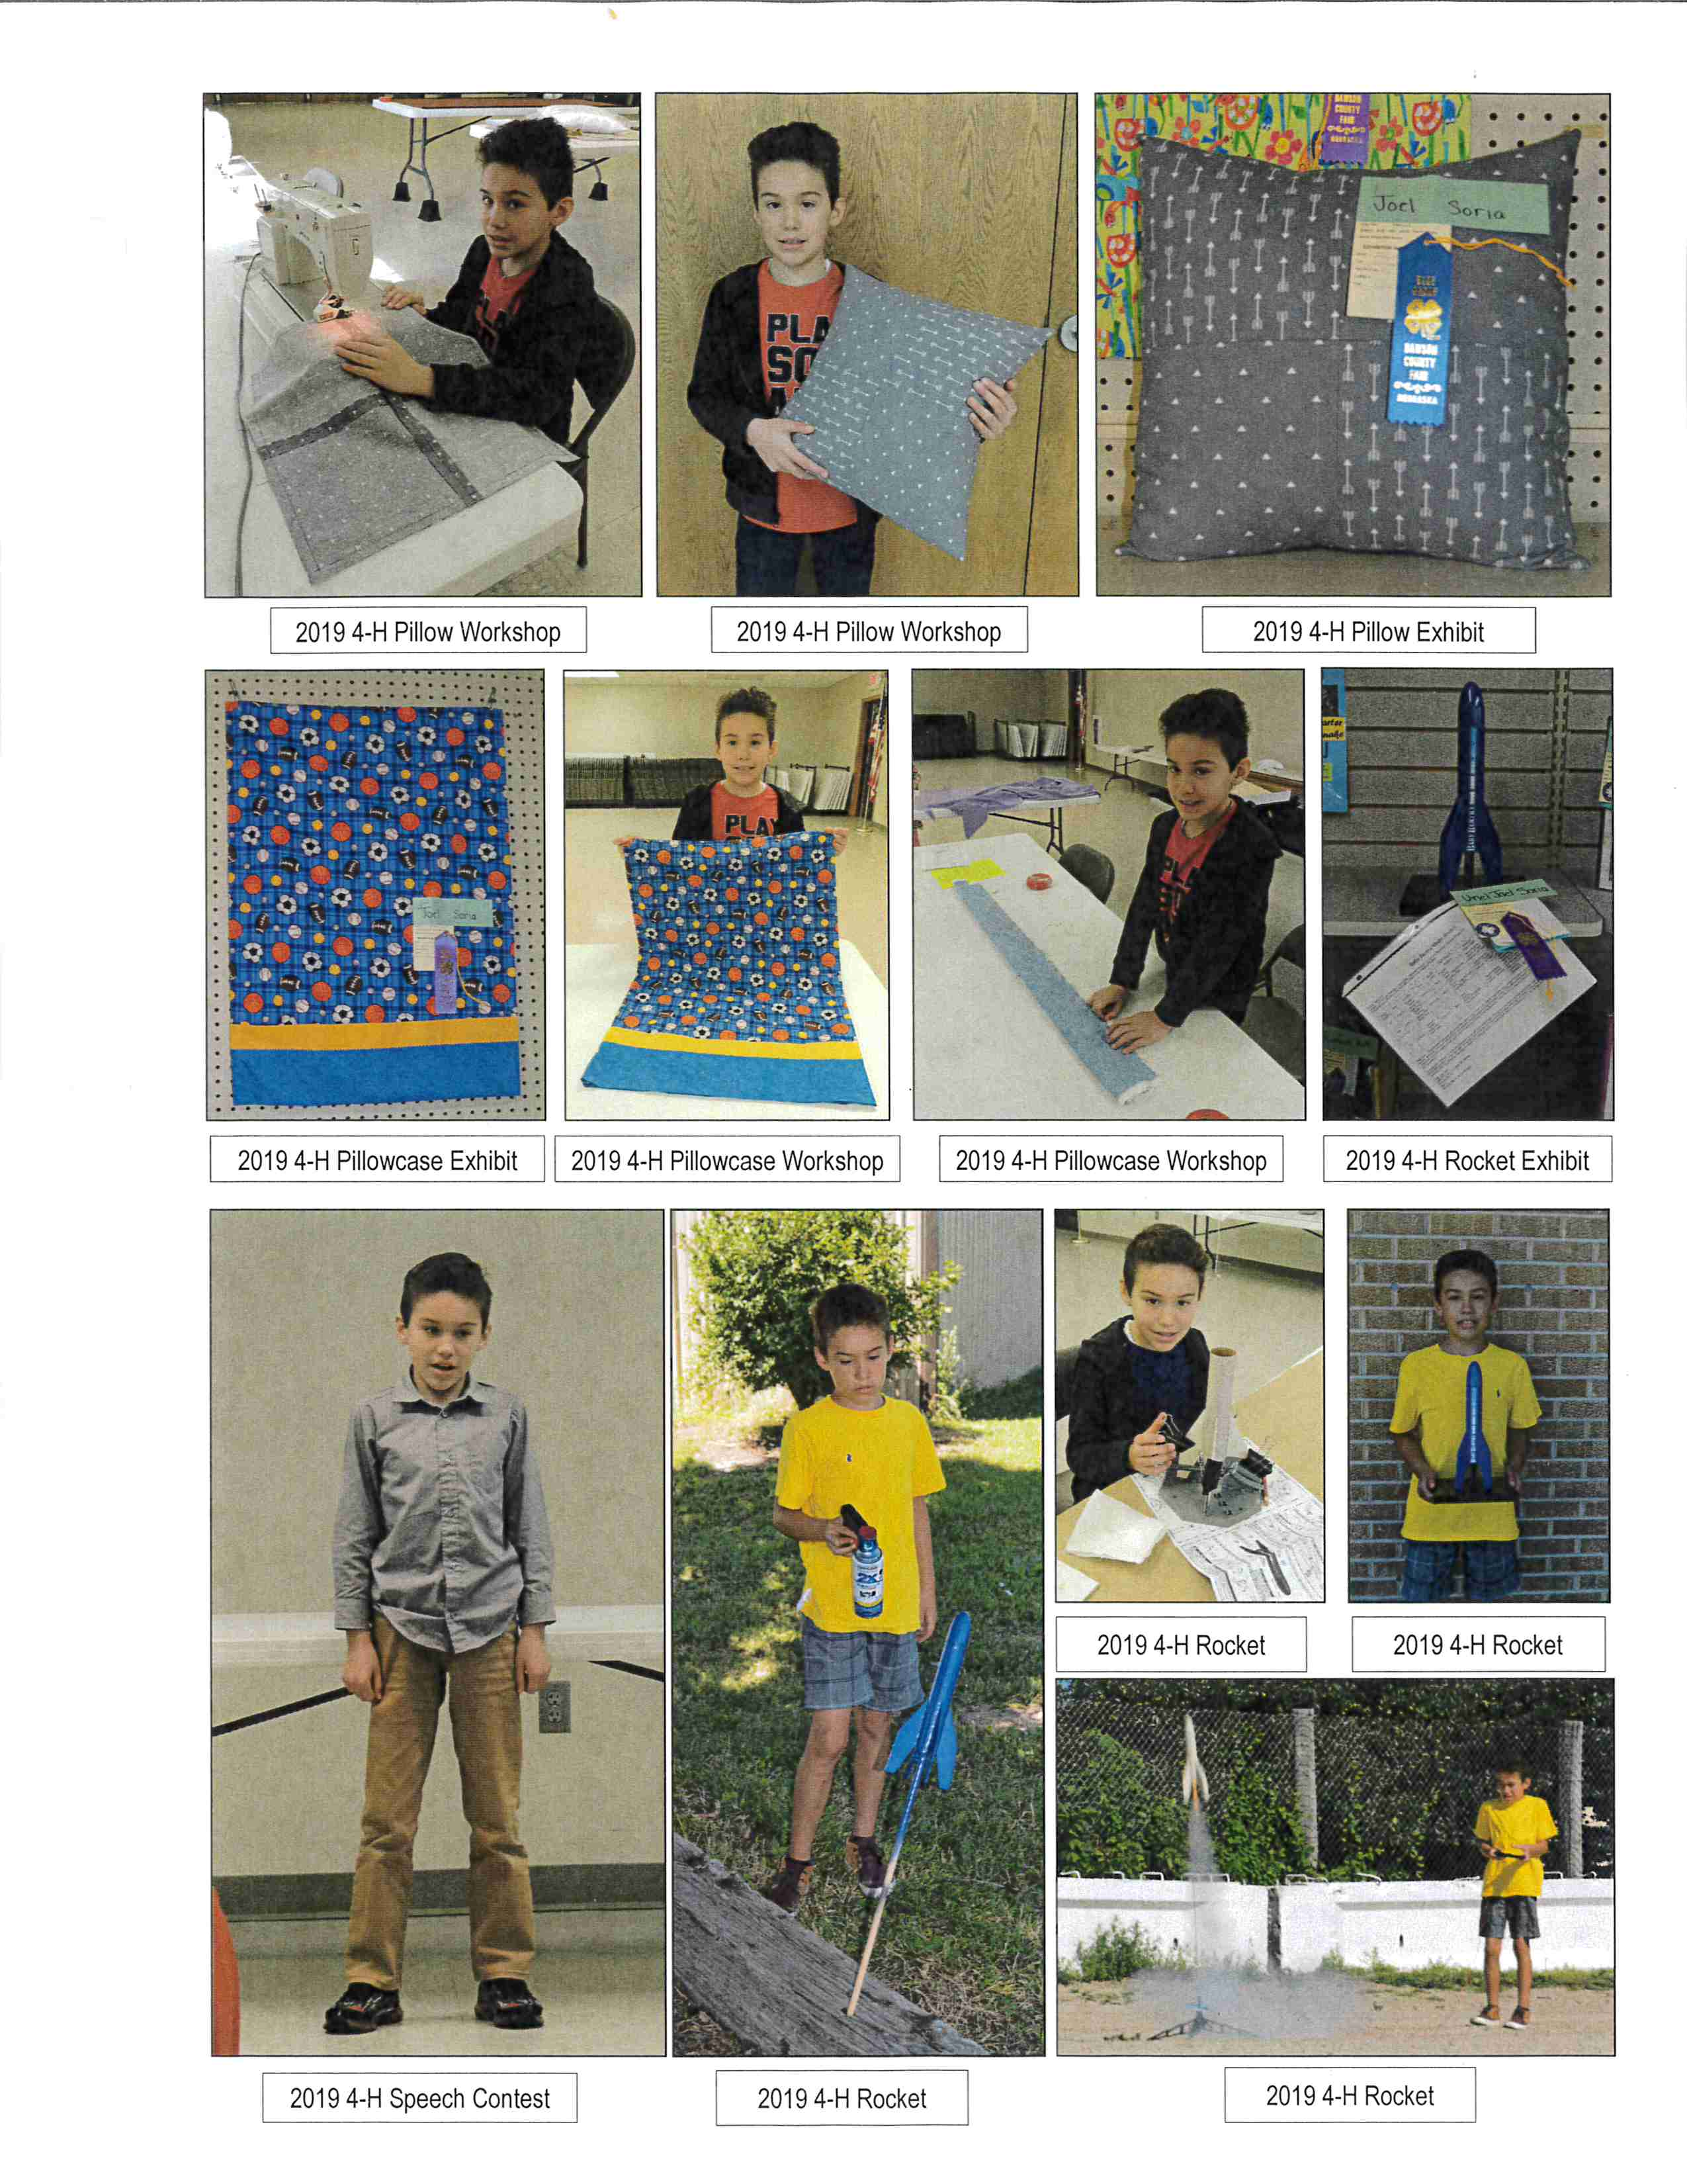
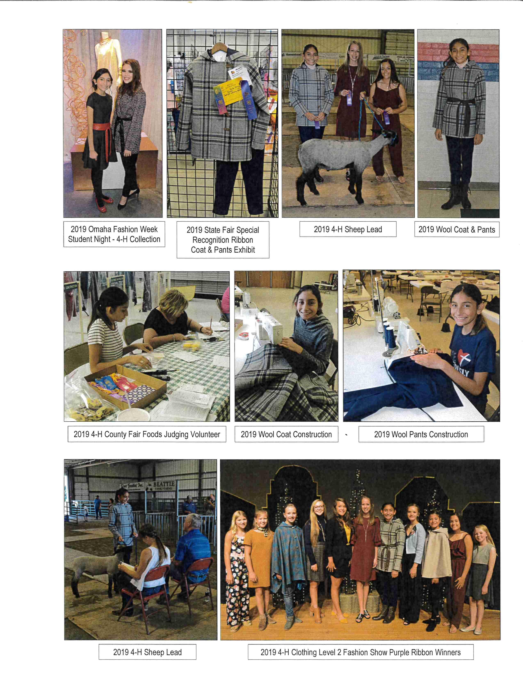
4-H Project and Activity Photo Page Examples

Slide 25
Dawson County Livestock Premiums
Funded by the Livestock Boosters
In order to receive the premiums a completed Nebraska 4-H Annual Achievement Application must be turned into the Extension Office by October 4th before 5:00 p.m.
Complete My Experiences Section
4-H Experiences
Leadership Experiences
Community Involvement/Service-Learning Experiences
Career Spark
4 pages maximum

Slide 26
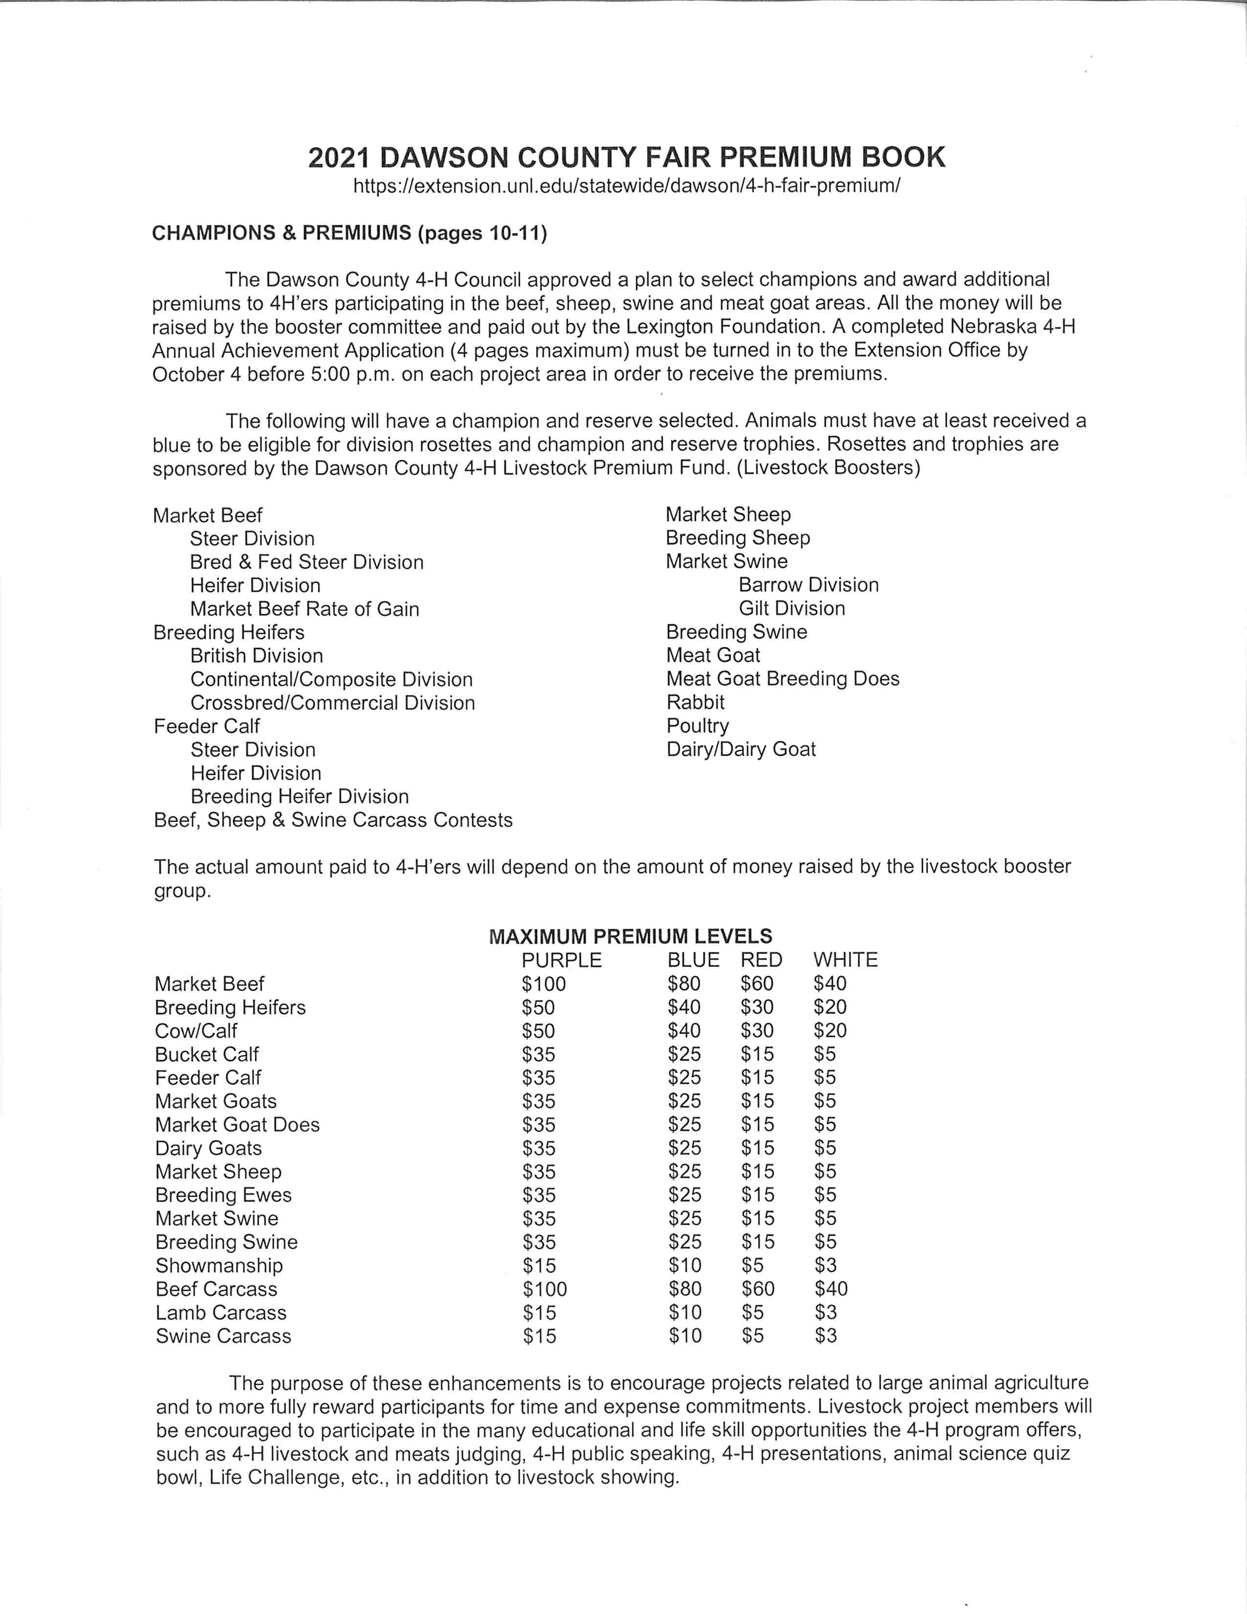
Dawson County Livestock Premiums Information

Slide 27
Dawson County Outstanding Junior Leader Award
4-H’ers enrolled in the Junior Leader Project must complete the ‘Nebraska 4-H Junior Leader Project Record NE4H9040’ to be eligible for the Outstanding Junior Leader Trophy.
A handwritten or computer-generated project sheet is acceptable.
The current year’s project sheet must be included to be eligible. Also include two past years’ Junior Leader Record Sheets.
Photographs are only added to the project record sheet when the record sheet asks for photographs.

Slide 28
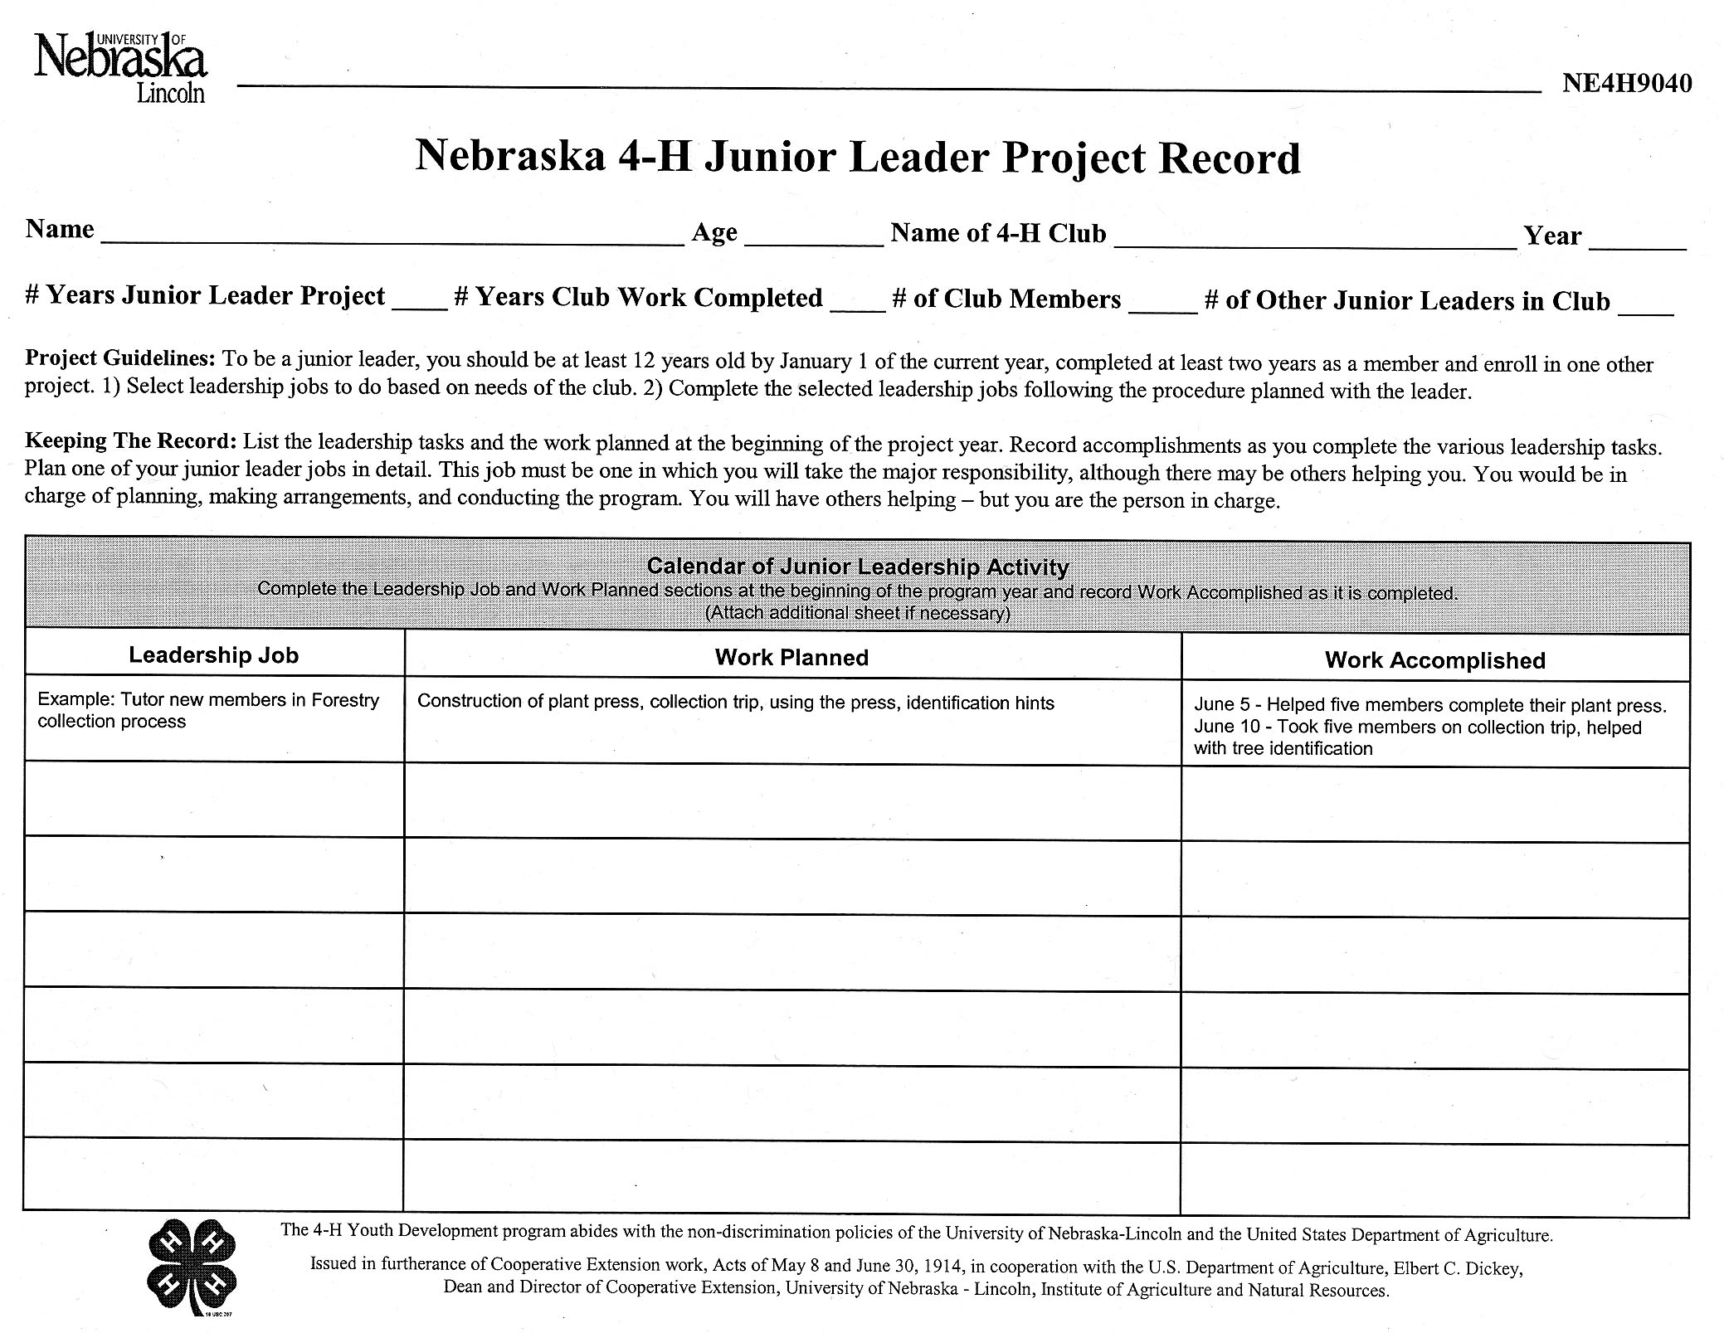
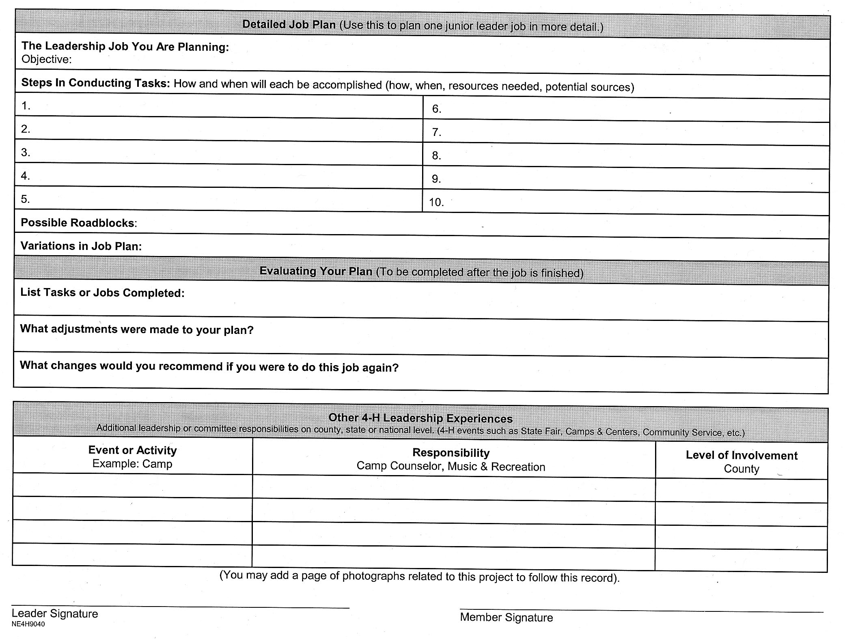
4-H Junior Leader Project Record Sheet

Slide 29
Judging Matrix
Judging (younger 4-H’ers)
4-H Experience 50 points
Leadership Experiences 20 points
Community Involvement/ Service Learning 20 points
Career Spark 5 points
General 5 points
Judging (15 -19 years of age)
4-H Experience 30 points
Leadership Experiences 15 points
Community Involvement/ Service Learning 15 points
Career Spark 15 points
Representing NE 4-H 10 points
As a NE 4-H Youth Leader, When I Look at My State 10 points
General 5 points
Notes:
Criteria for State Judging
Needs Improvement (0-69% of points)
Good (70-89% of points)
Outstanding (90-100% of points)

Slide 30
Documents
All the documents and directions are found on the Dawson County 4-H website under Dawson County 4-H Annual Achievement Application
https://extension.unl.edu/statewide/dawson/dawson-county-4-h-annual-achievement-application/

Slide 31
Questions
Please put your chair on the rack. Thanks!

