Slide 1
Cherry County Dog/Small Animal Project Check-In via Zoom
June 4, 2020

Slide 2

Welcome!
We miss you!!!
Let’s connect!
Unmute your microphone or type in the chat box
What is one thing you have learned about your small animal during quarantine???

Slide 3

Here are the basics for Fair prep!
June 1 was enrollment deadline.
June 15 is the earliest we are allowed to do in-person programs.
July 15 – Fair Entry forms are due.
  Social distancing and hygiene rules will apply at Fair.
  Last resort – Virtual Showcase

Slide 4

So how will we learn this summer?
Many AWESOME virtual workshops and classes being offered!
Statewide Programs - visit https://4h.unl.edu/virtual-home-learning for schedule updates
  Virtual Camps
  Living Room Learning
  Family Fun Night
  Boredom Busters
  Virtual Field Trips
  Additional resources – Dog Club, Cat Club, etc.

Slide 5

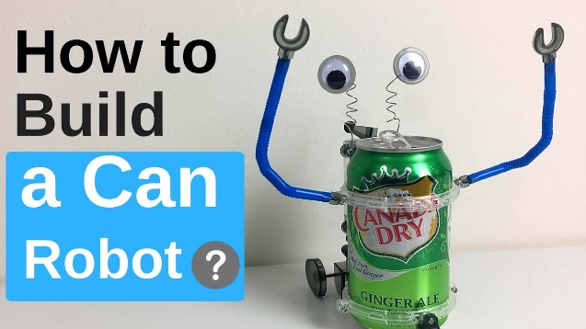
So how will we learn this summer?
Many AWESOME virtual workshops and classes being offered!
  Panhandle Workshops
  (11:00 am CT on the dates listed – register ASAP! Might need to gather materials, have shipped)

Slide 6
Quick poll
What is a virtual learning topic from those lists you would possibly participate in???

Slide 7
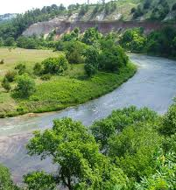
So how will we learn this summer?
NEW Niobrara National Scenic River Connections Exhibit Category!
  Check the last few pages of the NEW Premium Book available on the Cherry Co. 4-H website under “Fair”.
  Many existing projects apply – Photography, Wildlife Conservation, Entomology, Heritage, Child Development, and more!!
  How can YOU relate your project to our backyard wonder??
  Special recognition – ribbons and awards for top prizes. Banner on Park Service office.

Slide 8

So how will we learn this summer?
Dog/small animal workshop July 16
  9:00 am CT – 12:30 pm CT
  @ Cherry Co. Fairgrounds
  PRE-REGISTRATION REQUIRED by June 29

Slide 9
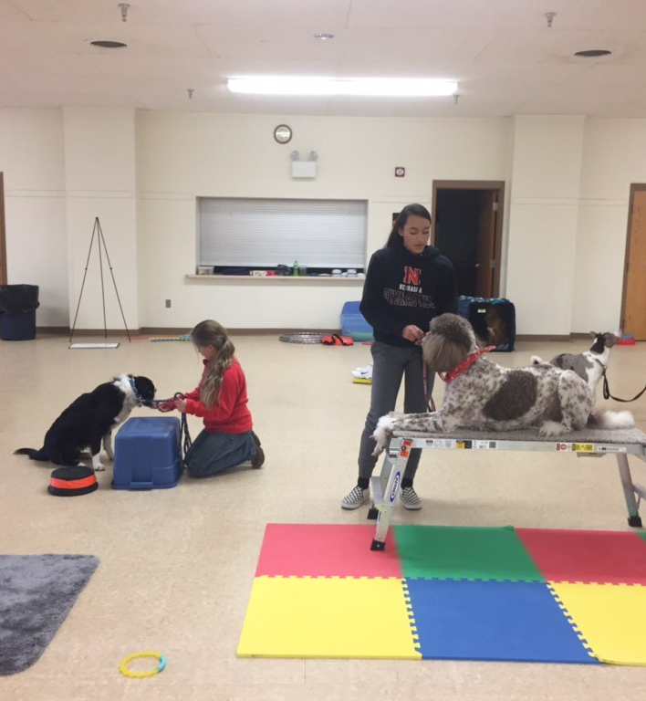
So how will we learn this summer?
Dog leader, Karen Viscuso, is available for dog practices by appointment
By the way, we have NEW agility equipment!!!! Thank you Cherry Co. 4-H Foundation grant.

Slide 10

Q & A/Share Time!!!
What can we help you with?
What concerns do you have?
Is your pet with you? Do they want to say “hi”!

Slide 11



For more information, contact:
Michelle Garwood, 4-H Educator
mgarwood3@unl.edu

