Slide 1
Cherry County 4-H Shooting Sports Check-In via Zoom
June 11, 2020

Slide 2

Welcome!
We miss you!!!
Let’s connect!
Unmute your microphone or type in the chat box
What have you been doing to hone your shooting sports skills during quarantine???

Slide 3
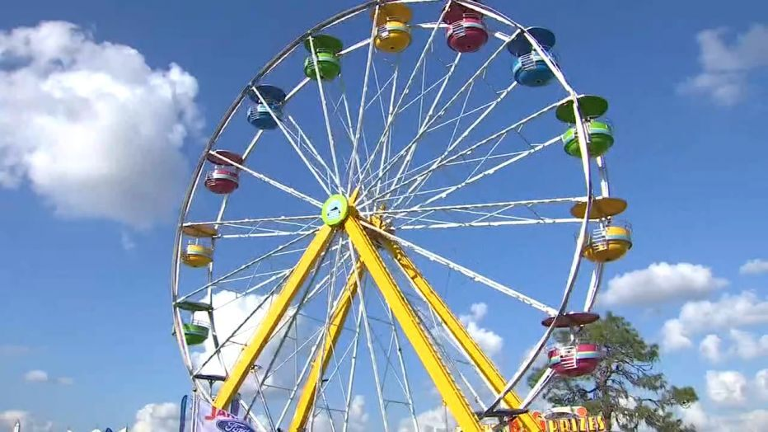
Here are the basics for Fair prep!
June 15 is the earliest we are allowed to do in-person programs.
July 15 – Fair Entry forms are due.
August 1 – County Shoot-Off date
  We may expand the time-frame depending on number of entries, distancing guidelines, etc.
  (Valentine graduation is set for July 31)

Slide 4

So how will we learn this summer?
Many AWESOME virtual workshops and classes being offered!
Statewide Programs - visit https://4h.unl.edu/virtual-home-learning for schedule updates
  Virtual Camps
  Living Room Learning
  Family Fun Night
  Boredom Busters
  Virtual Field Trips

Slide 5

So how will we learn this summer?
Many AWESOME virtual workshops and classes being offered!
  Panhandle Workshops
  (11:00 am CT on the dates listed)
    June 18 – Creating Family Adventures
    June 23 – Entomology
    MANY OTHERS!

Slide 6
Quick poll
What is a virtual learning topic from those lists you would possibly participate in???

Slide 7
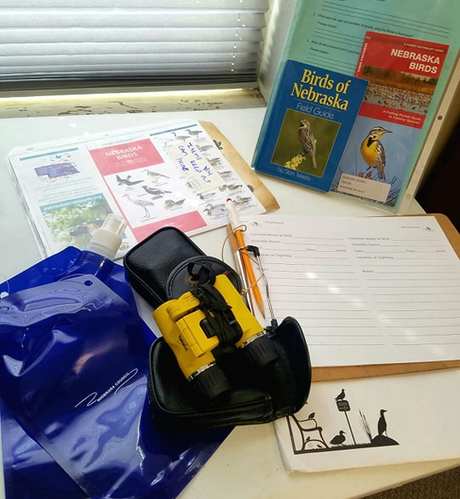

So how will we learn this summer?
Niobrara Council has Birding Kits available
  The Backpacks contain binoculars, field guides, checklists, and more!
Enroll in Wildlife Conservation to Exhibit at Fair
Can participate in real-life science through

Slide 8
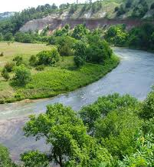
So how will we learn this summer?
NEW Niobrara National Scenic River Connections Exhibit Category!
  Check the last few pages of the NEW Premium Book available on the Cherry Co. 4-H website under “Fair”.
  Many existing projects apply – Photography, Wildlife Conservation, Entomology, Heritage, Child Development, and more!!
  How can YOU relate your project to our backyard wonder??
  Special recognition – ribbons and awards for top prizes. Banner on Park Service office.

Slide 9
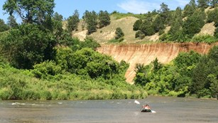
National Park Service In-Person Events!

Slide 10
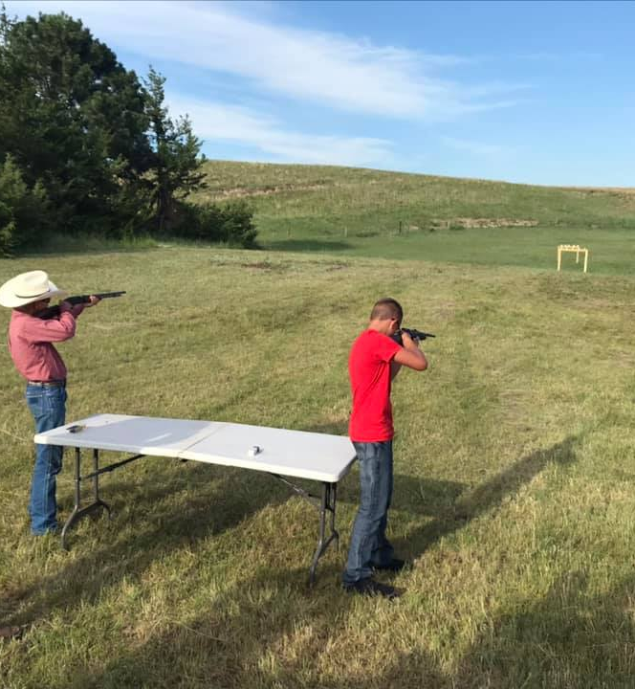
So how will we learn this summer?
Practices
Safety sessions are REQUIRED for first-year shooters! That will be our FIRST priority!
Let’s complete a couple polls on practices and safety…

Slide 11

So how will we learn this summer?
Hunt Safe Course taught by Tom Lancaster
For Trap shooters – ages 11 and up

Slide 12

Q & A/Share Time!!!
What can we help you with?
What concerns do you have?

Slide 13



For more information, contact:
Michelle Garwood, 4-H Educator
mgarwood3@unl.edu

