Slide 1
Cherry County Livestock Project Check-In via Zoom
June 18, 2020

Slide 2

Welcome!
We miss you!!!
Let’s connect!
When I call on you, unmute your microphone or type in the chat box
How are things going with working with your animals??

Slide 3
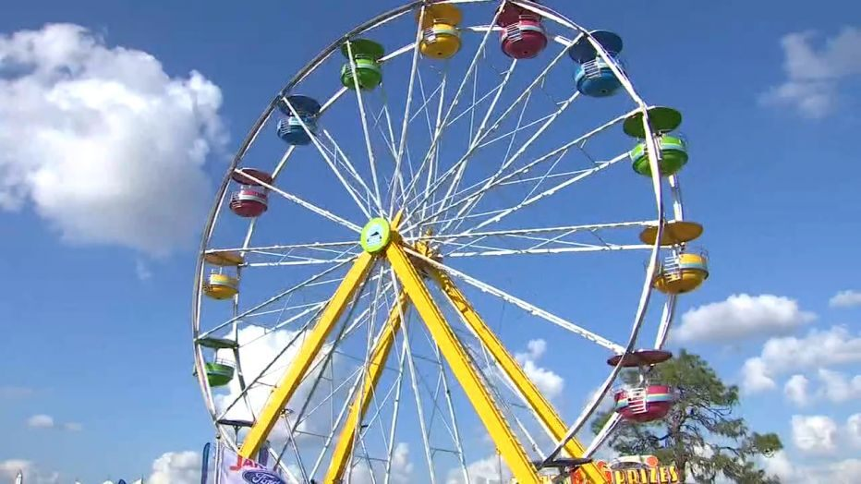
Here are the basics for Fair prep!
July 1 ID deadline for all livestock https://extension.unl.edu/statewide/cherry/cherry-county-4-h-resources/
  You must submit photos to Michelle of livestock with tags in ears.
  mgarwood3@unl.edu (Stocker Feeder photos due July 27)
July 15 – Fair Entry forms are due. YQCA certificates due.
  https://extension.unl.edu/statewide/cherry/cherry-county-4-h-fair/
  $10 per youth late fee for both deadlines
  In addition, each family will be asked to read and sign our final set of COVID guidelines for the show and sale. We will be in touch in July.

Slide 4
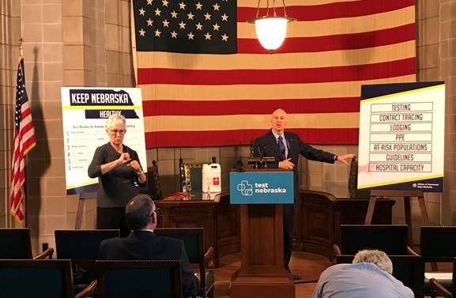

What are we thinking for Fair?
What is driving our decision-making process?
Governor’s Guidelines for Livestock Shows
https://nda.nebraska.gov/COVID-19/livestockshows.pdf
Livestock Committee, 4-H Council, Extension Board, Ag Society
Recommendations/expectations from UNL/4-H
In partnership with the Ag Society, we must submit an Event Plan to the North Central District Health Department and it must be accepted.

Slide 5
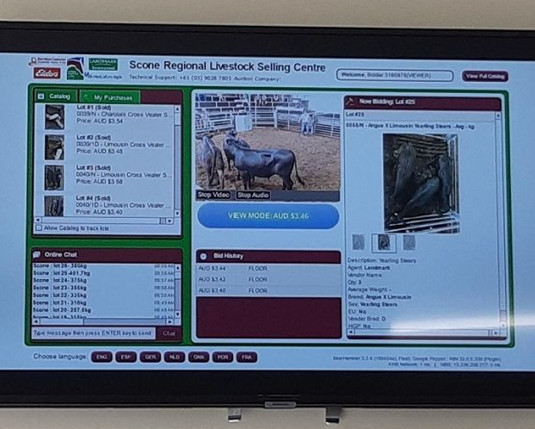
Virtual Sale
In Conversation with Valentine Livestock Auction – goal is to finalize next week
3 format possibilities
Show schedule will work backward from auction format – TBA
Likely breeding/stocker feeders Day 1
1-2 days of Market (hogs last)
There will be a cost, but we will look for financial support
Valentine Locker has regular reserved space
Final sale format will determine delivery process to Locker – families may be responsible this year.
PLEASE TELL THESE TWO PARTNERS THANK YOU EVERY CHANCE YOU GET!

Slide 6
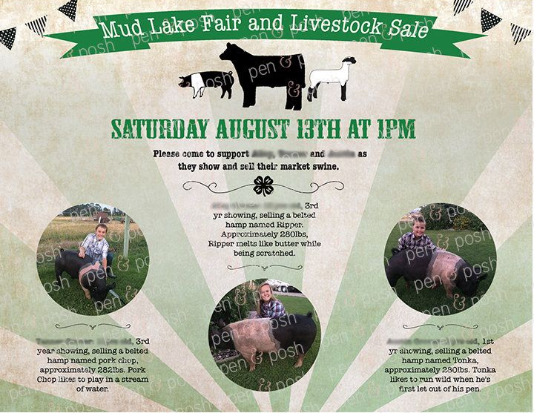
Virtual Sale
Let’s talk marketing…
  Wider geographic reach
  Fewer 4-H livestock auctions in 2020
  VISUAL & VERBAL + VIRTUAL story – social media in addition to snail mail, e-mails and socially-distanced in-person visits.
  Families/individuals in addition to businesses
    Splits
    Guaranteed locker processing time!
  Approx. number of animals
    24 hogs
    27 beef
    3 goats
    3 sheep

Slide 7

Pause – questions? Concerns?
  Feel free to unmute and/or type in the chat box. You can send a private message as well.

Slide 8
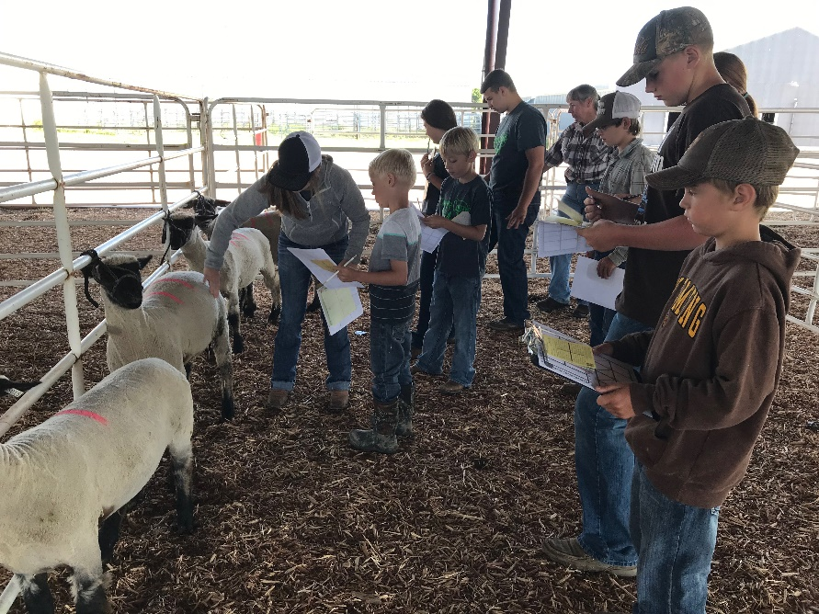
So how will we learn this summer?
No in-person livestock judging competition this year or fitting clinic.
Please take advantage of state and national virtual opportunities!
https://4h.unl.edu/virtual-home-learning
Self-paced video series for Livestock Judging Video Series

Slide 9


Slide 10

So how will we learn this summer?
  YQCA Training is REQUIRED annually for ALL youth enrolled in Livestock
    Online option ONLY this year – must submit certificate of completion by July 15
    http://yqca.org/
    Choose 4-H ONLINE OPTION

Slide 11
So how will we learn this summer?
Record Sheets
Great skill to develop regardless!
UNL has a universal record form for all livestock except:
https://extension.unl.edu/statewide/wayne/Large%20Animal%20Record_Reader.pdf
  Bucket Calf (optional Clover Kid version)
  Bottle Lamb
  Sandhills Production
  For all other Clover Kid livestock, submit a photo and 3-5 comments on what you learned, parents can help write/type.
Please complete as a back-up plan in case we have to go fully virtual.
  Will be due Fair week if needed.
  Take lots of photos this summer!

Slide 12

Q & A/Share Time!!!
What can we help you with?
What concerns do you have?

Slide 13



For more information, contact:
Michelle Garwood, 4-H Educator
mgarwood3@unl.edu

