Slide 1
Adding Tables on your County Website

Slide 2
How many of you have worked with tables on the web?

Slide 3
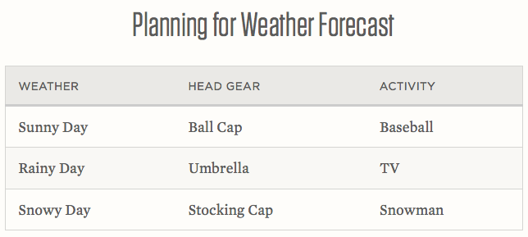
Tables
Tables are a way of organizing data into rows and columns.

Slide 4
What can you use a table for on a county website?
Training schedule
Staff contact information
File downloads
Room schedule

Slide 5
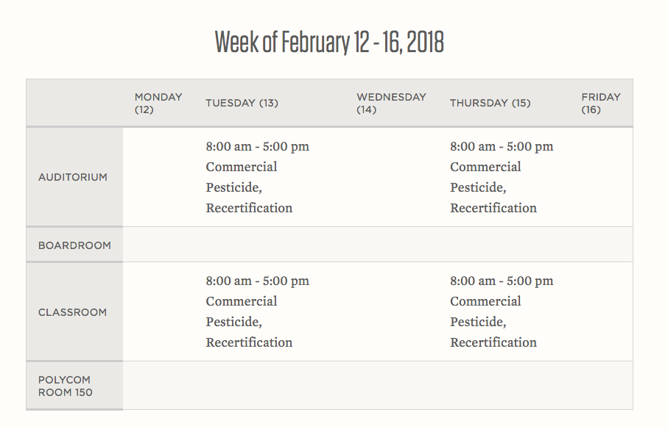
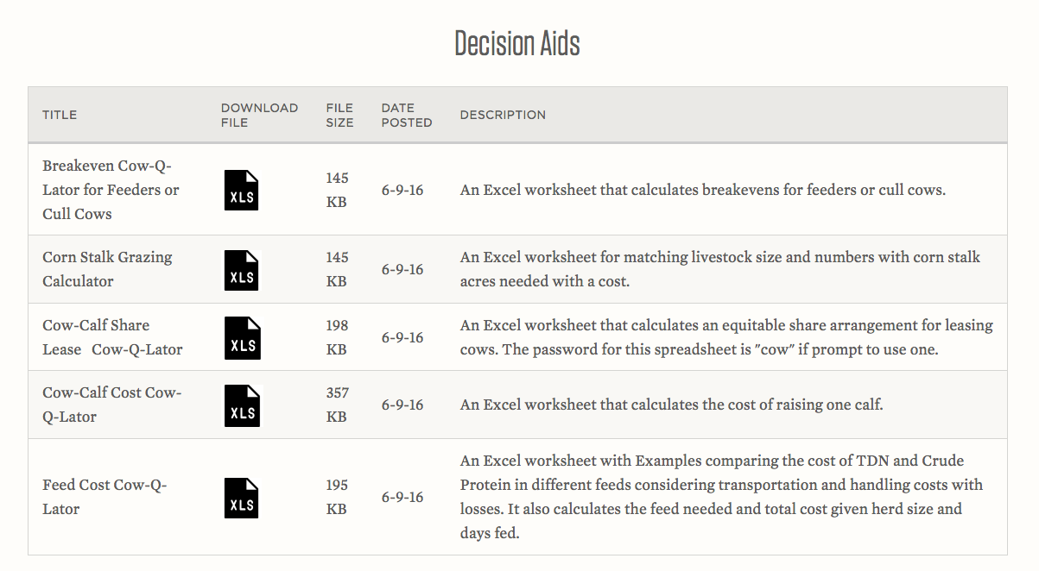
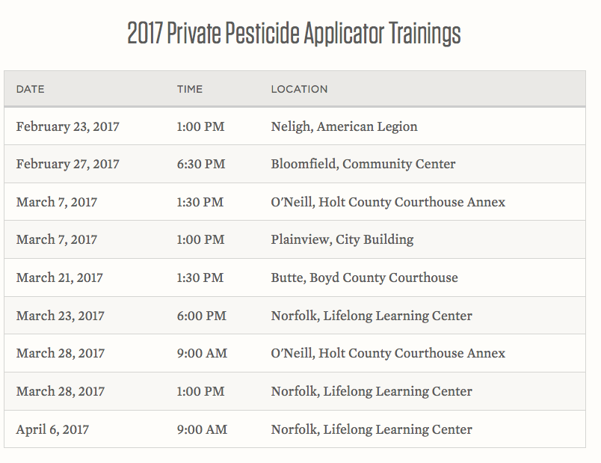
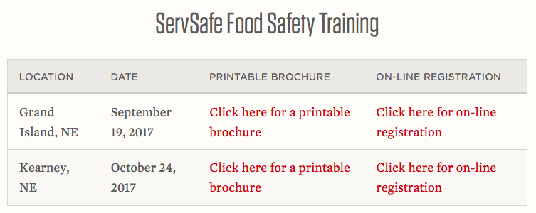

Slide 6
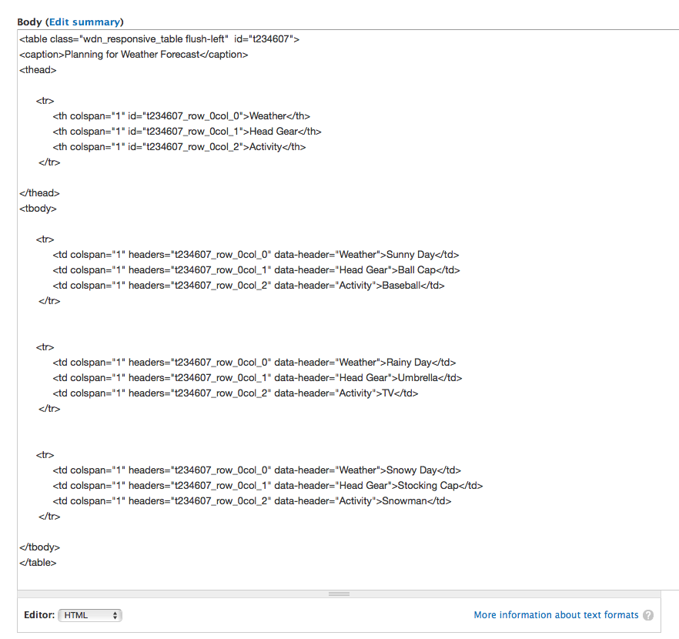
HTML Code
A table begins with <table> and ends with </table>

Slide 7
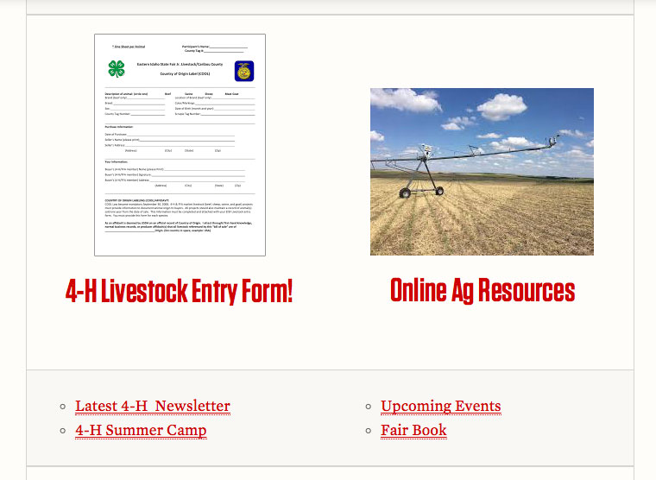
There are two types of tables
Layout tables
Data tables

Slide 8
Data table
Must have a table header
A column header identifies the data in the column
The table header is usually the first row of the table but it can also be a column. It’s styled differently to stand out from the other rows.

Slide 9
WEATHER
HEAD GEAR
ACTIVITY
Data table
Row contains a set of related data

Slide 10
When is it best to use a table?
if it makes sense to have a table header and there are multiple columns and rows

Slide 11
Responsive Table Generator Tool
best way to create a table
https://ianrmedia.unl.edu/responsive-table-generator-tool

Slide 12
Responsive Table Generator Tool
maps headers to cell data to make tables responsive and accessible
Viewable on mobile without scrolling left and right
Understandable, when read by a screen reader, to someone who is blind or has low vision.

Slide 13
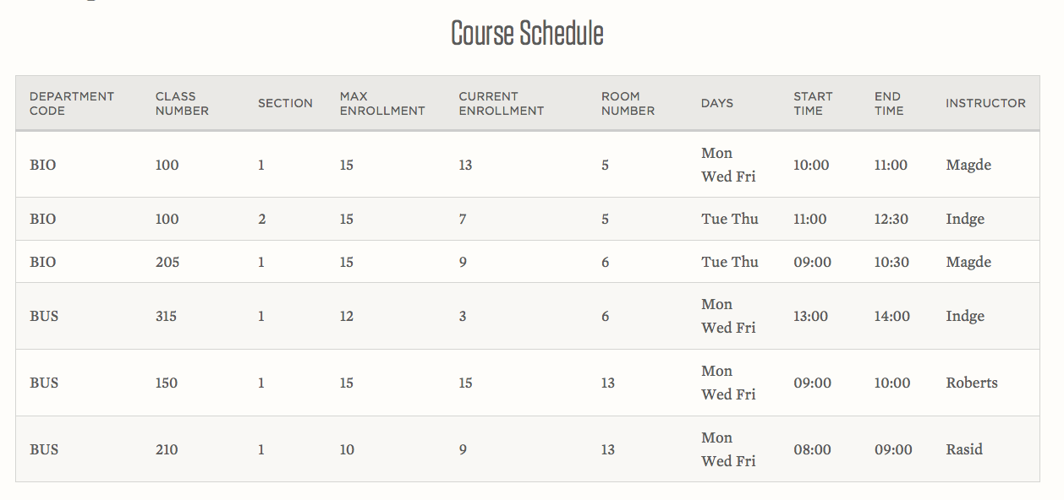

Slide 14
Department Code, Class Number, Section, Max Enrollment, Current Enrollment, Room Number, Days, Start Time, End Time, Instructor, BIO, 100, 1, 15, 13, 5, Mon,Wed,Fri, 10:00, 11:00, Magde, BIO,100, 2, 15, 7, 5, Tue,Thu, 11:00, 12:30, Indge, BIO, 205, 1, 15, 9, 6, Tue,Thu, 09:00, 10:30, Magde, BUS, 315, 1, 12, 3, 6, Mon,Wed,Fri, 13:00, 14:00, Indge, BUS, 150, 1, 15, 15, 13, Mon,Wed,Fri, 09:00, 10:00, Roberts, BUS, 210, 1, 10, 9, 13, Mon,Wed,Fri, 08:00, 09:00, Rasid.
https://webaim.org/techniques/tables/

Slide 15
Table header NOT mapped to cell data
BUS, 150, 1, 15, 15, 13…
Table header mapped to cell data
Department Code BUS, Class Number 150, Section 1, Max Enrollment 15…

Slide 16
Let’s create a table and look at examples
https://extension.unl.edu/statewide/herbie/table-examples/

Slide 17
Online Resources
Creating Accessible Tables https://webaim.org/techniques/tables/
Responsive Table Generator Tool https://ianrmedia.unl.edu/responsive-table-generator-tool
Icon Factory Tool https://experimentstation.unl.edu/IconFactory/

