Slide 1
County Website Content Management System

Slide 2
Content Strategy

Slide 3
Why do you need a content strategy?
Content strategy
Up-to-date
Consistency
User experience
Search engines
Notes:
Keep content unique, fresh and up-to-date
Ensure a professional look and feel that is consistent with the brand
Deliver content in the best format for a good user experience
Make sure content is discoverable by search engines

Slide 4
Which content is of interest to your target audience?
Content Strategy
About the county
News and announcements
Program information
Research information
Stats/Awards/Recognition
Tools and resources
Staff directory
Extension educator bios
Office hours and location
Events

Slide 5
Content Strategy
Workflow

Slide 6
Get Content
Content Strategy
Ask for content
Negotiate a deadline
Give options for delivering it
Advise on the best format
Look for content
Notes:
Identify content contributors
Determine the best way for contributors to deliver content to you (email, upload to Box, enter into UNLcms)
Communicate the best file format for content to be delivered (word doc, excel spreadsheet, text file, jpg image, PDF)
Search Extension program sites, Twitter, IANR News, Extension blogs and Extension Publications for related news and content you can link to

Slide 7
Determine Where Content Should Go on the Site
Content Strategy
Front page
4-H page
Related Program Page
Featured Promo
Menu bar
Calendar
Not on the site
Notes:
Every page must be linked to from at least one other page.

Slide 8
Content strategy
Choose the Best Content Type
Article Page
Temporary page
News and announcements
Can display in home or program page feed
Basic Page
Permanent page
Basic information
Will not display in home or program page feed
Can display in red bar menu under home or 4-H and in grey side navigation box
Featured Promo
Changes regularly
Highlights event or news at top of home page
Can link to an article page, basic page or a page on another site
Displays in image carousel

Slide 9
Add Content
Content Strategy
Write good descriptive page titles
Include a few introductory sentences at the top of a page
Include a mix of headings, text, links and images
Follow best practices for images
Use link colors only on links
Use default fonts, don’t introduce new fonts

Slide 10
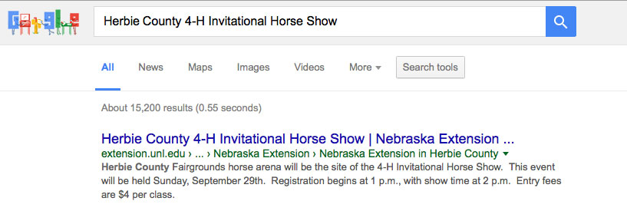
Content Strategy
Google Search Results
Title
First text on page

Slide 11
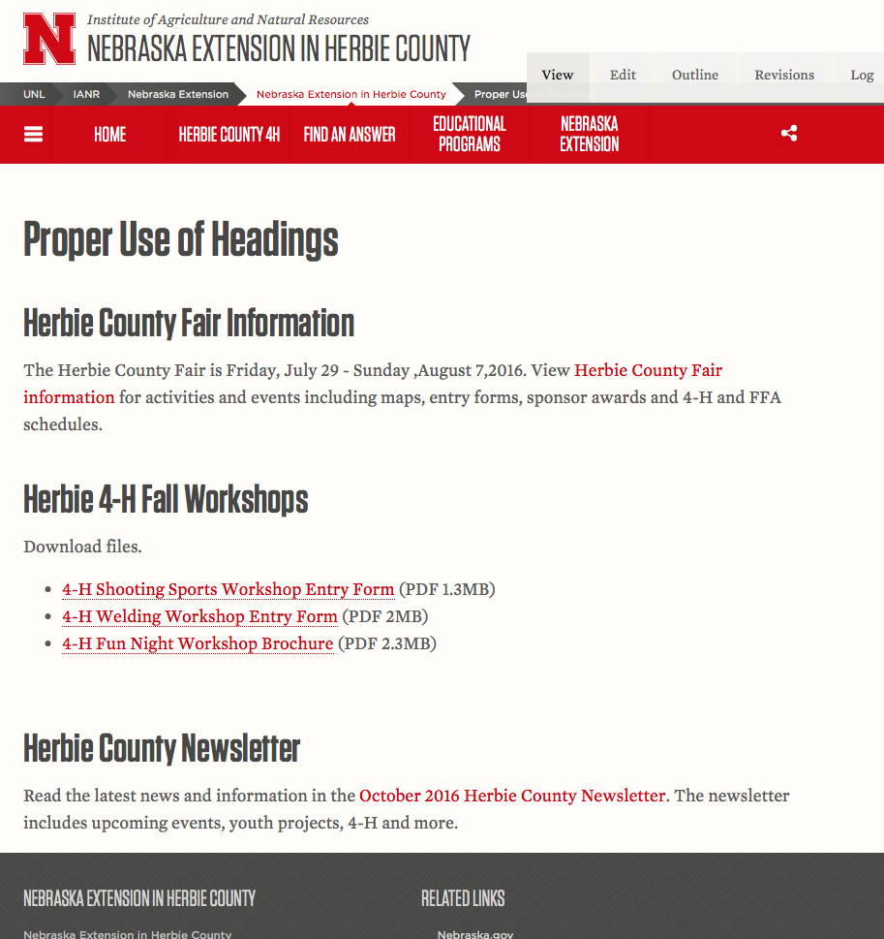
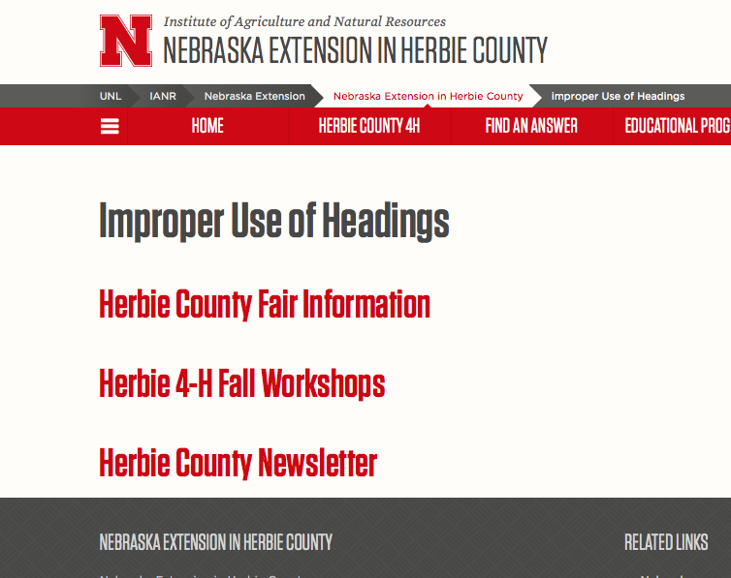
Content Strategy
Proper Use of Headings
Headings should be followed by non-heading text.
Notes:
Headings separate a page into sections and should have non heading text under them.

Slide 12
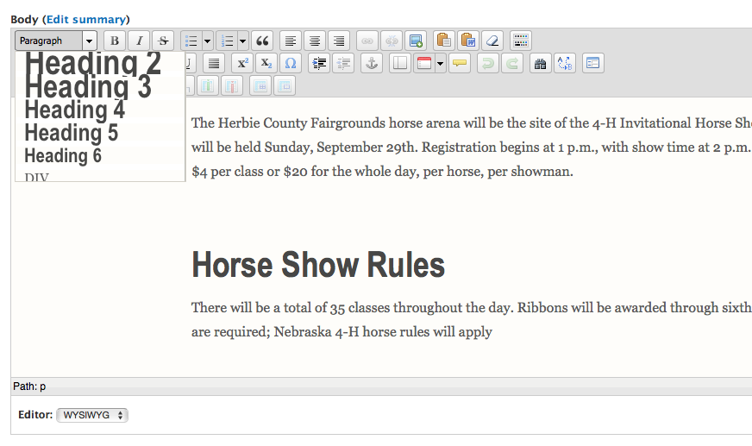
Content strategy
Headings in WYSIWYG Editor
First heading in the editor should be an <h2>
Use headings in the proper order. As you go down a level the number has to stay the same or increase. No skipping over numbers.

Slide 13
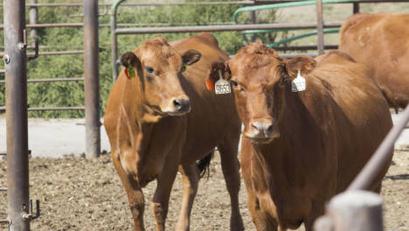
Content strategy
Images
Image name
cattle-feedlot.jpg
Alt text
alt=“two cows in a feedlot”

Slide 14
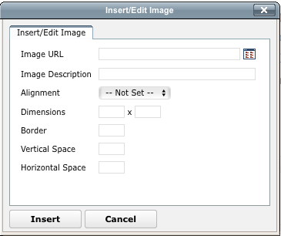
Content strategy
Alt text
Alt Text
Alt Text goes in the Image Description when inserting an image in the WYSIWYG editor.

Slide 15
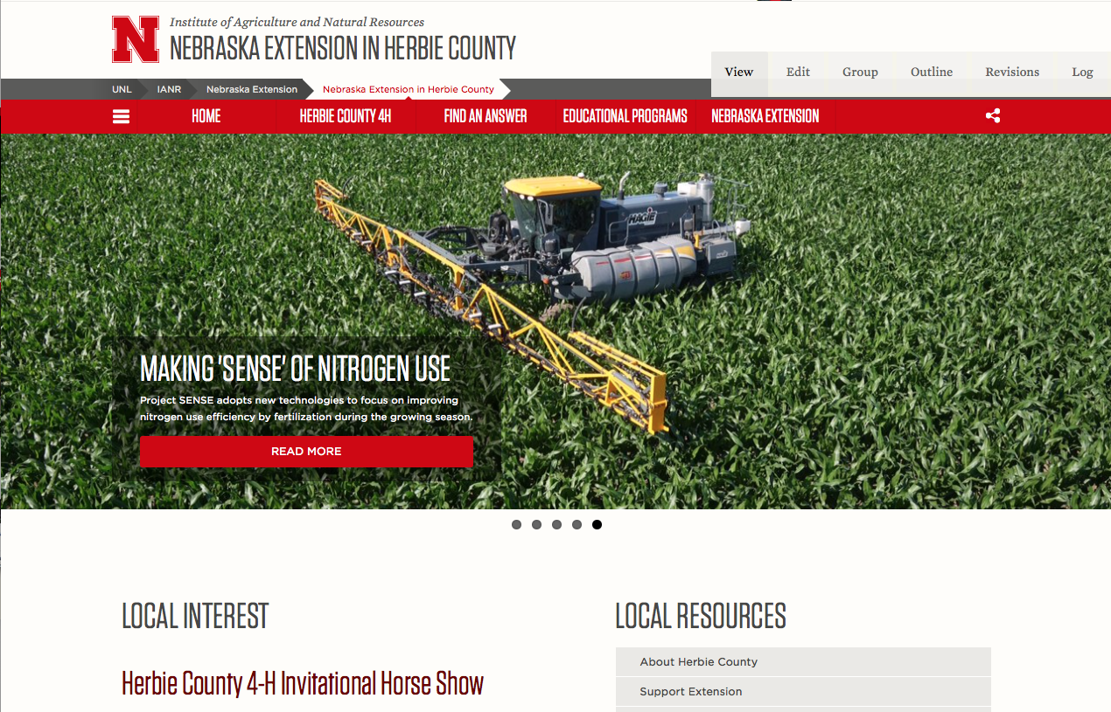
Featured Promo Image
Content strategy
Avoid using images that have text embedded in them (text will not be accessible)

Slide 16
Which anchor text (in red) is the best choice to link to http://extension.unl.edu?
Content Strategy
Text Links
Nebraska Extension is making an incredible impact on the success of our state.
Nebraska Extension is making an incredible impact on the success of our state. http://extension.unl.edu
Nebraska Extension is making an incredible impact on the success of our state. Click here.

Slide 17
Content Strategy
Answer
a) Nebraska Extension is making an incredible impact on the success of our state.
More accessible
Better for Search Engine Optimization (SEO)
Contains a good keyword phrase
Text is relevant to the page you’re linking to
Notes:
Gives more context to the link for people who are blind and using a screen reader
Indicates to search engines that the page http://extension.unl.edu is relevant when someone searches for “Nebraska Extension”

Slide 18
Link to the Original source
Content Strategy
Nebraska Today article
IANR News article
CropWatch
PDF files on the main 4-H site
Extension site
.gov and .edu sites

Slide 19
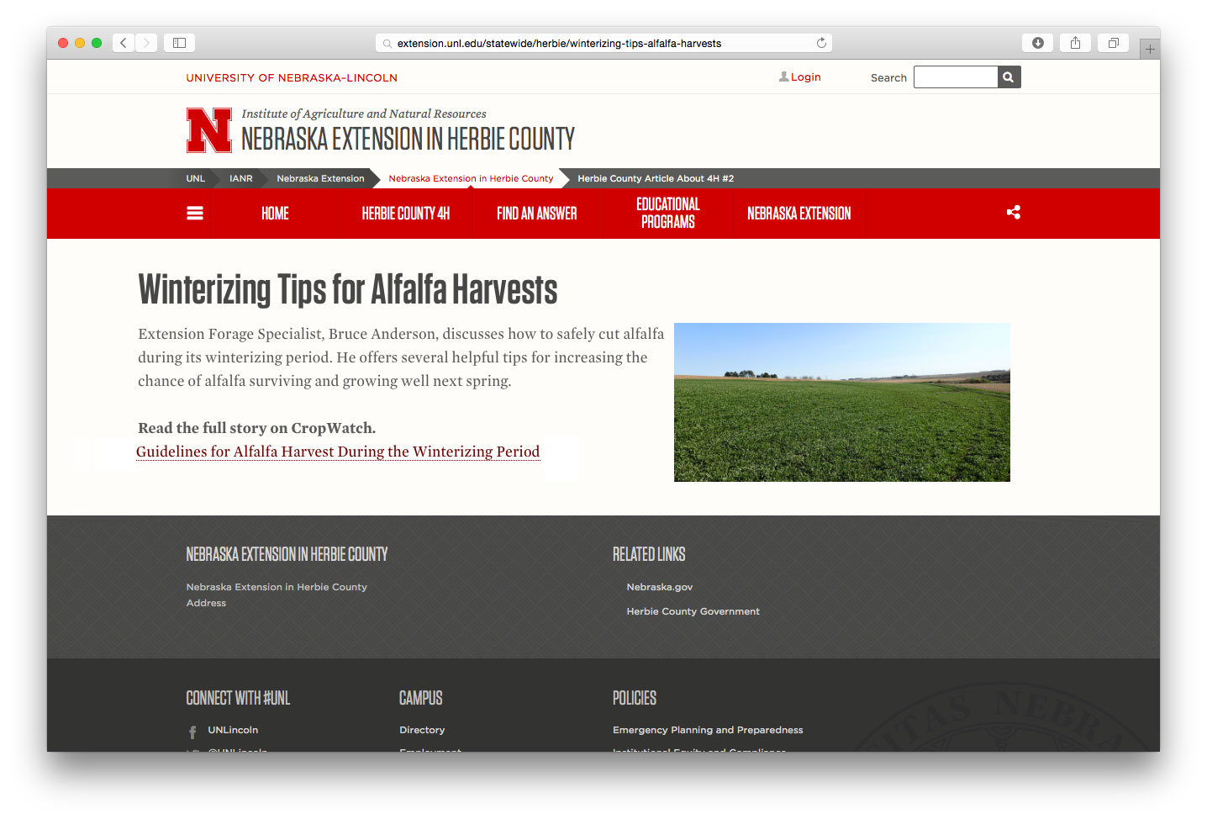
Content Strategy
Article Page
Do not cut and paste the entire contents of the original source.
Give your article a unique title
Add a summary of the content you’re linking to in the Editor
Include a link to the original source

Slide 20
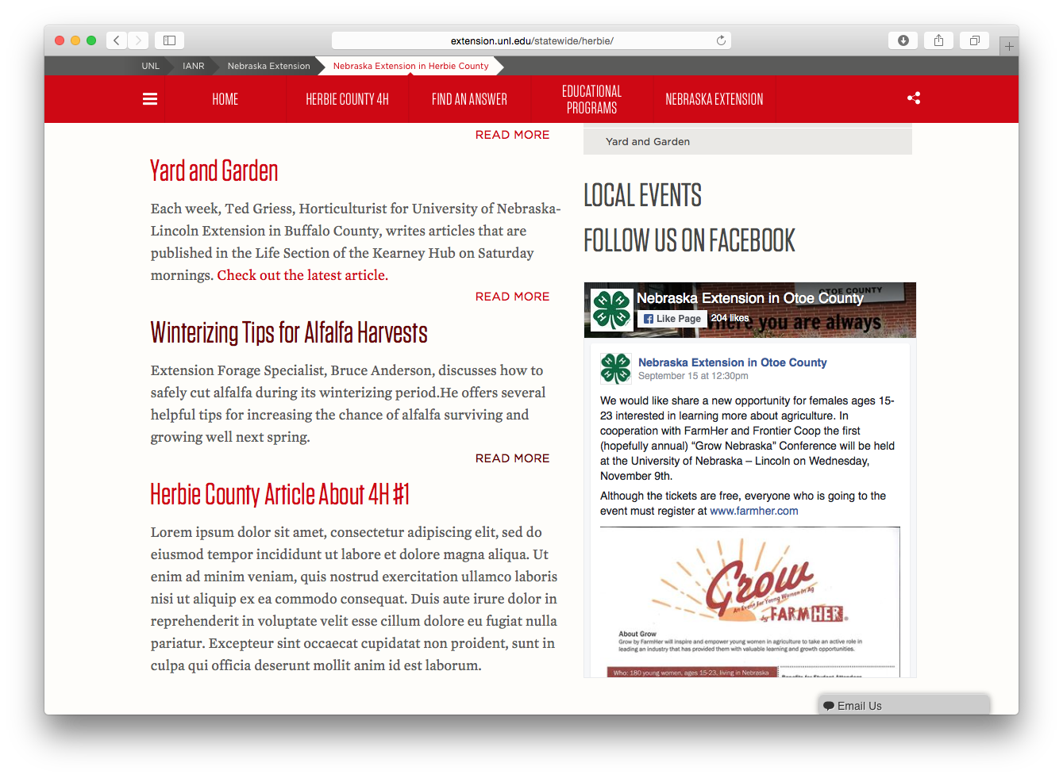
Content Strategy
Article Feed on Front Page

Slide 21
PDFs
Content strategy
Only link to a PDF when the document is curated, several pages long, or has to be printed in the same format
Consider creating as a basic page instead of linking to a PDF

Slide 22
Content strategy
Linking to Files
Let the user know when clicking a link will download a file and what type of file.

Slide 23
Web Accessibility
Content strategy
An accessible website allows people with disabilities to navigate, understand and interact with the site without barriers.
Proper use of headings
Images have alt text
Color contrast ratio of 4.5:1
Embedded videos have captions and titles

Slide 24
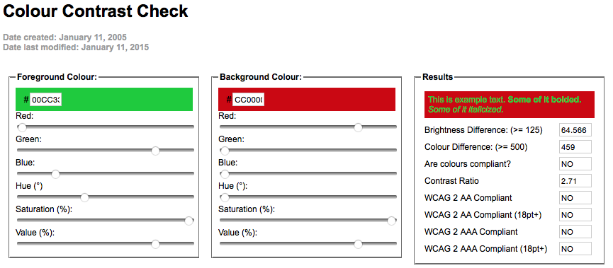
Colors
Content Strategy
Content strategy
WCAG 2 AA must display YES to pass
Color Contrast Checker
https://snook.ca/technical/colour_contrast/colour.html#fg=33FF33,bg=333333

Slide 25
Promote Content
Content Strategy
Share on Facebook and Twitter
Link to it in email newsletter
Include a link to site in print pieces
Ask relevant authoritative sites to link to it

Slide 26
Online Resources
Content strategy

Slide 27
examples
Online resources
Color Contrast Tool
https://snook.ca/technical/colour_contrast/colour.html
Web Accessibility Image Tutorial
http://www.w3.org/WAI/tutorials/images/
Icon Factory
http://experimentstation.unl.edu/IconFactory/
Responsive Table Generator
http://ianrmedia.unl.edu/responsive-table-generator-tool
UNL Media Hub (supports .mp4 video and .mp3 audio files)
Caption service $1/minute (rounded up) and most are completed within 24 hours
http://mediahub.unl.edu
Webaudit Report Strategy for Fixing Errors
http://ianrmedia.unl.edu/resources/webaudit-report-strategy-fixing-errors

