Slide 1
Pollinators and Tubular Nesting Native Bees
Paul C Hay
University of Nebraska Lincoln
Extension Educator

Slide 2
Background: Pollinators
Honeybees pollinate $15 billion in crops/year (apples, cherries, berries, nuts etc.)*
75% of flowering plants need pollinators*
Pollinators are in decline worldwide, best data are for honeybees: 31% loss of hives each year between 2007-2012 in the US**.
Commonly called "Colony Collapse Disorder" (CCD), appears to be due to multiple stressors (Varroa mites, Nosema and virus infection, moving hives, tobacco ringspot virus, pesticide exposure, etc)
*Status of pollinators in North America, National Research Council
**vanEngelsdorp et al. PLosOne: 3:1-6 e4071.
Notes:
The larger than normal hive losses have abated and research is still identifying the complex of causal agents oc Colony Collapse Disorder.

Slide 3
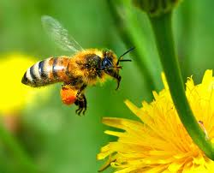
Honey Bee
Notes:
Honeybees collect both pollen on body hairs and legs barbs and nectar (sugar water) from the flower.

Slide 4
Honey Bee Loaded With Corn Pollen
Notes:
Honey bees forage in fields with just pollen sources like corn fields in pollinating season.

Slide 5
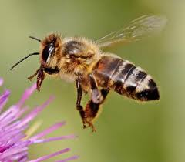
Honey Bee
Notes:
Bees are attracted to various flower colors and shapes. Some pollinating insects are general feeders and some are very select.

Slide 6
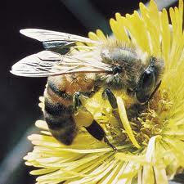
Honey Bee
Notes:
Honeybees will forage out over one mile in search of food sources.

Slide 7
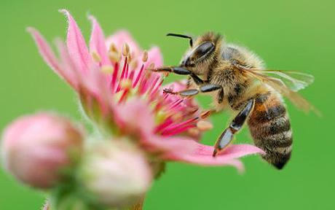
Honey Bee

Slide 8
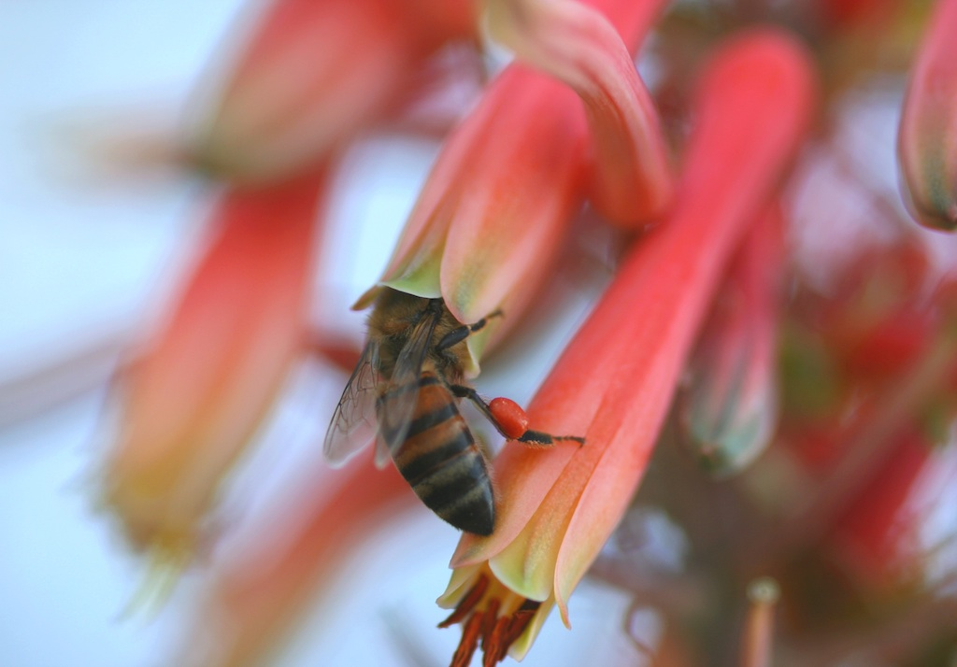
Honey Bee

Slide 9
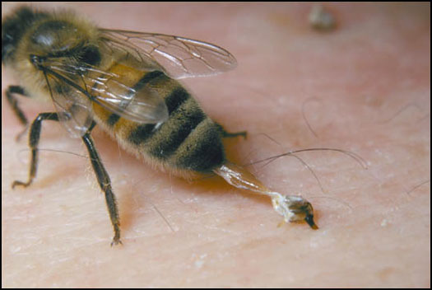
Honeybee Stings Kill The Bee
Notes:
When a honey bee stings you, remember, don’t slap it. Slide your thumb nail across the skin breaking off the stinger and avoid forcing the bee venom into the skin.

Slide 10
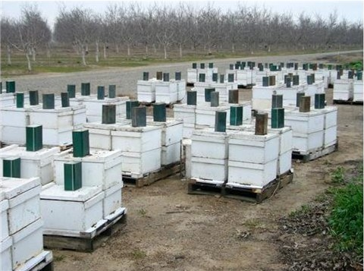
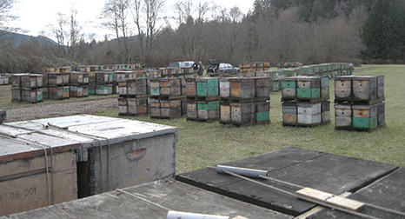
Honey Bee Hives
Notes:
Significant dollars for pollination services in almonds, apples, blueberry and other crops results in bees being moves across the country. Generally raises more income than the honey.

Slide 11
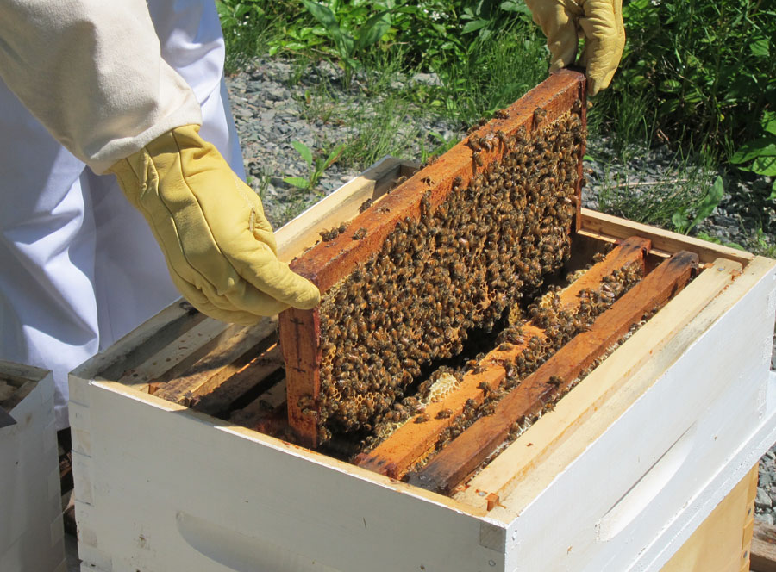
Frames in Super

Slide 12
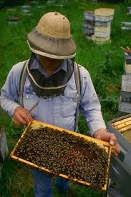
Examining a Brood Frame

Slide 13
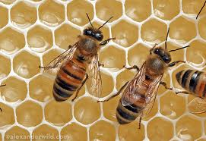
Honey Bee

Slide 14
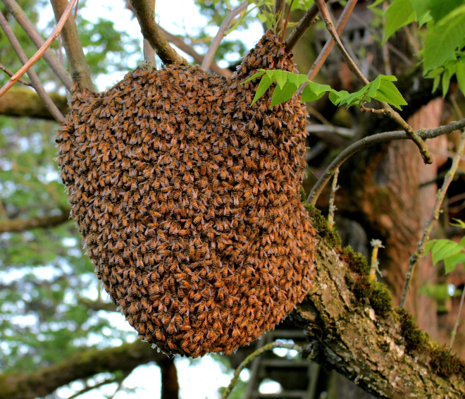
Honey
Bee Swarm
Notes:
Strength of the hive and other factors can result in swarms on the move. The queen in protected inside this mass of bees. When in the open like this beekeepers have a fair chance of capturing the swarm.

Slide 15
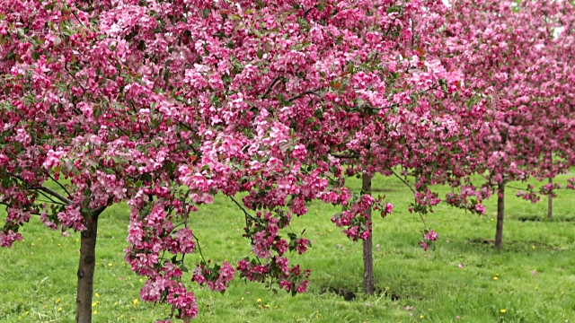
Apples Needing Pollination
Notes:
Apples in Michigan, New York, Pennsylvania, and Washington need pollination.

Slide 16
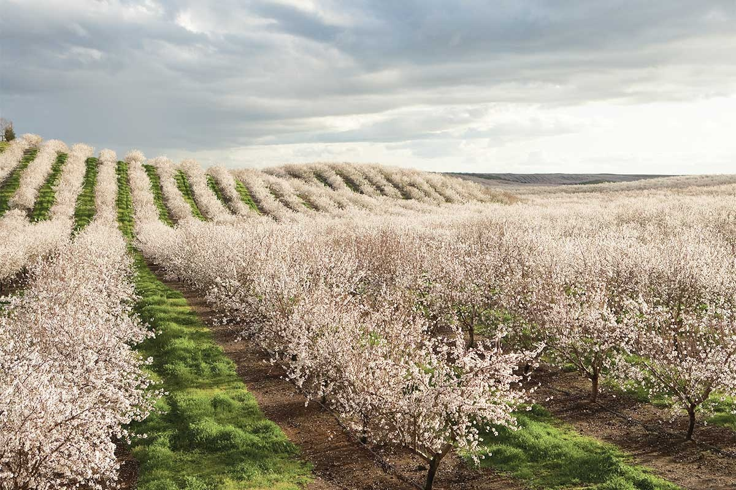
Almonds In Bloom
Notes:
Almonds in California

Slide 17
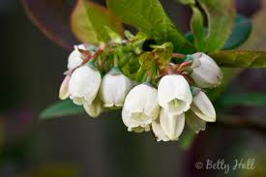
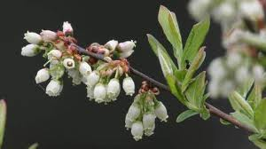
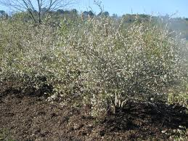
Blueberries In Bloom
Notes:
High Bush Blueberries in Michigan and Georgia

Slide 18
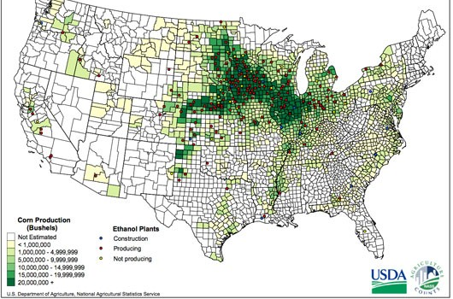
Where/when do bees and treated field crops overlap?
Many managed bees spend May through October in MN, ND, SD
Notes:
Hive off pollinating season location is in the upper Midwest.

Slide 19
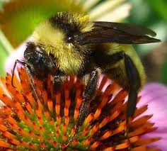
Bumblebee
Notes:
Most species of bumble bees in Nebraska are fairly docile and calm when left alone. There is a small ground nesting type that is quite aggressive when disturbed by mowing or tillage.

Slide 20
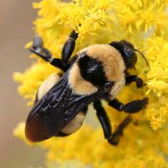
Bumblebee

Slide 21
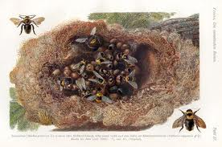
Bumblebee Nest
Notes:
Can be old mouse nest.

Slide 22
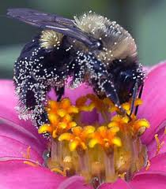
Bumblebee
With
Predator
Mites
Notes:
Every insect has friends and enemies.

Slide 23
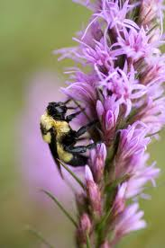
Bumblebee On Liatris

Slide 24
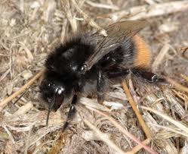
Bumblebee

Slide 25
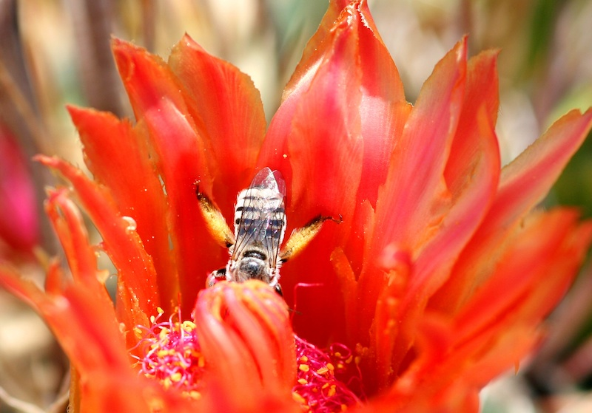
Cactus Bee

Slide 26
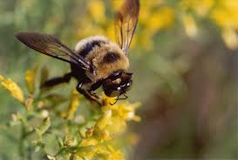
Carpenter Bee

Slide 27
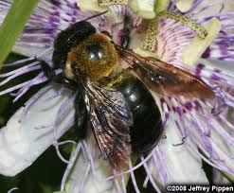
Carpenter Bee

Slide 28
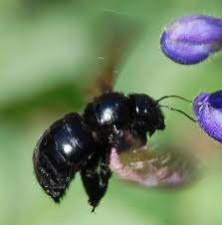
Carpenter Bee

Slide 29
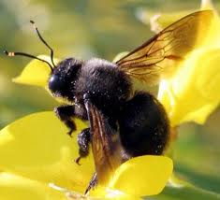
Carpenter Bee

Slide 30
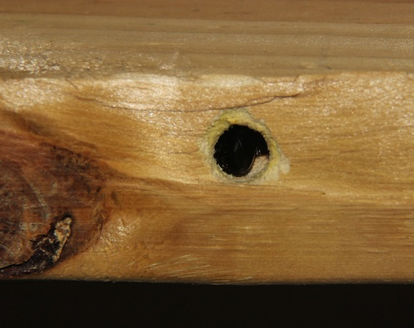
Carpenter Bee Rafter Damage
Notes:
Often get Extension calls about why rafters in open sheds have holes drilled in them.

Slide 31
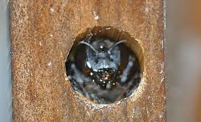
Carpenter Bee Emerging From Nest Hole Drilled Into Wood

Slide 32
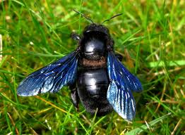
Carpenter Bee

Slide 33
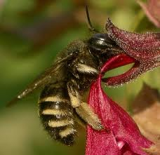
Carpenter Bee Foraging

Slide 34
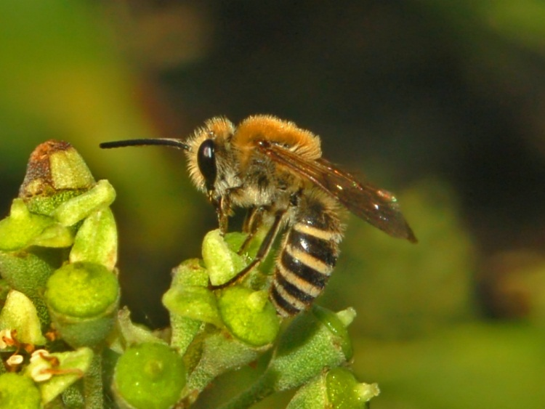
Diggerbee

Slide 35
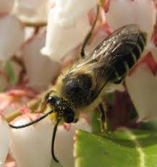
Diggerbee
Notes:
Ground nesting pollinator

Slide 36
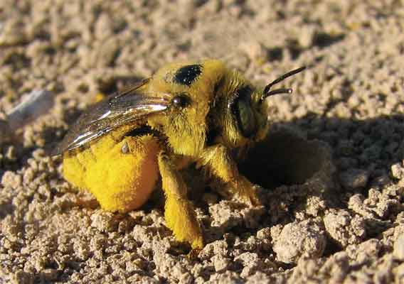
Digger Bee

Slide 37
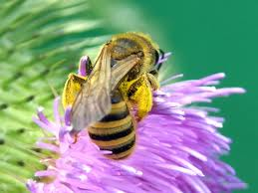
Diggerbee

Slide 38
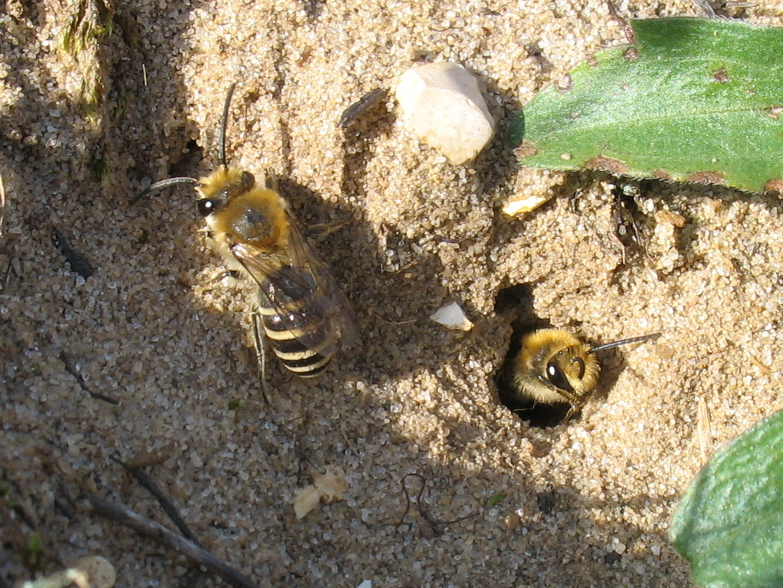
Diggerbee Nest

Slide 39
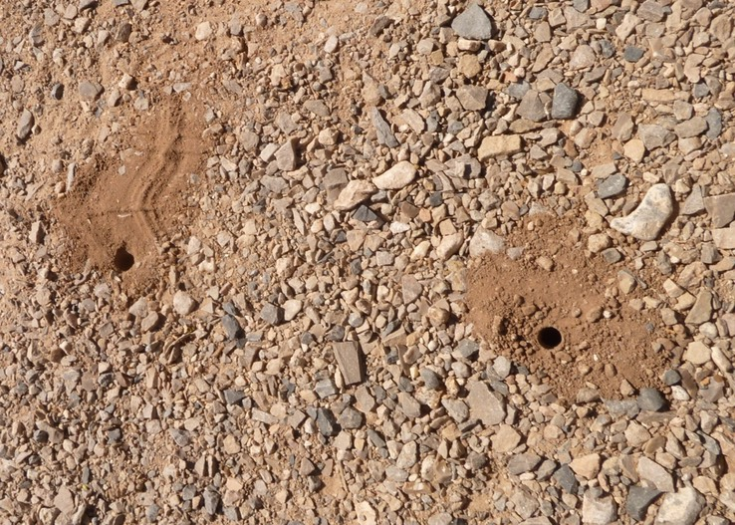
Diggerbee Nest

Slide 40
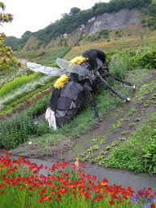
Giant Garden Bee
Notes:
Scary artwork

Slide 41
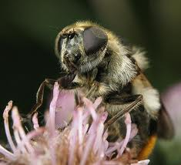
HoverFly

Slide 42
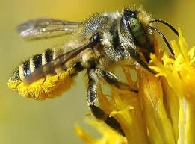
Leafcutter Bee
Notes:
Leafcutter bees are commercially used for alfalfa and other crops as pollinators.

Slide 43
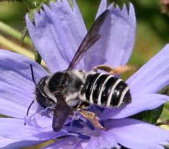
Leaf
Cutter
Bee

Slide 44
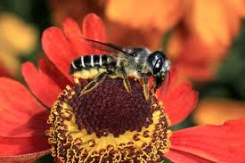
Leafcutter Bee

Slide 45
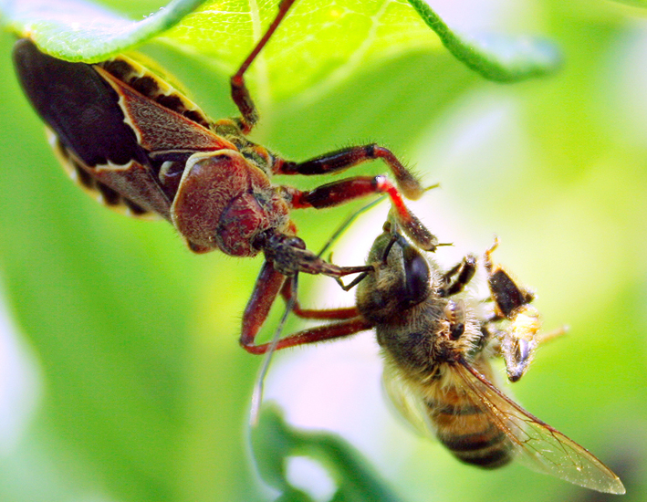
Assassin Bug Eating Leaf Cutter Bee
Notes:
Always an enemy.

Slide 46
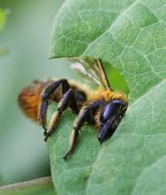
Leafcutter Bee Cutting Leaf Disc Out For Larvae To Feed On
Notes:
They cut out a leaf disc, pack it into a tubular hole, lay female eggs near the bottom of the hole and male eggs near the surface. Males emerge first.

Slide 47
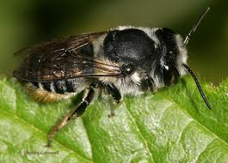
Leafcutter Bee

Slide 48
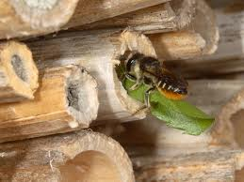
Leafcutter Bee Laying Eggs Between Leaf Layers

Slide 50
Notes:
Leefcutters generally use larger holes and sweat bee types the smaller holes.

Slide 51
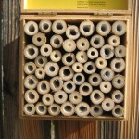
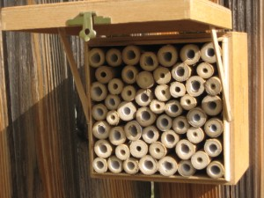
Tubular Bee Nesting Box With Replaceable Straws

Slide 52
Leafcutter Bee In Tubular Nest

Slide 53
Leafcutter Bee Laying Eggs Between Leaf Layers

Slide 54
Leafcutter Bee Lays Eggs Between Leaf Layers

Slide 55
Leafcutter Bee

Slide 56
Sweat Bee

Slide 57
Sweat Bee Nest

Slide 58
Sweat Bee Nest

Slide 59
Sweat Bee

Slide 60
Sweat Bee

Slide 61
Sweat Bee Nest

Slide 62
Sweat Bee

Slide 63
Sweat Bee Nest
Tubes
Notes:
Nectar and pollen packed in cells with egg and mudded in make up the sweat bee nest.

Slide 64
Sweat Bee
Aka
Halicid Bee

Slide 65
Mason Bee

Slide 66
Mason Bee

Slide 67
Mason Bee

Slide 68
Mason Bee
Notes:
Mason bees are commercially available to pollinate or aid in honeybee pollination in apples and other tree fruits.

Slide 69
Mason Bee

Slide 70
Mason Bee

Slide 71
Mason Bee
Types: Mason Bee
Blue Orchard Bee
Hornfaced Bee

Slide 72
Mason Bee

Slide 73
Big Headed Fly

Slide 74
Blow Fly

Slide 75
Fruit Fly

Slide 76
Parsley Beetle

Slide 77
Long Horned
Beetle

Slide 78
Soldier Beetle

Slide 79
Scarab Beetle

Slide 80
Paw Paw
Notes:
Recent research in North Carolina found that honeybees and common pollinators are not very effective for Paw Paw trees.

Slide 81
Blow Fly
Carrion Beetle
Notes:
Adding carrion (dead animals) to the Paw Paw grove attracted Carrion beetles and blow flies which also visited the foul smelling flower aiding in pollination.

Slide 82
Reticulated Netwinged Beetle

Slide 83
Blister Beetle

Slide 84
Caesia Moth
Notes:
Moth and butterfly species are also good pollinators.

Slide 85
Cranbid Moth

Slide 86
Sphinx Moth

Slide 87
Hawk Moth

Slide 88
Caper White Butterfly

Slide 89
Glassywing Skipper Butterfly

Slide 90
Cloudless Sulfur Butterfly

Slide 91
Homestead Butterfly

Slide 92
Cabbage Butterfly

Slide 93
Branded Skipper

Slide 94
Parnassian
Butterfly

Slide 95
Parnassian Butterfly

Slide 96
Parnassian Butterfly

Slide 97
Peck’s Skipper Butterfly

Slide 98
Silver Spotted Skipper Butterfly

Slide 99
Small Skipper Butterfly

Slide 100
Sulfur Butterfly

Slide 101
Black Swallowtail

Slide 102
Giant Swallowtail Butterfly

Slide 103
Yellow Swallowtail Butterfly

Slide 104
White Butterfly

Slide 105
White Butterfly

Slide 106
Hummingbird

Slide 107
Hummingbird

Slide 108
Ruby Throated Hummingbird

Slide 109
Long Nosed Bat
Notes:
There are 13 species of bats in Nebraska. Nine stay year around and 4 migrate south in the winter months.

Slide 110
Greater Long Nosed Bat

Slide 111
Mexican Long-nosed Bat

Slide 112
Lesser Long
Nosed Bat

Slide 113
Wind

Slide 114
Wind

Slide 115
Wind

Slide 116
Wind
Notes:
Wind is the pollinator of choice in corn fields.

Slide 117
Wind

Slide 118
QUESTIONS
Paul C Hay, Extension Educator
1115 West Scott Street
Beatrice NE 68310
(402) 223-1384
Fax: (402) 223-1370
Email: phay1@unl.edu
Website: www.gage.unl.edu
Notes:
Don’t hesitate to drop me an e-mail with your thought positive or negative and any questions.

